Slide 1
Women’s Rights Movement

Slide 2
Women around the Country
North
Poor women were expected (and needed) to work to support the family
Especially in cities
South
Rich Women would be stuck on the plantation, often alone with the plantation’s slaves
Poor women would work just as hard as men to grow enough food to eat and provide for the family
West
Nearly all woman were required to do just as much as men to survive on the frontier
Women were much more respected in the west for the work they had to do

Slide 3
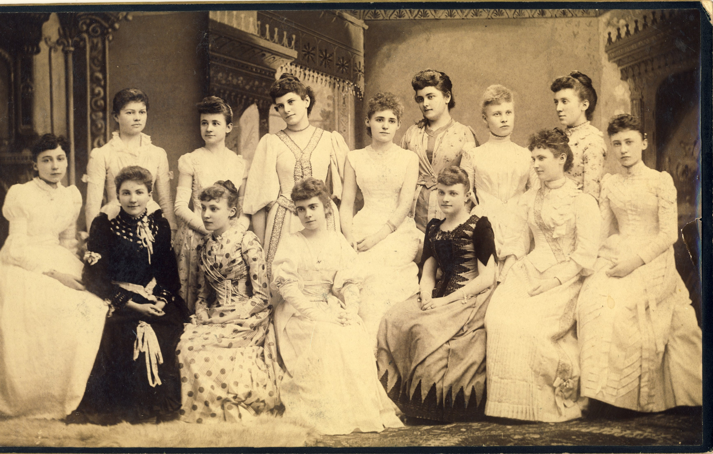
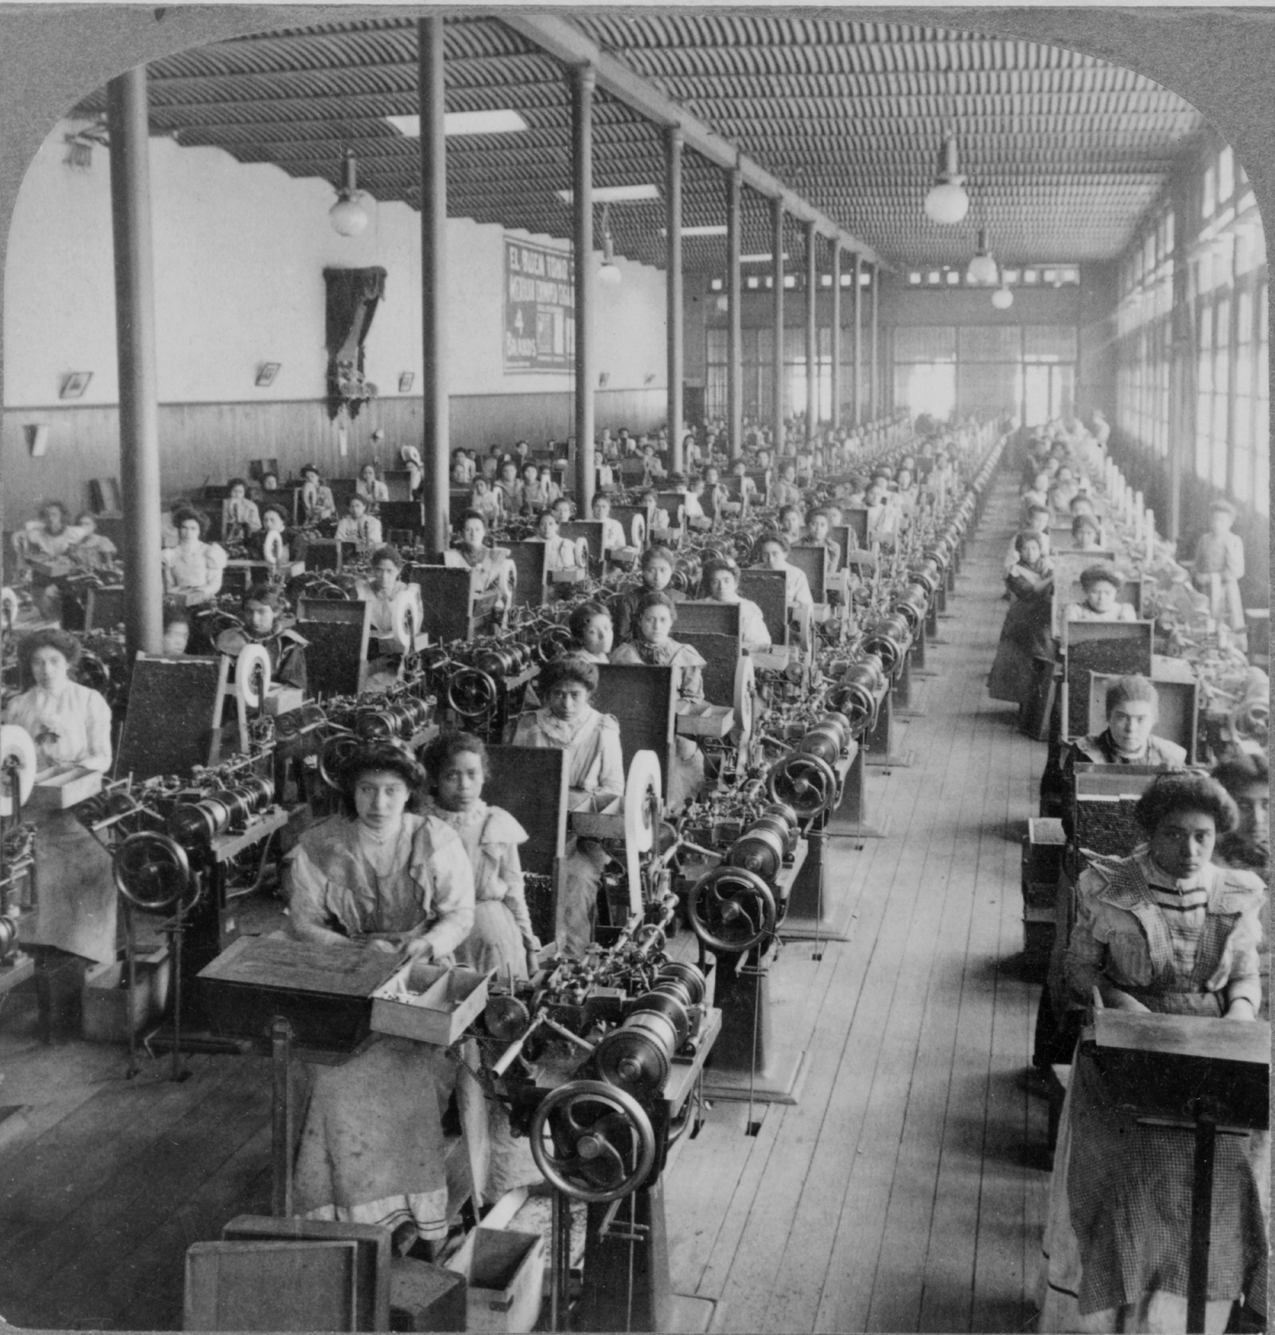
Lack of rights
No women had equal rights to men
Not paid the same in factories
Not equal in front of the law
Did not have the right to vote
Reform seemed long overdue

Slide 4
Discuss
1. What was common of women across the country?
2. How could women successfully protest their inequality? What could happen if they pushed too hard?
3. Predict what women will do to achieve equal rights.

Slide 5
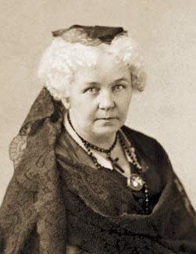
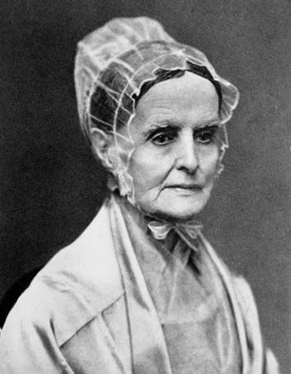
Fight for Suffrage
Many reformers tried to achieve rights for women, especially Women’s Suffrage
Right to vote for women
Elizabeth Cady Stanton and Lucretia Mott led the fight to gain women the right to vote

Slide 6
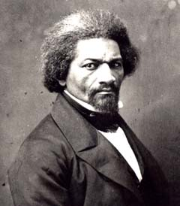
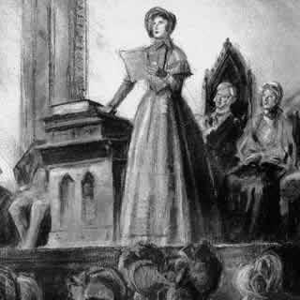
Attempting to Reform
Stanton and Mott, along with other reform-minded people like Frederick Douglass attended the Seneca Falls Convention
Meeting with the goal of getting equality for women
The convention produced the Declaration of Sentiments
Modeled after the Declaration of Independence
Laid out that women deserved equal rights
Inspired Susan B. Anthony who would later help achieve
women’s suffrage

Slide 7
Reflection
Do you believe women made any improvement to their lives?

