Slide 1
Transforming the West

Slide 2
Transcontinental Railroad
Railroad that connected the Eastern US and Western US
Debate prior to Civil War over location-Settled on a more Northern route post war
Two companies worked to complete the railroad
Union Pacific Company- worked west from Nebraska
Utilized Irish immigrants and African Americans
Central Pacific Company- worked east from California
Tough terrain (mountains) and used Chinese immigrants
Railroad met in Utah in 1869
Ceremony to drive in the “golden spike” to connect the two railroads

Slide 3
Impact of the Railroad
Boost to the economy
Moved goods and people much faster
Towns were created as stops along the railroad
Many new settlers moved west as it was easier to buy and sell goods
Times zones created standard time for the country

Slide 4
Discussion
How difficult do you believe it was to have two separate railroad companies meet in the middle of America?
Why did the Central Pacific Railroad Company get fewer miles?
How will the Railroad improve the quality of life in the West? What other inventions will improve the quality of life out West?

Slide 5
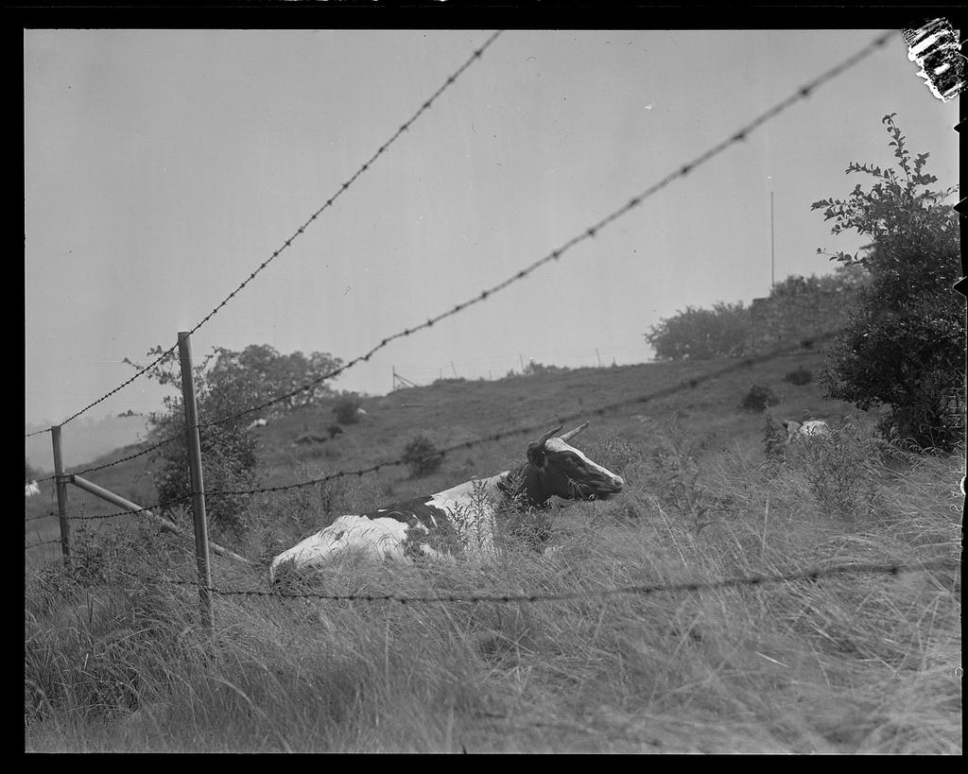
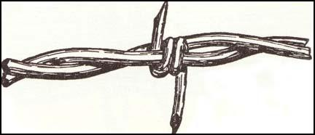
Barbed Wire
1873 - Joseph Glidden gets patent for a better design of barbed wire
Glidden’s had two wires to hold the sharp bur
Barbed wire = cheaper solution to wood
Necessary - kept cattle out of farmer’s crops

Slide 6
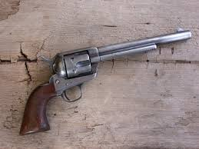
Six Shooter
1836 - Samuel Colt - got patent for the revolver mechanism that allows guns to fire multiple shots
Made it easier to defend oneself on the frontier

Slide 7
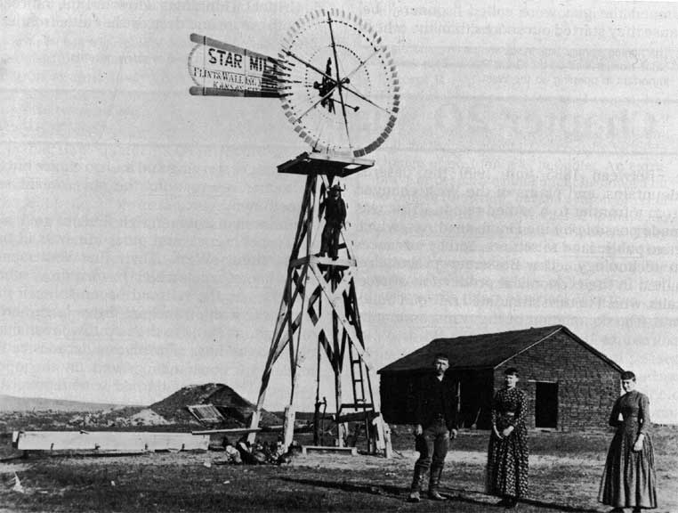
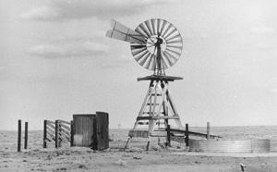
Windmills
Converted force of wind into power
Allowed farmers to draw water from super deep wells

Slide 8
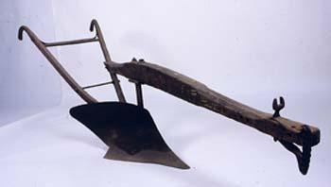
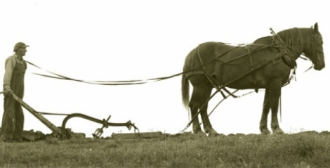
Steel Plow
Invented by John Deere - 1837
Saved farmers time when they plowed
Notes:
Cast iron before - dirt and grass would stick - didn’t stick to steel

Slide 9
Inventions of the West (#5 of the Unit Book)
On the white piece of printer paper – write “Inventions of the West” at the top
Pick one of the inventions discussed today
Create an advertisement to sell the product
Your advertisement should include a price (any fake price) and WHY people should buy your product. (The importance).
On the back, in a paragraph, write about the significance of the invention you chose. Explain why you believe it to be more significant than two other inventions discussed.

