Slide 1
The West

Slide 2
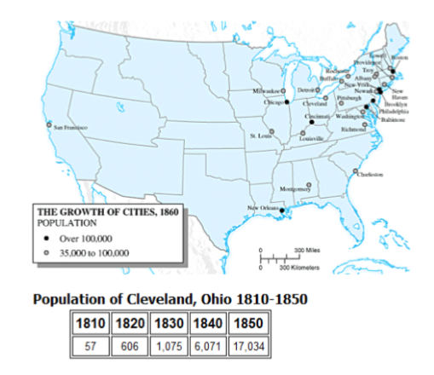
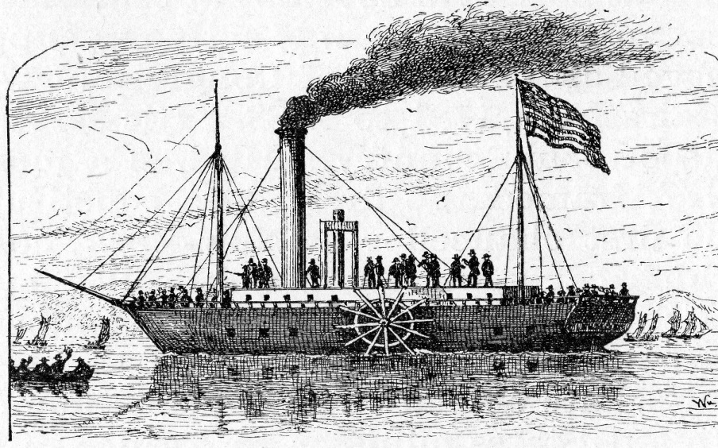
Moving West
There were two major advancements that caused people to be able to move west quickly
Canals – the construction of canals leading West created large cities (such as Cleveland – turned it into an important commercial center)
Steam boats – allowed for small towns to grow into important trading centers

Slide 3
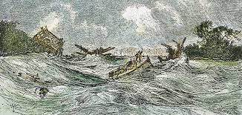
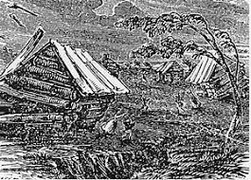
Tragedy Out West
New Madrid Earthquake: a series of powerful earthquakes that occurred in 1811 and 1812
Were so powerful that the Mississippi River started flowing backwards

