Slide 1
Daily Quiz – 4/8
Which is an example of opposition to the war?
Immigrants refusing to come to the US
Copperheads protesting
Women working in factories
African Americans joining the army
What were economic changes caused by the war? (choose two)
Copperheads
Lee’s invasion of the North
Food shortages in the South
Creation of greenbacks
Habeas corpus

Slide 2
The Tide of War Turns

Slide 3
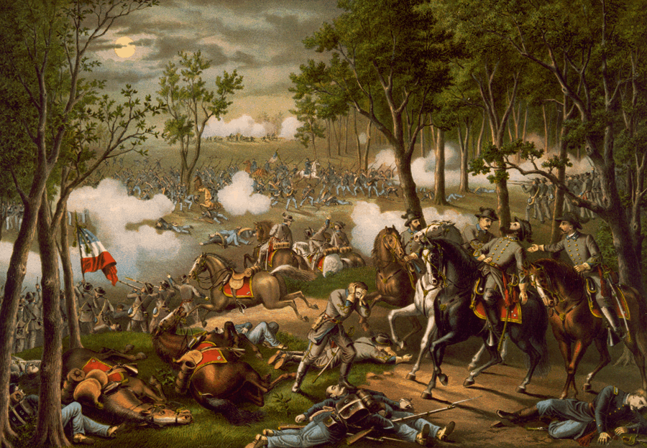
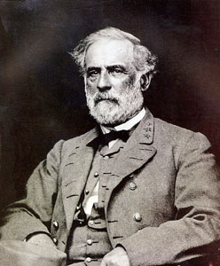
Lee’s Charge
After losing at Antietam, Lee regroups and scores more victories in Virginia
He attempts to invade the North once more
Last ditch effort
Break Union Spirit
Get aid from Europe (Show them South is winning)

Slide 4
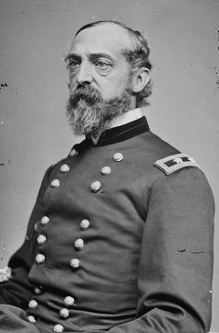
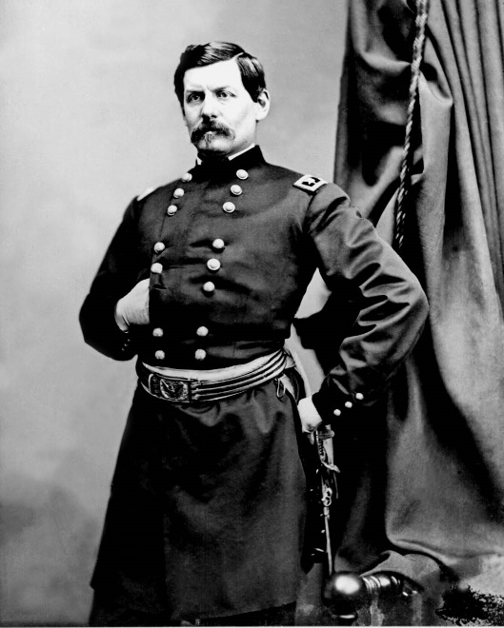
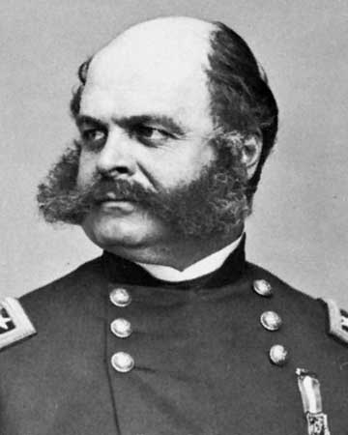
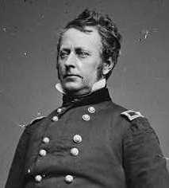
Union Leadership Issues
General McClellan was fired
Lincoln was fed up with McClellan being too cautious
After a carousal of Generals (Burnside, Hooker…) Lincoln appoints George Meade
Three days later, Meade is put to the test

Slide 5
Discussion
Why did the South feel the need to invade the North?
What problems could changing military leaders so frequently do to an army?
What could make this war turn in favor of one side?

Slide 6
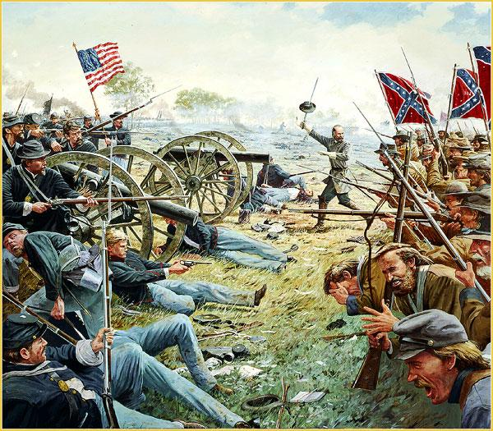
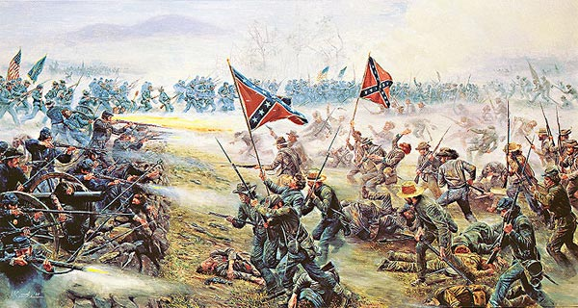
Battle of Gettysburg
In the Summer of 1863, Lee’s army fell upon the Union army at the town of Gettysburg, Pennsylvania
The battle raged for three days before Confederate general George Pickett made a fateful decision
Pickett’s Charge: Southern troops charged into the middle to divide the Union army; fails terribly
The Confederates are forced to retreat
Nearly 50,000 casualties

Slide 7
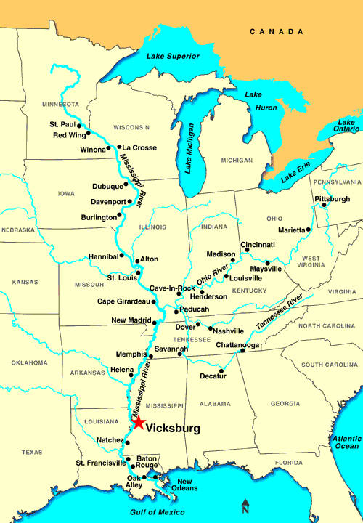
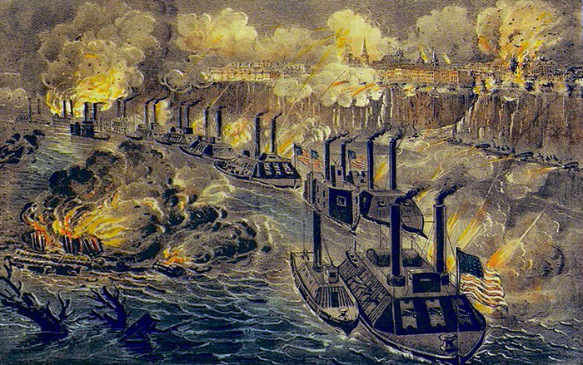
Siege of Vicksburg
In the West, the only place the Confederates had control on the Mississippi was Vicksburg, Mississippi
General Grant had surrounded the city and began his attack
Lasted nearly 50 days
Confederates eventually surrendered and the Union took control of all the Mississippi River

Slide 8
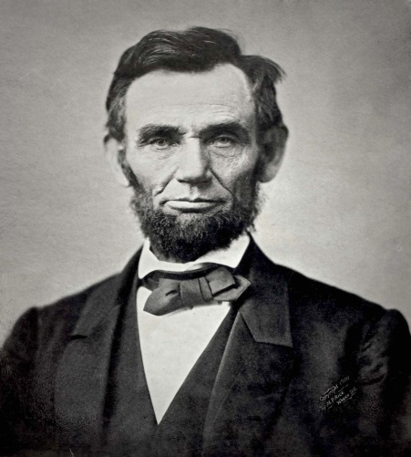
The Turning Point
Gettysburg and Vicksburg served as the turning point of the war
The loss at Gettysburg forced Lee to retreat and destroyed his army
Vicksburg gave the Union complete control of the Mississippi River and cut the Confederacy in half
Effects:
Lee would never be able to invade the North again
Britain now had no interest in helping the Confederates
Gettysburg Address: Lincoln’s speech at Gettysburg that gave hope to reunite the country
“Government of the people, by the people, for the people.”

Slide 9
Reflection
What was the purpose of the Gettysburg Address? What role did it play in the Civil War?

