Slide 1
Texas Revolution

Slide 2
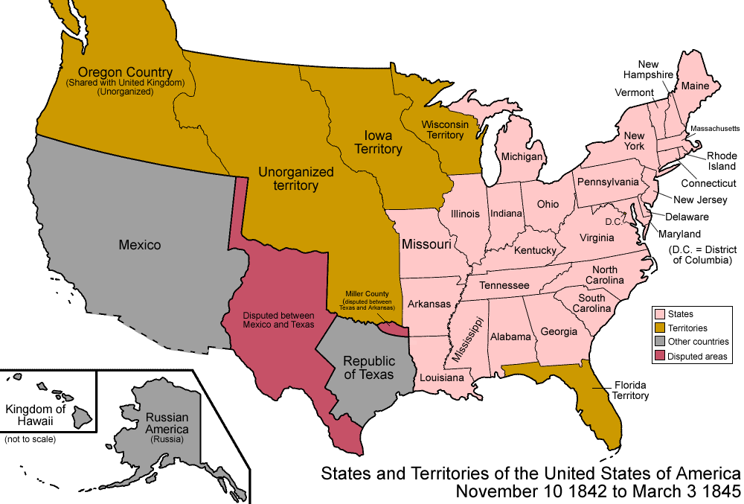
Texas
Texas had been controlled by Spain until Mexico declared independence
Texas was called Tejas
Mexicans who lived in Texas were called Tejanos
Texas was very attractive for Americans
Lots of land
Great cotton growing area

Slide 3
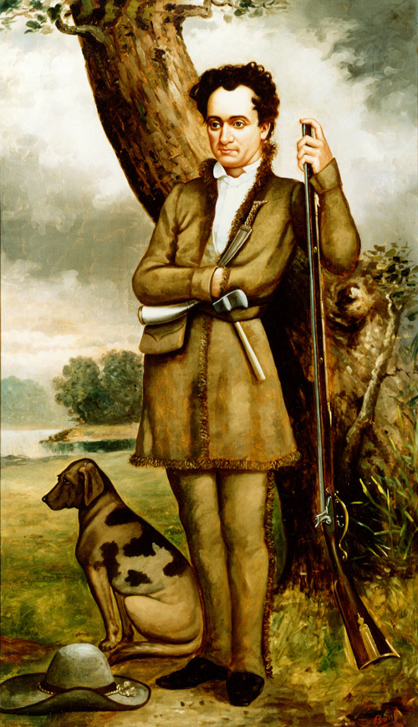
Americans in Texas
Mexico invited Americans to come to Texas
More people = more money in the economy
Americans would become Mexican citizens
Stephen F. Austin lead American settlers into Texas
Americans began outnumbering Tejanos and no longer wanted to follow Mexican laws
Speaking Spanish
Becoming Catholic
Mexico threatened to ban slavery

Slide 4
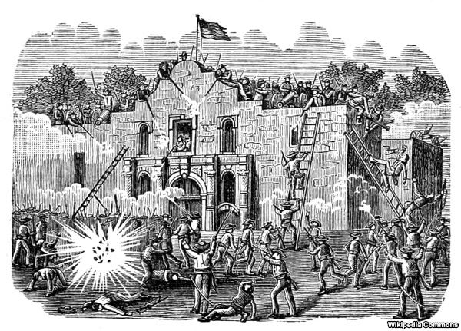
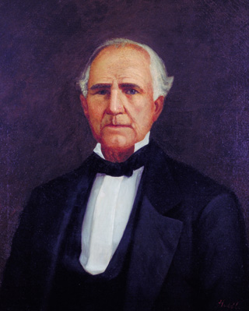
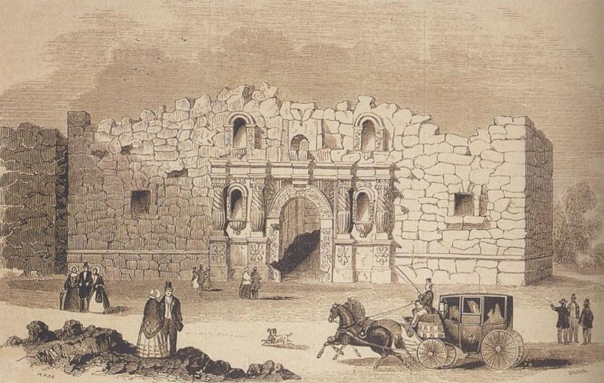
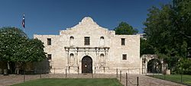
Texas sized Tension
Tensions rose to the point that American leaders in Texas, Austin and Sam Houston (from TN) planned to split from Mexico
Mexico surrounded a Texan mission (church) building called the Alamo
The Alamo was attacked and most Americans inside were killed (over 200)
Davy Crockett (Famous Texan who died defending the Alamo)

Slide 5
Discussion
Why would Mexicans want to invite Americans to their land?
Why would Americans that moved to Texas believe they had the right to disobey laws they didn’t like?
How could an event like the Alamo impact the Americans living in Texas?

Slide 6
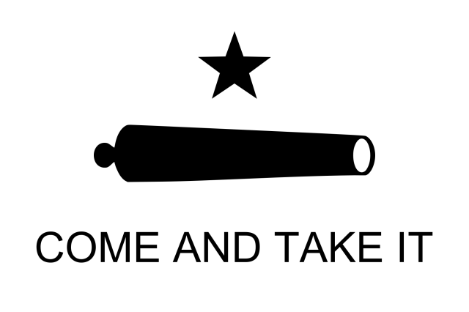
Texas Independence
Alamo inspired Texans(“Remember the Alamo”)
Texans fought back and forced Mexico to give them independence
The Lone Star Republic was formed
Texas as its own nation
Wanted to join US
Issue: debate over the spread of slavery

Slide 7
Reflection
What type of issues would Texas becoming an independent nation create for the United States?

Slide 8
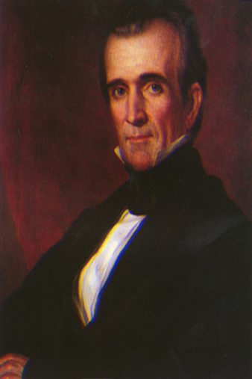
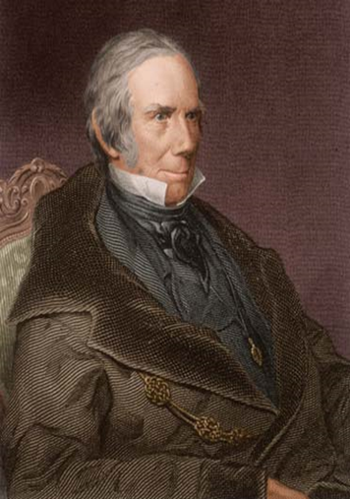
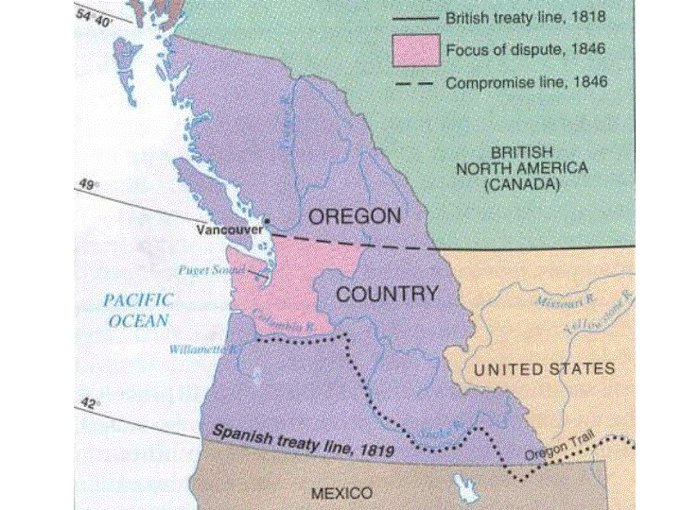
James K. Polk
Election of 1844: James K. Polk v. Henry Clay
Issue of Election: Westward expansion
Polk supported expansion; wins
Polk’s Promises:
“54⁰ 40⁰ or Fight!”
Settle Oregon border conflict with Britain
Annex Texas (make it part of country)
Take over California and southwest

