Slide 1
Tennessee in Early America

Slide 2
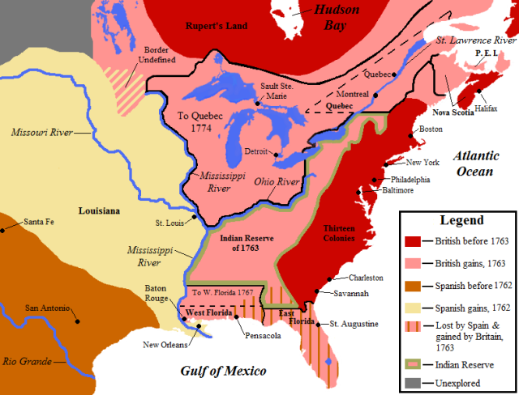
Proclamation of 1763

Slide 3
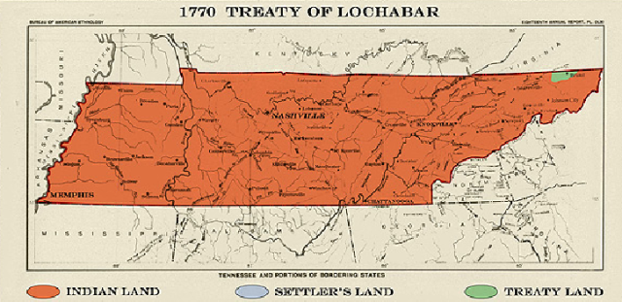
Treaty of Lochabar

Slide 4
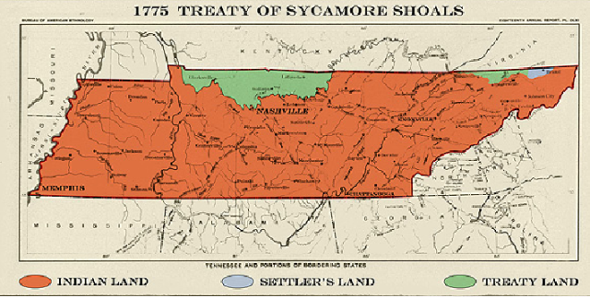
Treaty of Sycamore Shoals

Slide 5
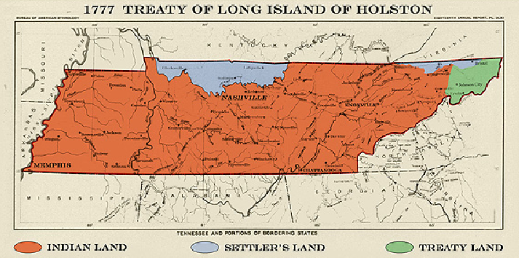
Treat of Long Island of Holston

Slide 6
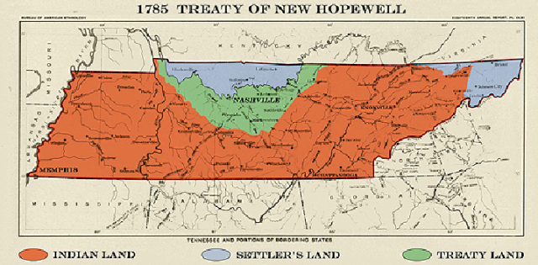
Treaty of New Hopewell

Slide 7
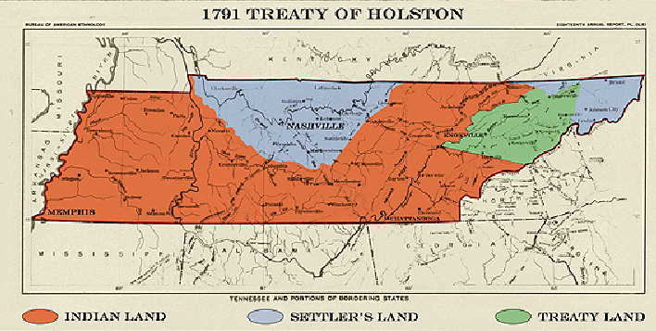
Treaty of Holston

Slide 8
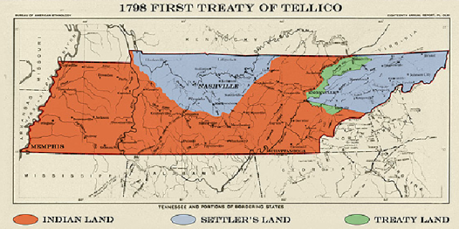
First Treaty of Tellico

Slide 9
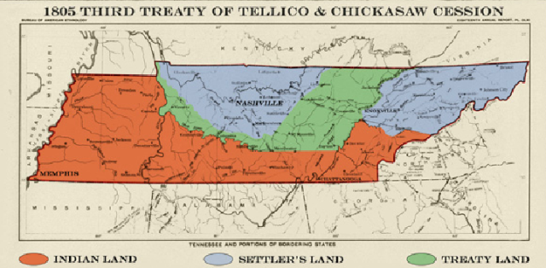
Third Treaty of Tellico and Chickasaw Cession

Slide 10
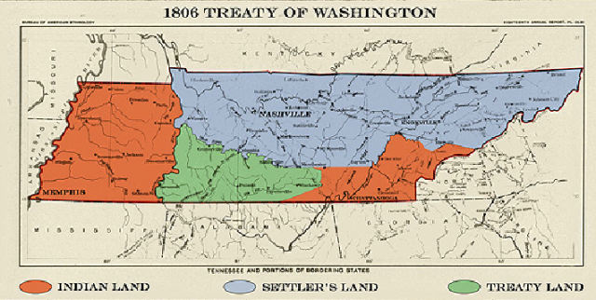
Treaty of Washington

Slide 11
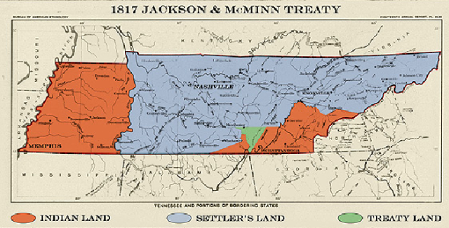
Jackson and McMinn Treaty

Slide 12
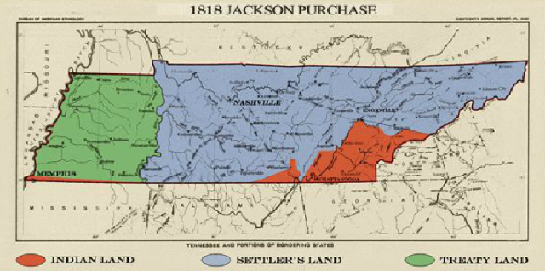
Jackson Purchase

Slide 13
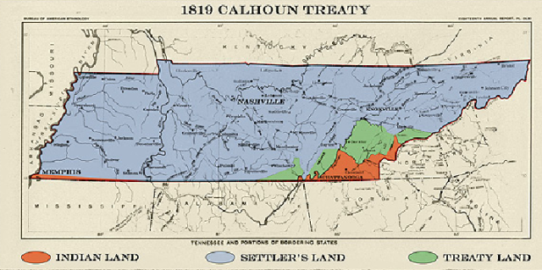
Calhoun Treaty

Slide 14
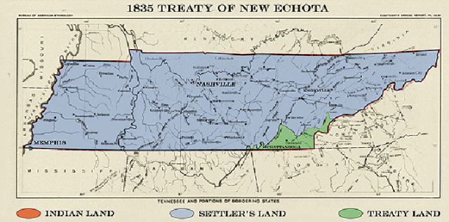
Treaty of New Echota

Slide 15
Native American Relations
Two tribes dominated Tennessee
Cherokee
Chickasaw
Natives and Settlers struggled to find peace
Treaty of Holston: Treaty between US and Cherokee to make peace
No more violence
US recognize Cherokee
land
US protects Cherokees

Slide 16
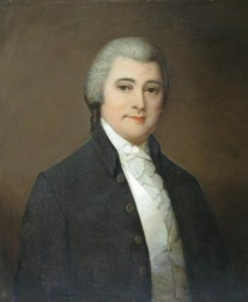
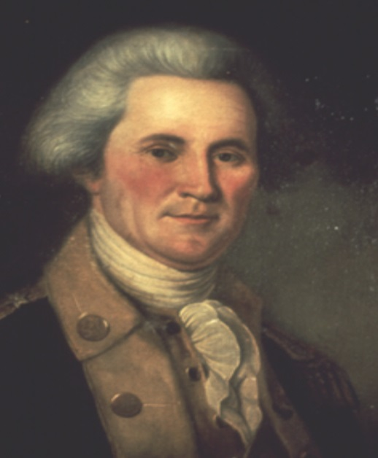
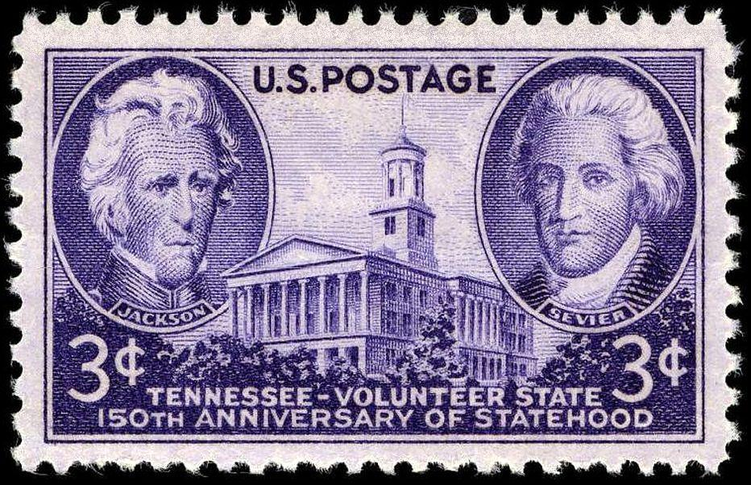
Tennessee Statehood
William Blount: Signer of Constitution, called for convention to make Tennessee a state
In 1796, Tennessee is officially made a state of the United States
John Sevier: Made the first Governor of Tennessee

Slide 17
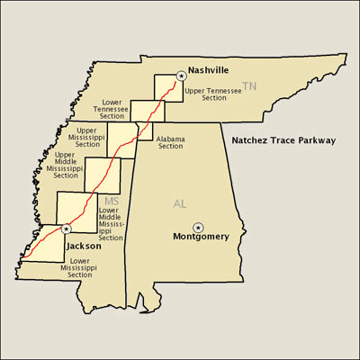
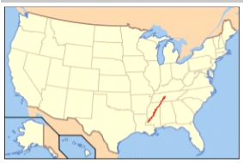
Expanding Tennessee
Natchez Trace: road created from Nashville to Mississippi River- opened up ability to get goods to New Orleans

Slide 18
Expanding Tennessee
Jackson Purchase: Purchase of land in the West from the Chickasaw Indians
Gave the state of Tennessee all land west of the Tennessee River
Memphis becomes a major city
Memphis

Slide 19
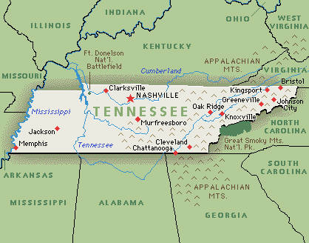
Tennessee Geography

