Slide 1
Southern Colonies

Slide 2
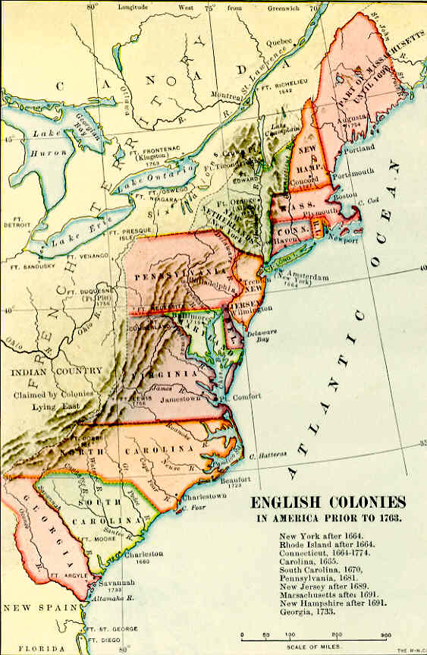
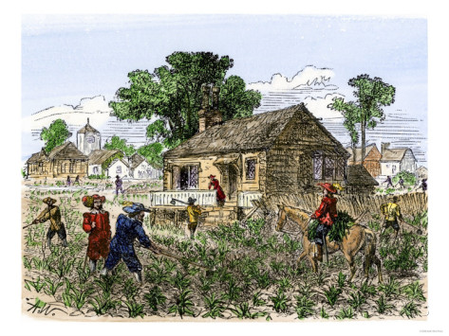
Virginia
Home of the Jamestown colony
Successful by growing tobacco as a cash crop
Cash crop: crop grown to make a profit
Demand for workers rises

Slide 3
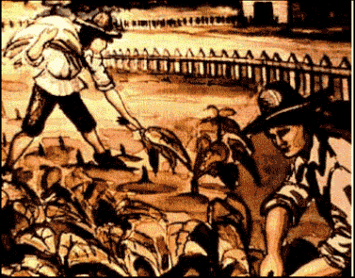
Servants and Slaves
Indentured Servants: Poor whites brought to America from Europe for free in exchange for working for a set time
Living expenses paid
Once they worked their allotted time, they were free
and provided with land
Showed success through hard work
African Slaves: Captured and brought to New World and forced to work
Poor living conditions
No expectation of freedom in future
Indentured Servants and Slaves sympathize with each other’s condition

Slide 4
Discussion
How do cash crops lead to a rise in demand for workers?
How are indentured servants and slaves both similar and different?
What problems may occur when all indentured servants receive freedom and land after serving their time?

Slide 5
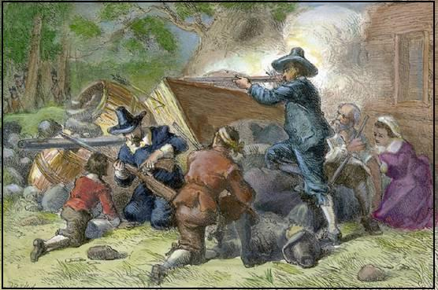
Rebellion in Virginia
As Virginia grows, comes into conflict with Native Americans over land
Virginia government not in step with poor people
Government wanted peace with Natives
Poorer people wanted land Natives had
Bacon’s Rebellion: Colonist rebellion against Natives and royal colonial government helping Natives
1st time colonists went against royal authority
Causes slavery to boom in order to replace indentured servants

Slide 6
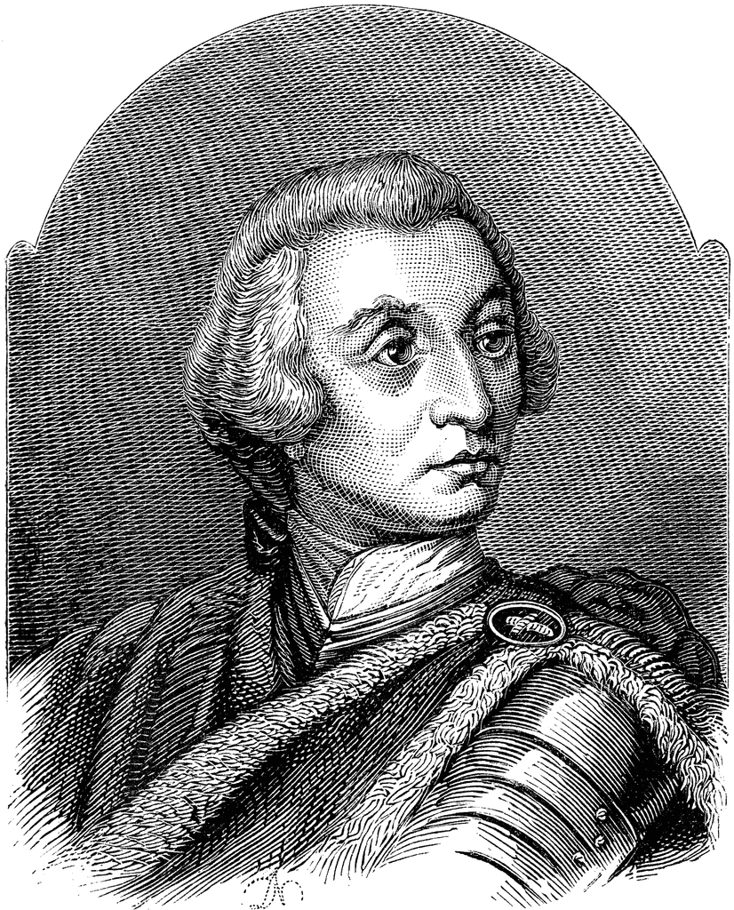
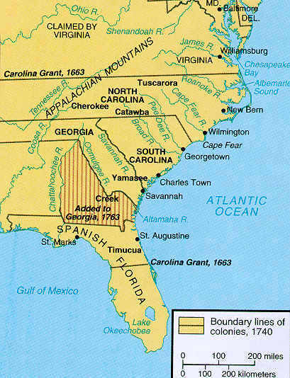
Georgia
Founded by James Oglethorpe
Role as
Colony for debtors to go
Buffer colony: between British colonies and Spanish (Florida)
Instead, becomes a place where the poor can come and get a new start

Slide 7
Reflection
How did Bacon’s Rebellion impact African slavery?

