Slide 1
Sectionalism and the South

Slide 2
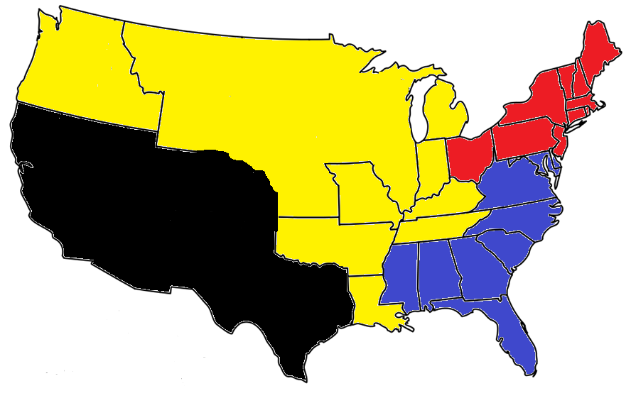
Where is the South?

Slide 3
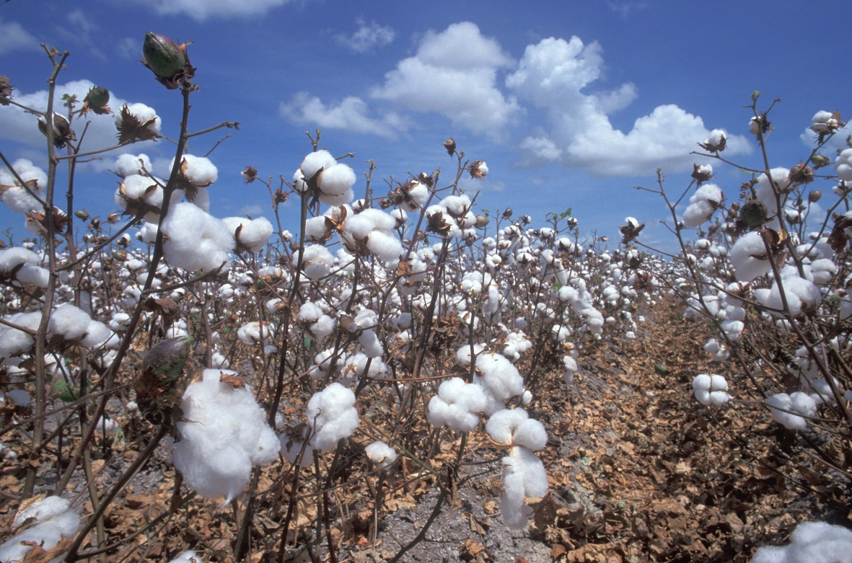
Economy of the South
CA$H CROPS!!!
The Southern economy revolved around the farming of cash crops
Tobacco, Rice, and Indigo
However, Cotton was becoming the primary cash crop in the South
Very profitable

Slide 4
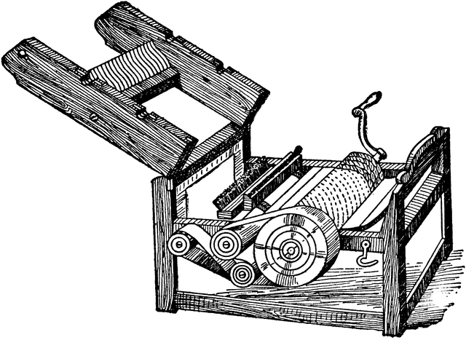
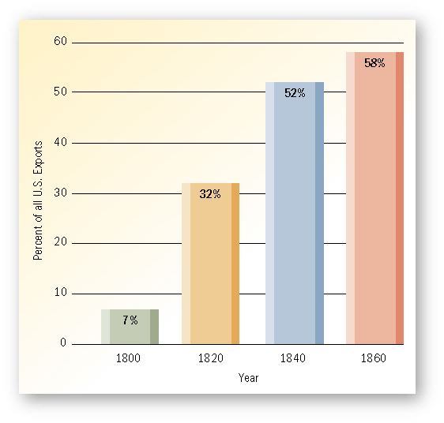
Why Cash Crops? Why Cotton?
The South’s geography supported farming
Warm Climate
Great, rich soil
New inventions
Cotton Gin: Invented by Eli Whitney. Made producing cotton much easier and faster. (3,000 bales a year to 300,000 bales a year) Increased cotton production
Access to Slave labor
Cotton gin rose demand for slaves

Slide 5
Discussion
What allows the South to excel in growing cash crops?
How does the cotton gin, which makes it easier to clean cotton, actually lead to more slavery?
What problems do you predict will come from increased demand for slavery?

Slide 6
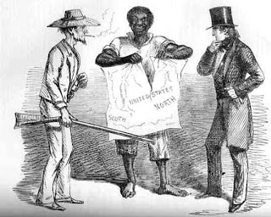
Sectionalism
Sectionalism: Having loyalty to a certain section of the country (North, South, or West) over the nation as a whole
Opposite of Nationalism
As people expanded west, new territories began to seek statehood, a question came up…
To slave or not to slave
Slavery banned in the North, huge in the South

Slide 7
Missouri Compromise
Missouri wanted to become a state, they also wanted to allow slavery
North did not want to allow it, South encouraged it
Nationalist Henry Clay worked out a compromise
Missouri Compromise: Deal to solve the Missouri issue and future slavery issues
Missouri becomes a Slave state
Maine brought in as a free state
Line drawn at Missouri’s southern border outlawing slavery in any state created north of the line.

Slide 8
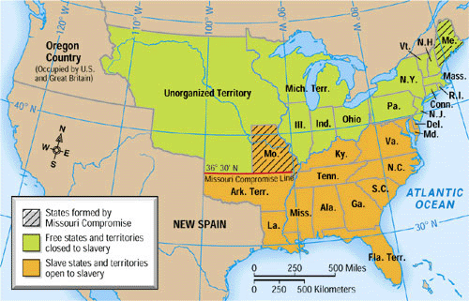

Slide 9
Reflection
Do you believe that the Missouri Compromise is a good solution to the problem? Why?

