Slide 1
Reform Movements

Slide 2
What is reform?
Reform: making changes to something with the goal of improving it
American society was both good and bad
For those who were wealthy and well off, life was great (landowning men usually)
For those who were poor and not well off, life was not so great (workers, women and the common man)

Slide 3
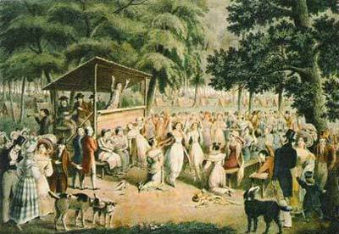
Religious Transformation
Reform reached the churches as well
Second Great Awakening: revival of religious interest (people ran back to religion)
Caused many to want to be better people and fix the country’s problems
Temperance movement: led primarily by religious leaders and women to stop the sale and drinking of alcohol
Some protests even became violent

Slide 4
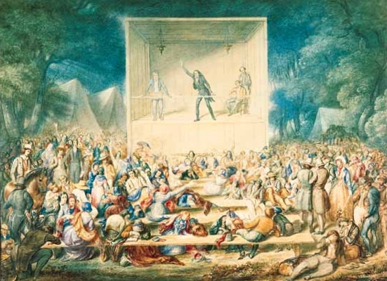
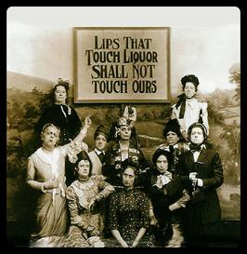
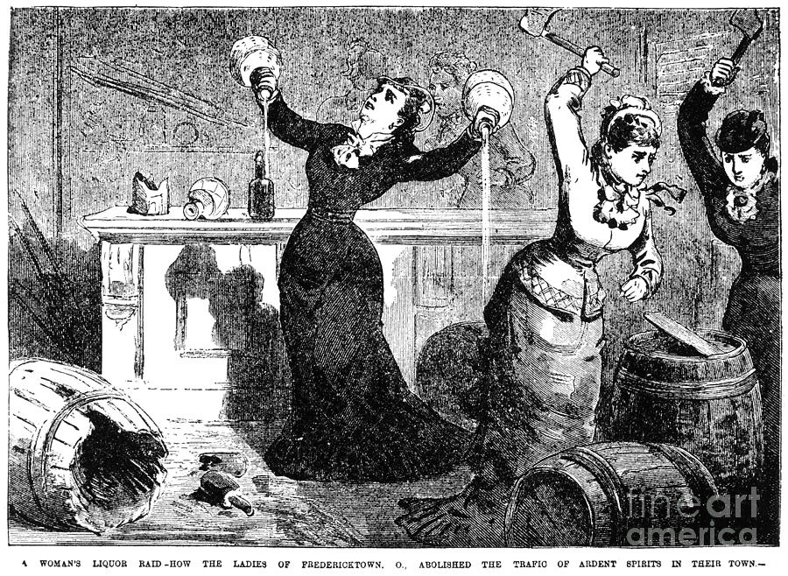

Slide 5
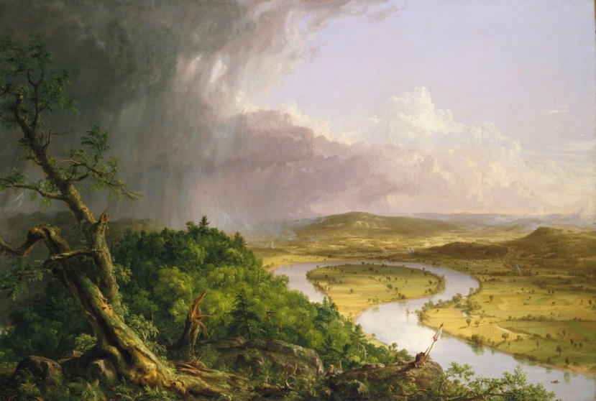
Transcendentalism
Transcendentalism: idea that people are best off when they rely on themselves and nature around them
Culture began to change
Emphasis:
Simplicity
Nature
Getting out of the fast paced “city” life

Slide 6
Discussion
Why is there a need for reform?
How could new religious revival cause reform elsewhere?
What impact could Transcendentalism have on attitudes toward government?

Slide 7
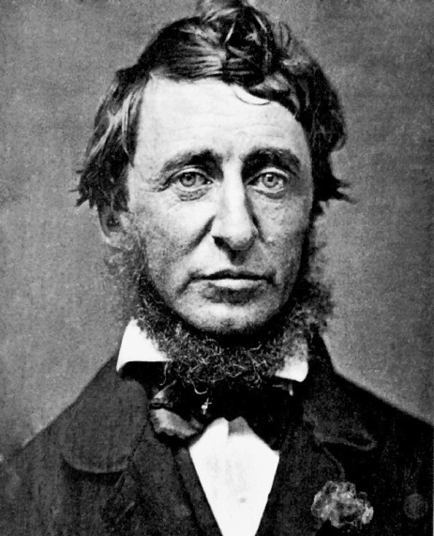
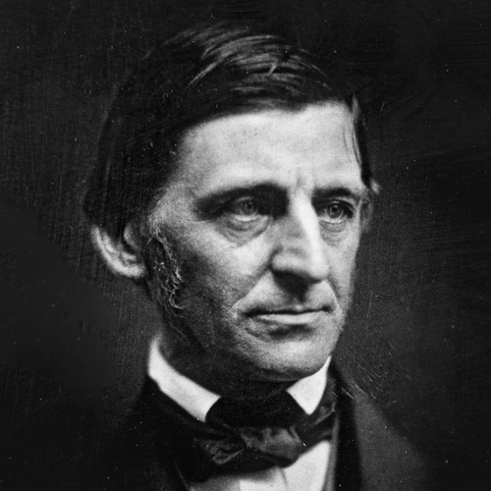
Transcendentalism and Government
Authors began writing about it
Henry David Thoreau: Wrote about Civil Disobedience (disobeying laws that are unjust or unfair)
Ralph Waldo Emerson: Wrote about overcoming prejudice and ending slavery
The movement believed role of government should be minimal

Slide 8
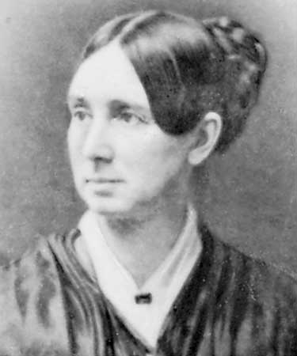
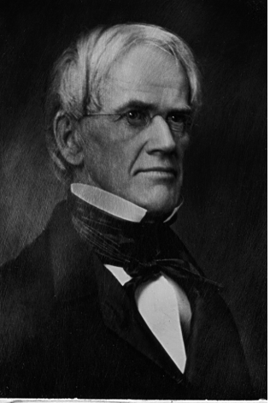
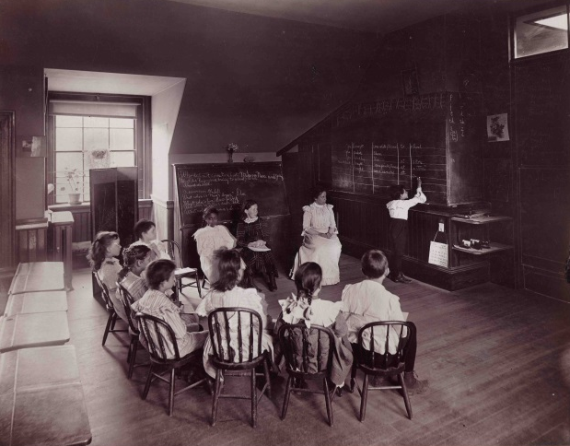
Equality in Society
Many began trying to reform society
Dorothea Dix: worked to help the poor and mentally ill
Horace Mann: worked to improve public education (make everyone go to school)

Slide 9
Reflection
How did the 2nd Great Awakening influence America?

