Slide 1
Reconstructing the Union

Slide 2
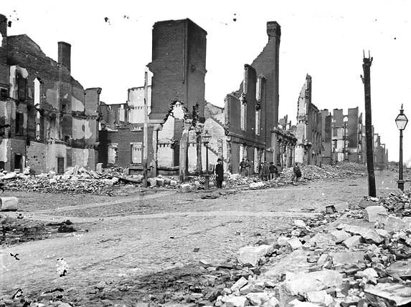
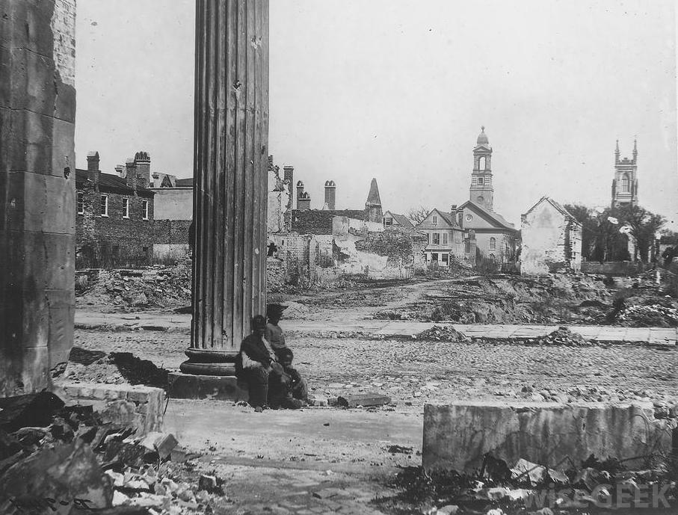
Reconstructing the South
Reconstruction: period of rebuilding and readmitting the South and establishing the role of African Americans in the new Southern culture.
Issues: How to bring states back into country? How to fix damage to the South? How to ensure fair treatment of newly freed African Americans? What branch of the government would control it?

Slide 3
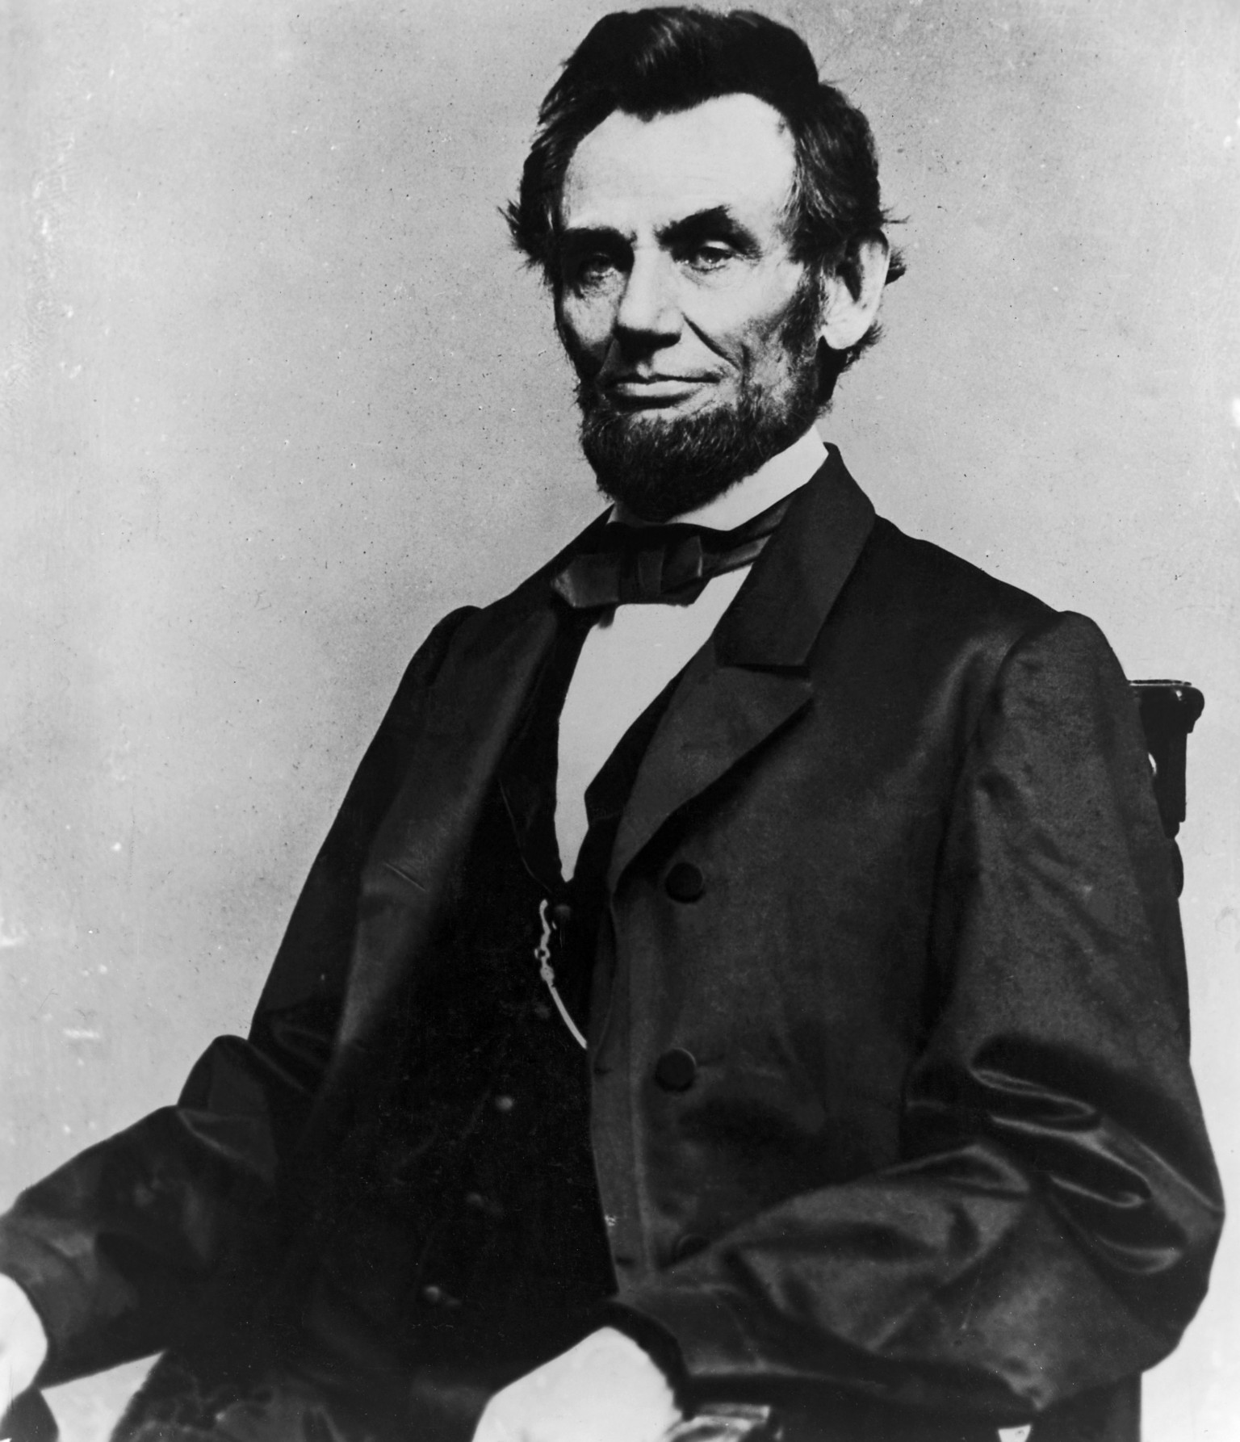
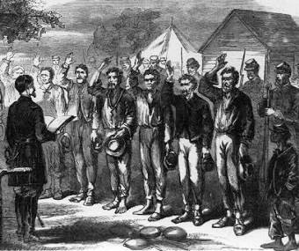
Lincoln’s Attitude
Lincoln did not want to punish the South
Punishment would not allow nation to heal
Southerners, aside from Confederate leaders, would be given amnesty (forgiven) if they took the oath

Slide 4
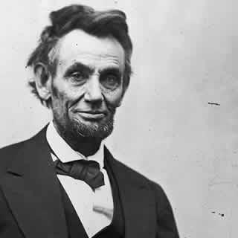
Lincoln’s Plan
President Lincoln developed a plan prior to the end of the war
Lincoln’s Ten Percent Plan: Lincoln’s plan for reconstruction
For states to return they must:
Have 10-percent of voters take an oath of loyalty
Ban slavery
Meant to bring in states quickly and allow healing to happen faster

Slide 5
Discussion
How did Lincoln’s attitude toward the Confederate States effect his planning for Reconstruction?
Why do you think Republican’s would oppose the President’s plan?
Predict what might happen in the Southern States if Lincoln’s plan were to actually happen?

Slide 6
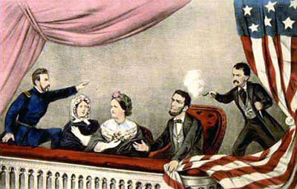
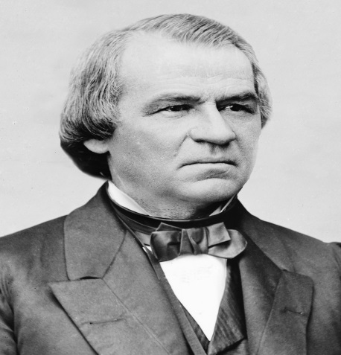
Johnson takes office
Lincoln’s assassination shocked the nation who was set to recover from a brutal war
Lincoln’s Vice President Andrew Johnson took over
From Tennessee
A Pro-Union Southerner during the war

Slide 7
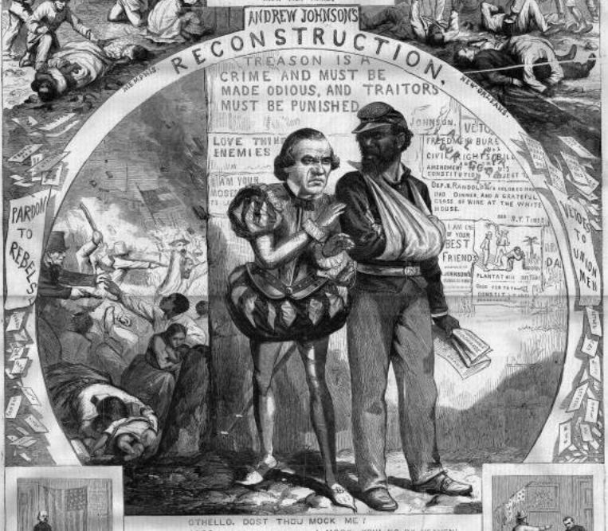
Johnson’s Reconstruction Plan
New president Johnson had a plan of his own for reconstruction
Amnesty to any Southerner who took the oath
Even Confederate officials with pardon from President
Must outlaw slavery
Opposed equal rights for freed slaves

Slide 8
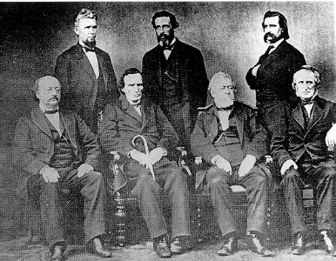
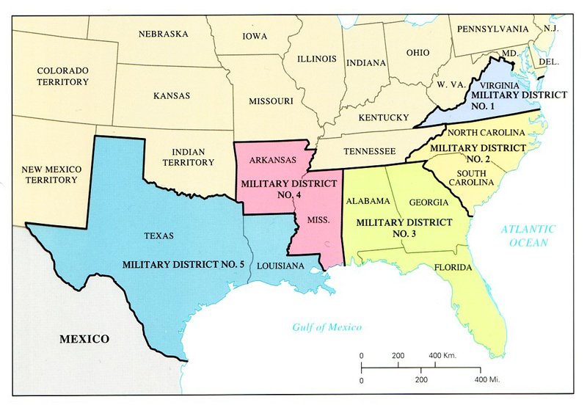
Radical Republican Plan
Radical Republicans: Republicans in Congress who wanted harsh penalties to those who supported the Confederacy
Congressional Plan for Reconstruction:
Majority of white population must take oath
No Confederates can vote
Equality for former slaves
Split South into military zones

