Slide 1
Populism in America
Populism

Slide 2
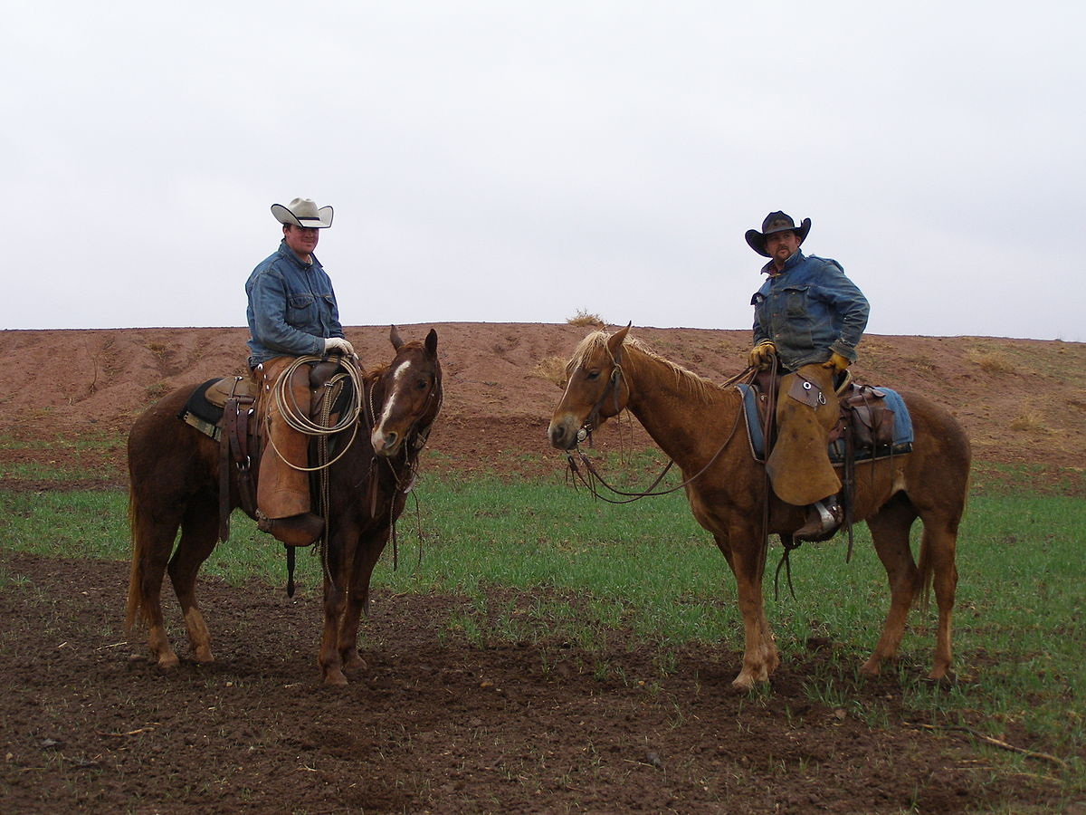
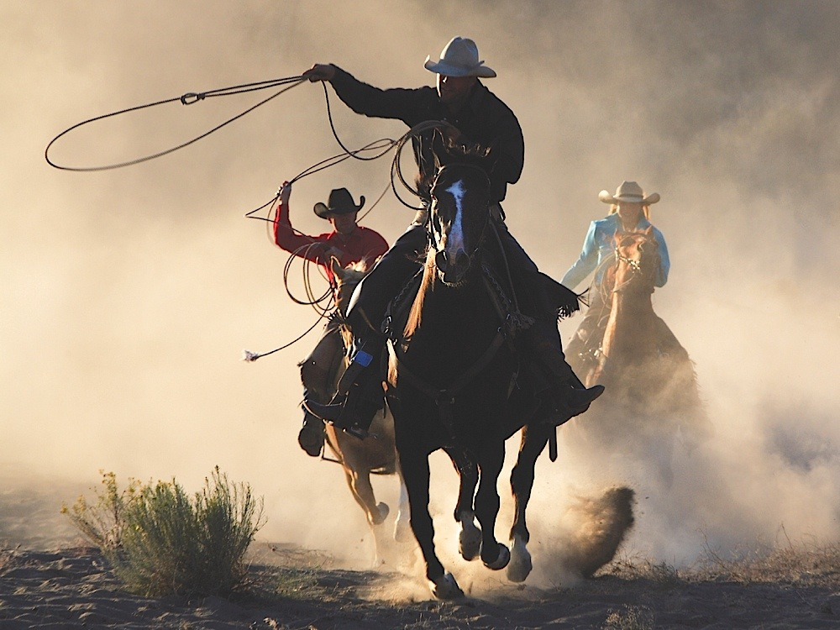
Cowboys real Quick
Cowboys were the ones wrangling the cattle that wondered in the range
Their responsibilities are to control where the cattle go
Stampedes of cattle were always a danger
Life was often harsh as they rode through rough conditions on horse back
Chaps protected them from common issues of riding.

Slide 3
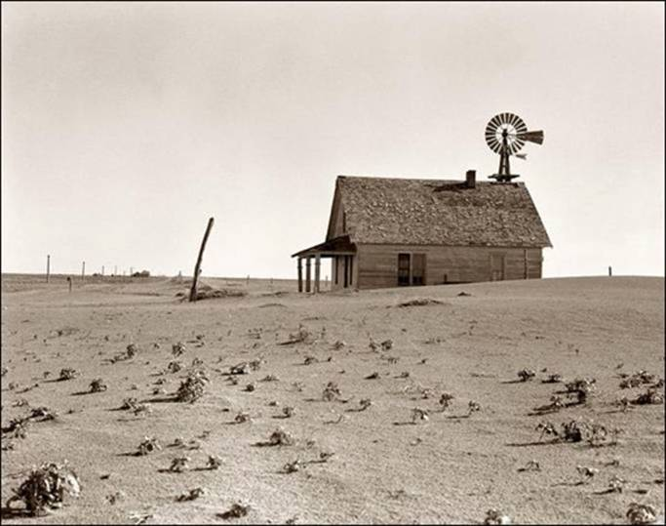
Hardships of Farmers
Late 1800’s - expansion of farming in the Great Plains = major cause of great economic hardships
Supply increased but demand did not = lower prices
Ex: 1866 bushel of wheat = $1.45 AND 1880’s = $0.80 AND mid-1890’s = $0.49

Slide 4
National Grange
Farmers began to organize in order to solve their problems
Before long, they’d started a political movement
First farmers’ organization = network of local groups
The National Grange
First purpose = social

Slide 5
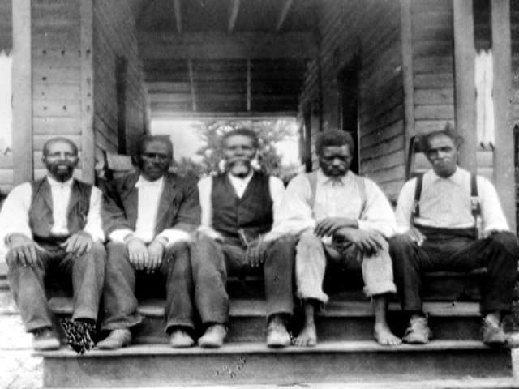
Grange Alliances
Network of organizations in the West and South
1890 - Southern Alliance = 3 million members
The Colored Farmers’ National Alliance = separate group of African American farmers = 1 million members
Things they were for:
Cooperative buying & selling
Federal government building warehouses to store crops
Loans to farmers

Slide 6
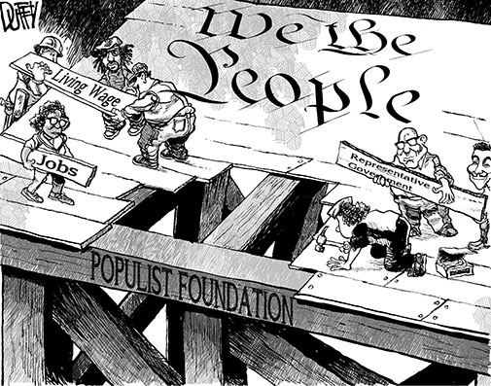
A Party of the People
Farmers’ Alliance got active in politics during 1890 election
Won 6 governorships, 3 seats in Senate, 50 seats in House
Farmer’s Alliance Created Political Party
People’s Party of the U.S.A. - aka Populist Party
Populism = appeal to the common people

Slide 7
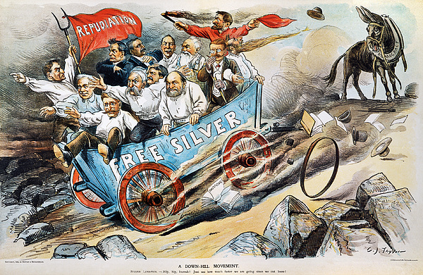
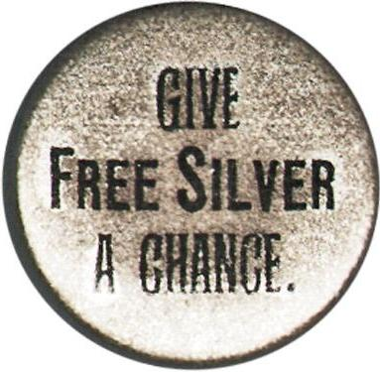
Populist Views
Government should own railroads & telegraph lines (not private companies)
Replace gold-based currency (tended to drive down prices) with a “free silver” system
Called for unlimited production of silver coins
Believed this would help farmers see prices and income rise & help them pay their debts

Slide 8
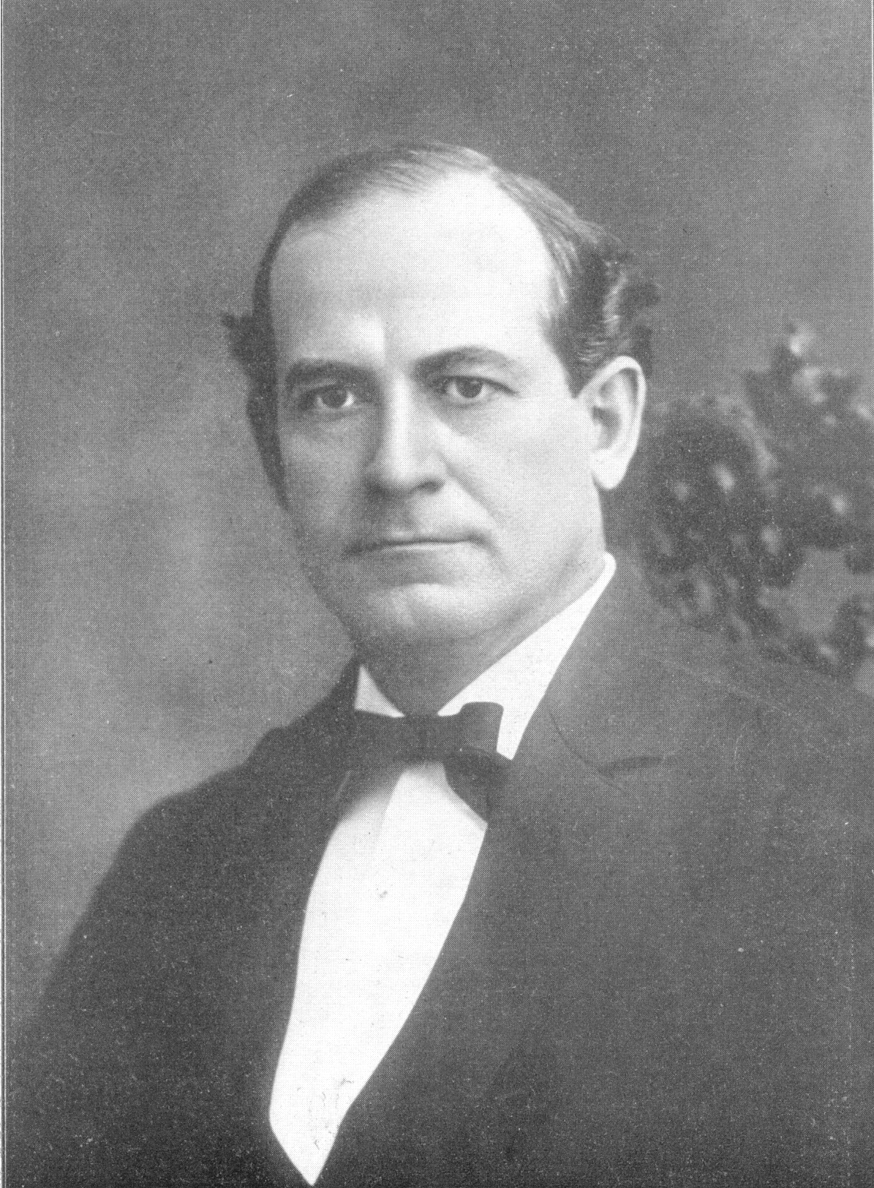
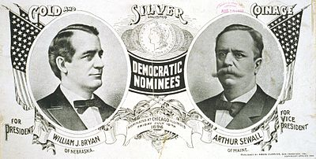
Election of 1896
William Jennings Bryan - Democratic Candidate (populist)
Known as the “Great Commoner” - appeal to the average American
Received Populist endorsement as well - supported free silver and other goals

Slide 9
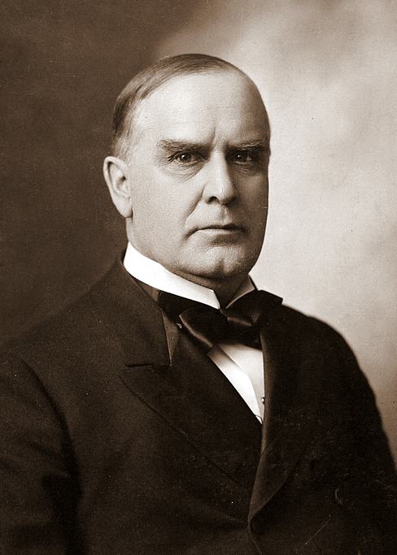
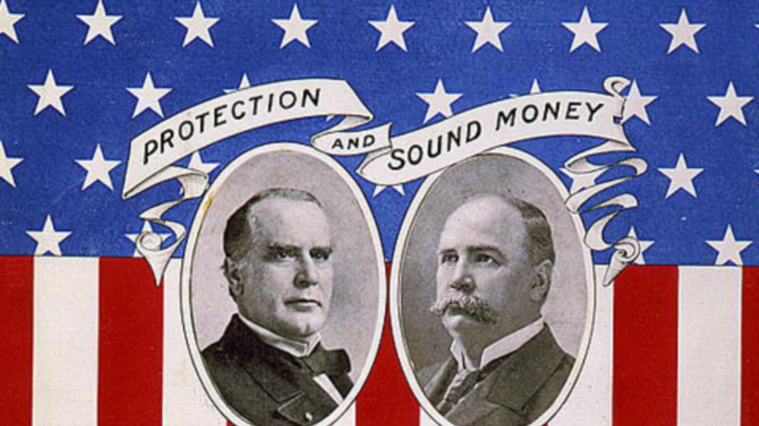
Election of 1896
William McKinley - Republican Candidate
Opposed free silver
He had served in Congress 14 years and as governor of Ohio for 4 years

Slide 10
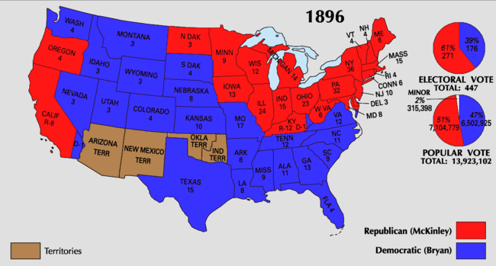
Election of 1896 & the Populist Party
McKinley won - the economy had started to improve, and the Populist agenda was not as urgent anymore
Populists still made an impact in the 1900’s:
U.S. adopted an eight-hour workday
Income tax
Secret ballot
Direct election of Senators
1933 - the nation abandoned the gold
standard

Slide 11
Populist Party - Crash Course
https://www.youtube.com/watch?v=Spgdy3HkcSs
Notes:
8:47-13:18

Slide 12
Election of 1896
http://www.history.com/topics/us-presidents/william-mckinley/videos/presidential-election-of-1896?m=528e394da93ae&s=undefined&f=1&free=false

Slide 13
William McKinley
http://www.history.com/topics/us-presidents/william-mckinley#

Slide 14
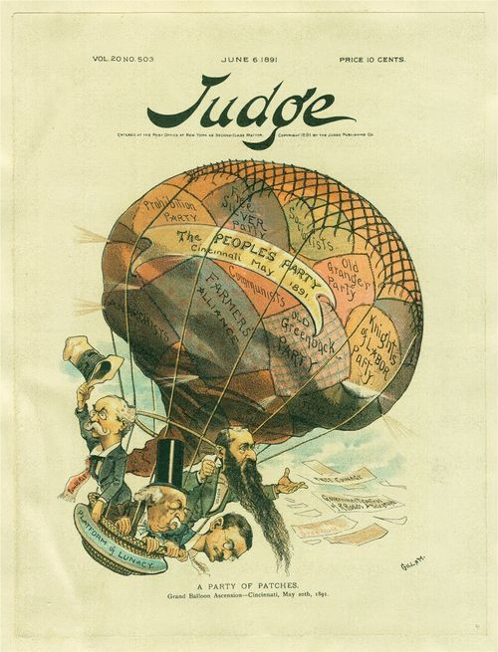
Populist Party Political Cartoon
The People’s Party - Cincinnati May 1891
Farmer’s Alliance
Old Greenback Party
Knights of Labor Party
Socialists
Free Silver Party
Prohibition Party
Anarchists
“Platform of Lunacy” - on basket
“A Party of Patchers” - at bottom

