Slide 1
Daily Quiz 1/5
Who does Jacksonian Democracy benefit most?
Rich Bankers
Southern Plantation owners
Poor white men
Women
Which of the following was not a belief of the Democratic Party?
Support states’ rights
Less government power
More government power
Common man having more power in government

Slide 2
Daily Quiz 1/5
3. Which issues did Jackson discuss in his inaugural address? (Choose all that apply)
A. Presidential Power
B. States’ Rights
C. National Debt
D. Government Jobs
E. Indian Tribes
F. Westward Expansion

Slide 3
Nullification Crisis

Slide 4
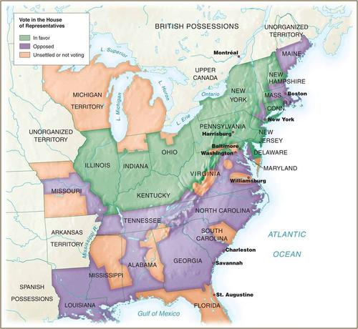
Tariff of Abominations
Congress passed a VERY high tariff
North liked tariffs because they help industry
South dislikes tariffs because they raise prices of things that Southerners buy
Jackson was not much a fan of tariffs but could not change what was already law

Slide 5
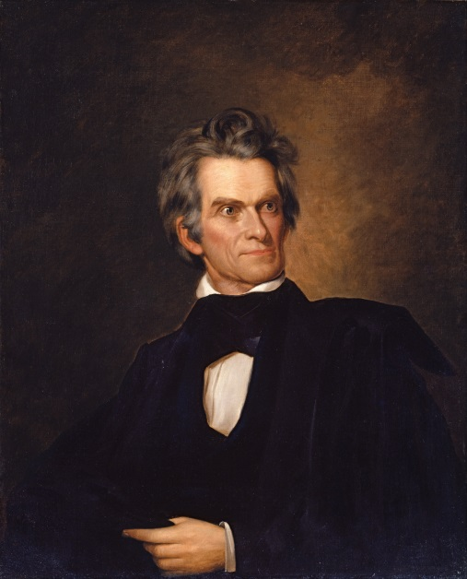
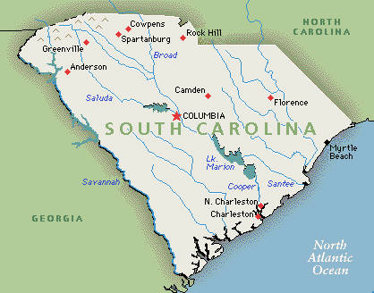
Doctrine of Nullification
Vice President John C. Calhoun (from South Carolina) hated the tariff
He claimed his state could nullify (reject) the law
He believed the law went against the state’s best interests and was unconstitutional
Jackson believed this nullification idea was dangerous

Slide 6
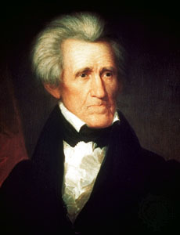
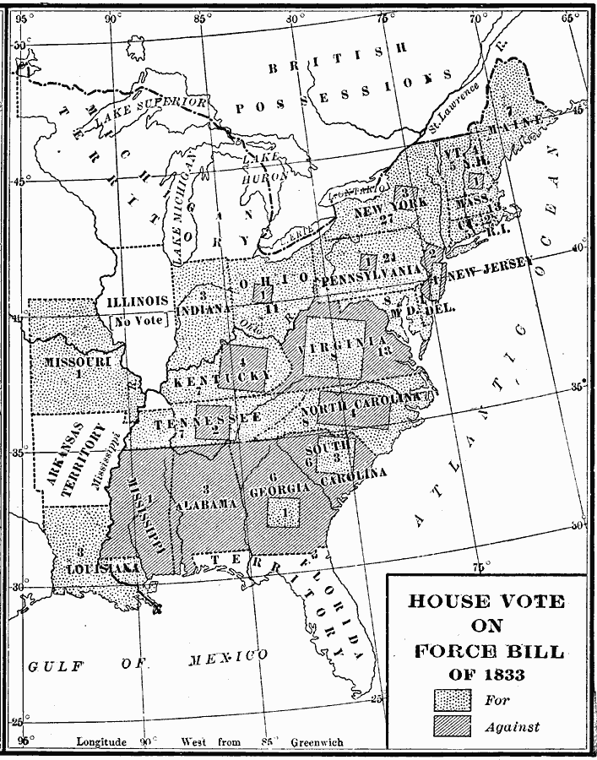
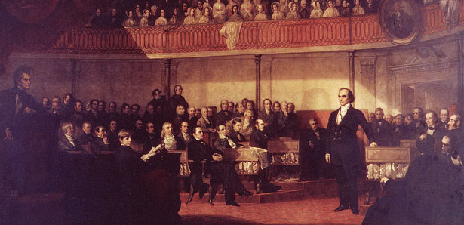
Jackson’s Response
Fearing the consequences of a state refusing to obey the national government, Jackson declared nullification illegal
Supremacy clause of Constitution says National government supreme to states
Calhoun continued to push for South Carolina to nullify the tariff
Daniel Webster in Congress pressed for Nationalism (favoring the North)
Jackson had Congress pass the Force Bill
Allowed the President to use military to enforce the laws

Slide 7
Discussion
What did the force bill let the President do?
Why would Jackson (who supports states’ rights) disagree with the doctrine of nullification?
Predict what may happen with tensions rising over the issue of nullification.

Slide 8
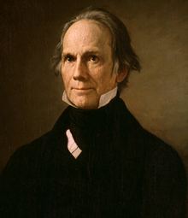
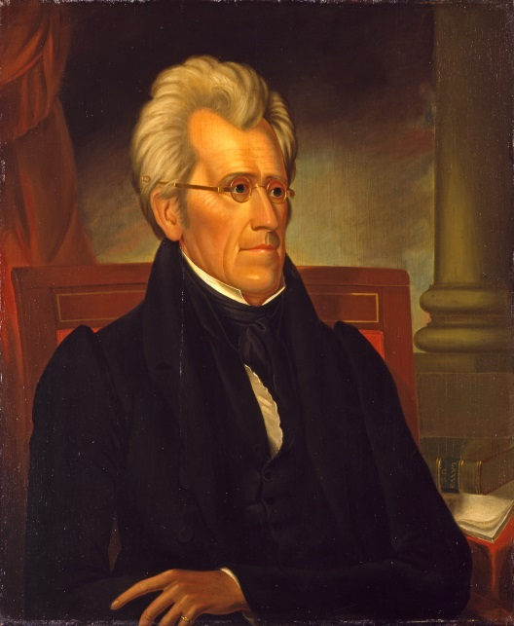
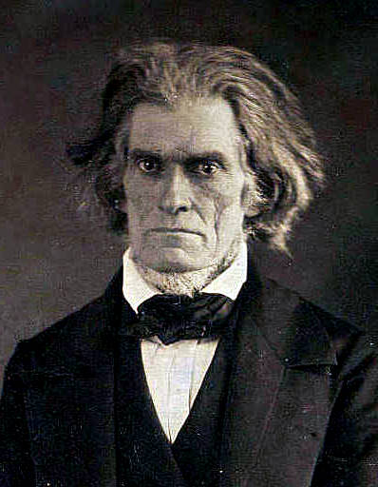
Compromise Tariff
With Calhoun and Jackson facing off with a potential civil war, Henry Clay came in to save the day
Clay proposed a tariff that was lower to compromise between the two.
The South had a lower tariff and Jackson didn’t let South Carolina break the law

Slide 9
Reflection
Do you believe states should be allowed to nullify a law from the national government? Why or Why not?

