Slide 1
New England Colonies

Slide 2
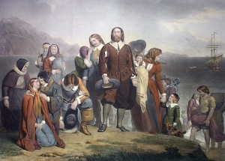
Religious Separatists
Religious dissenters, the Pilgrims wanted to separate from the Church of England, not reform it (separatists)
They travelled to the Americas first on the Mayflower, settled the colony of Plymouth
William Bradford: leader of Pilgrims and Governor of Plymouth colony

Slide 3
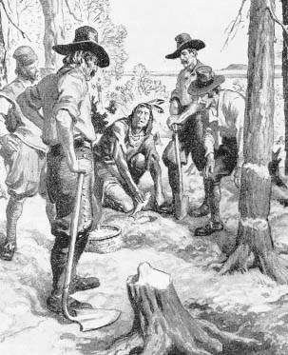
Mayflower arrives
On the way to America, the Pilgrims agree to the Mayflower Compact
Created the first representative government in colonies
Native Americans led by Squanto aid the Pilgrims in their first year
Taught them how to plant crops
Helped them keep peace with other Natives

Slide 4
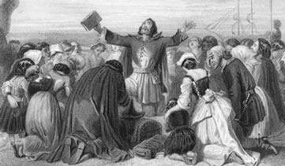
Non-Separatists
“Heretics” (those in disagreement with the Church of England) fled England for the New World
Puritans sought to reform the Church of England, not leave it. (Non-Separatists)

Slide 5
Discussion
What is similar and different between Pilgrims and Puritans?
Why is the Mayflower Compact important to the new colonies in America?
What may be some problems with over focusing on religion?

Slide 6
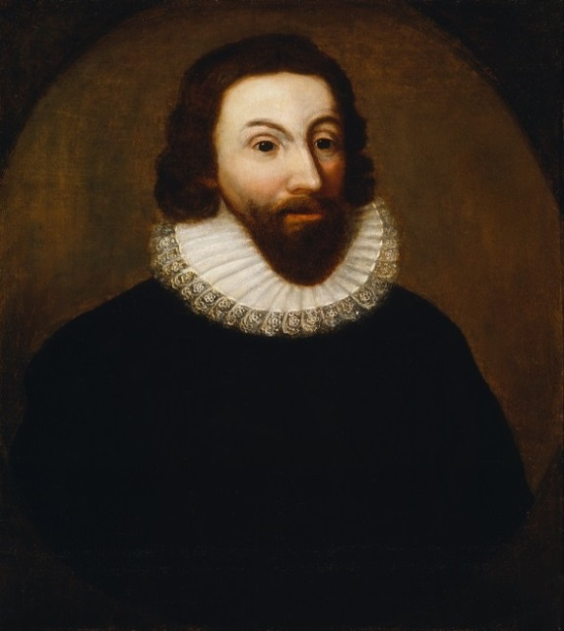
Massachusetts Bay Colony
John Winthrop establishes the colony for Puritans with himself as its leader (Boston)
Puritans settling for religious freedom but persecute others
Theocracy (government based on religion-priests in charge)
This lack of religious tolerance leads others to form new colonies

Slide 7
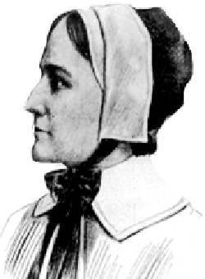
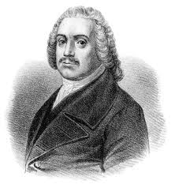
Puritan Dissenters
Roger Williams breaks away from Massachusetts Bay and founds Rhode Island
Supported separation of Church and state (no theocracy)
Anne Hutchinson was banished to Rhode Island
Believed ministers were unnecessary to connect with God
Equal rights for women

Slide 8
Reflection
Who was a person that was banished by the Puritans and what colony did they go to?

