Slide 1
Native Americans of the West

Slide 2
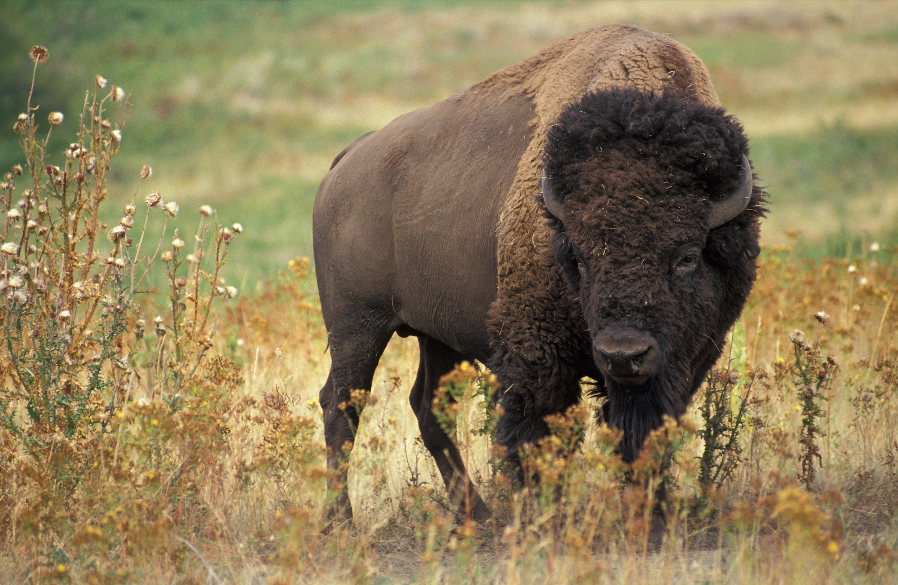
Life before Expansion
Native Americans utilize the Buffalo for a ton of different resources
Food
Clothes
Weapons
Shelter
Tools
As many as 50 million buffalo roamed the American West before settlers
Native Americans were nomadic travelling where ever they wanted

Slide 3
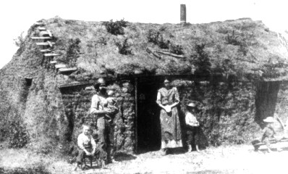
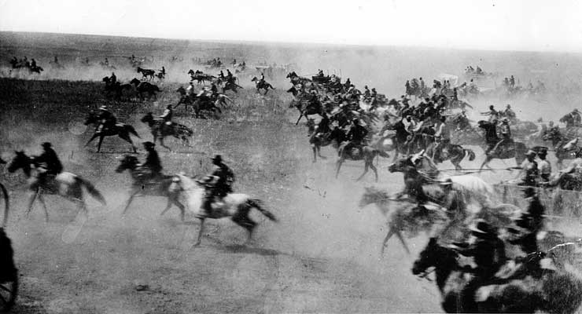
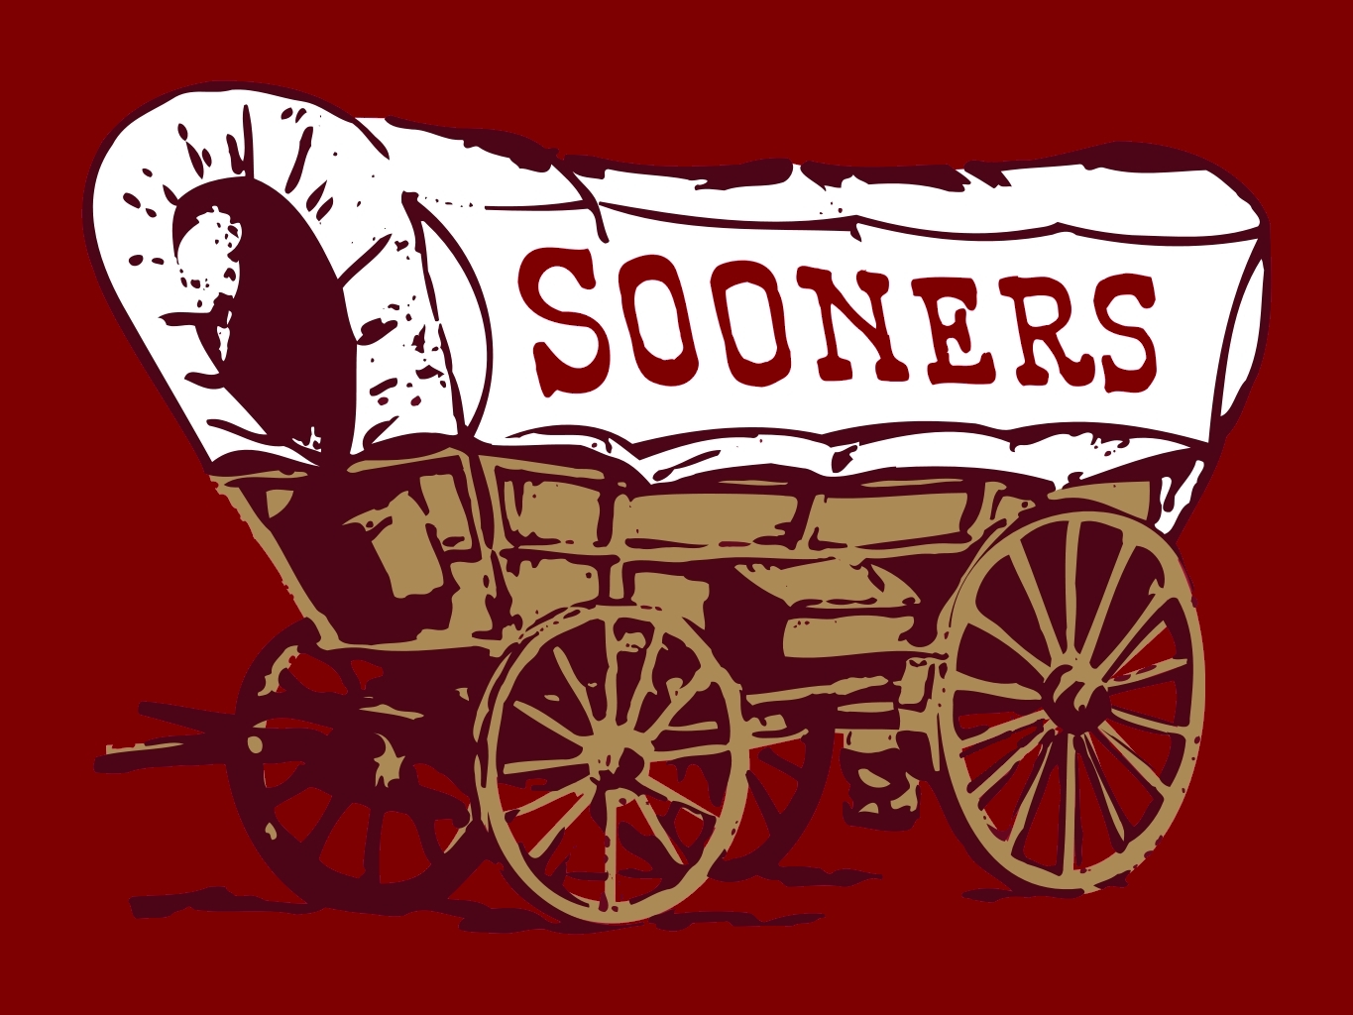
Peopling the West
Homestead Act: act set up to encourage expansion West
Gave 160 acres for $10
Brought Settlers (Especially Immigrants and African Americans) west for new opportunities
Sod Houses
Oklahoma Land Rush: Land in Oklahoma is opened to settlers on first-come, first-served
Sooners: Settlers who rushed to Oklahoma too “soon”

Slide 4
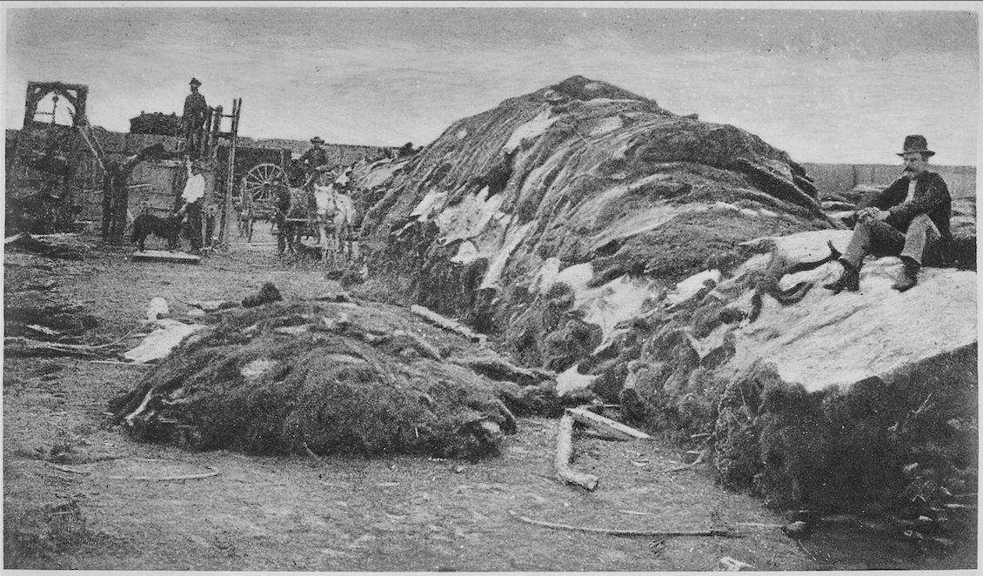
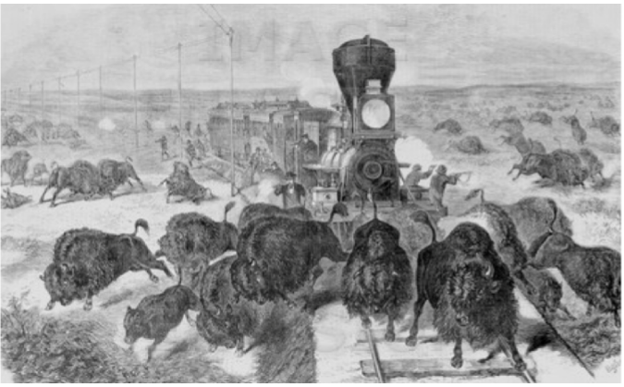
Settlers Arrive
Native populations have their lives upended
Settlers buy land and force Natives to leave lands
Buffalo populations are cut down to just a few hundred
Settlers kill buffalo and do not use them like Natives
Damaged Indian culture
Killing Buffalo makes way for railroads

Slide 5
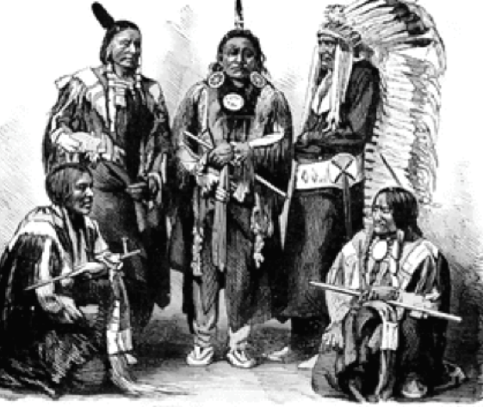
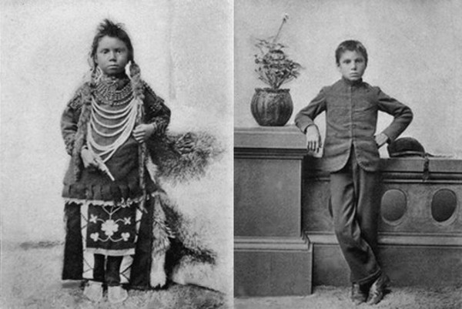
Reforming Native Culture
Settlers pose a few options to Native Americans
Reservations: Designated land by government for Natives to live on
Goal: keep Natives out of the way of settler development
Dawes Act: Aimed to assimilate Natives (have them adopt “white” culture)
Broke up Reservations and sold off land to natives (property ownership)
Boarding Schools: Worked to assimilate Native Americans

Slide 6
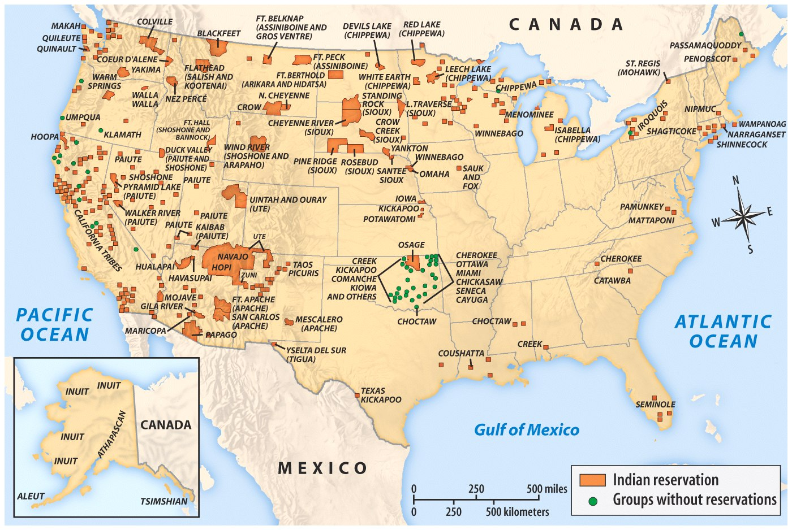

Slide 7
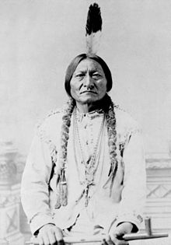
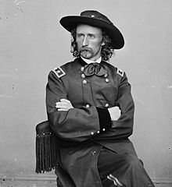
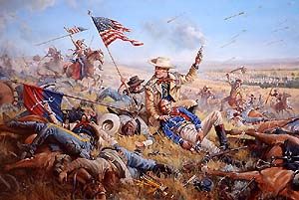
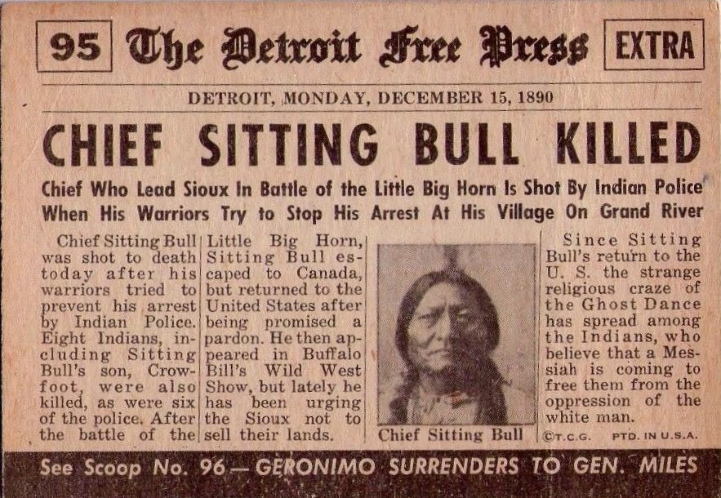
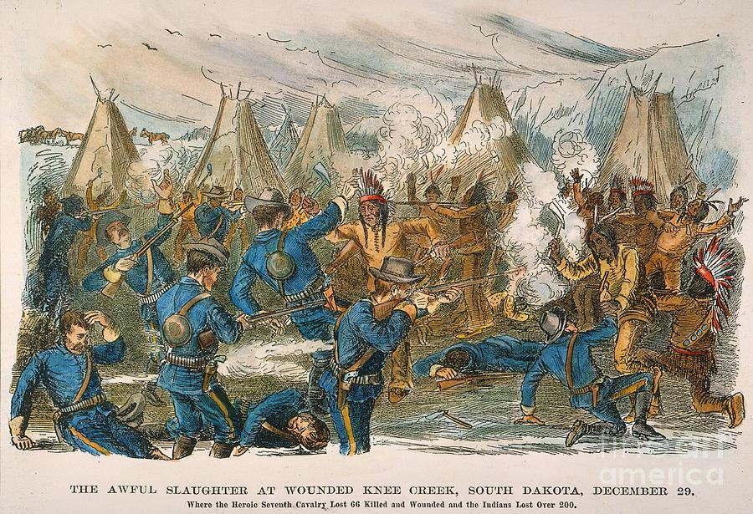
Resistance
Many Natives took up arms to defend their way of life
Sioux: Tribe in the Dakotas
Sitting bull: medicine man that lead resistance
Crazy Horse: Chief that helped led resistance
Battle of Little Big Horn: Massacre of American forces under George Custer, by
the Sioux
Wounded Knee Massacre: American retaliation for Little Big Horn, end
of Native resistance

Slide 8
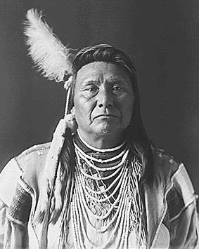
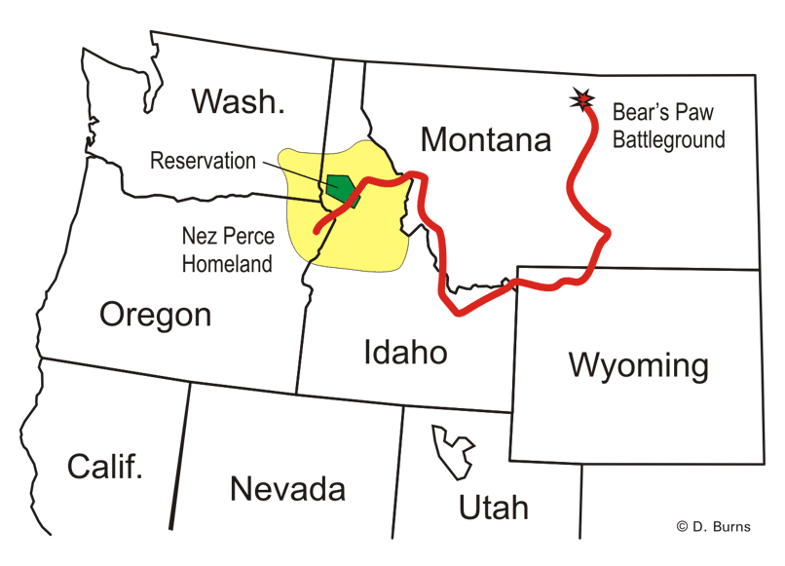
Native Submission
Nez Perce: Native tribe in Northwest
Chief Joseph: Chief of the Nez Perce that chose not to resist
“I shall fight no more forever”
Long March: Nez Perce attempted to retreat into Canada
Captured by Americans and relocated to reservations

