Slide 1
Middle Colonies

Slide 2
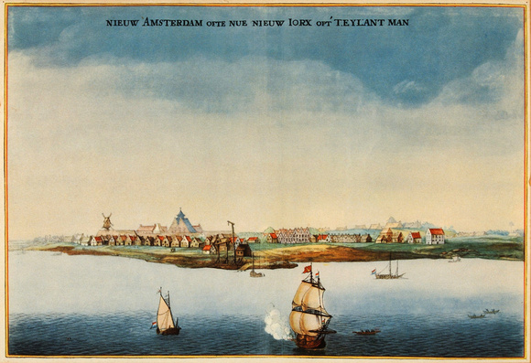
Dutch in Americas
The Dutch (Netherlands) started the colony of New Netherlands centered around the port city of New Amsterdam
Patroon System: granted large tracts of land to people who brought 50 settlers to America

Slide 3
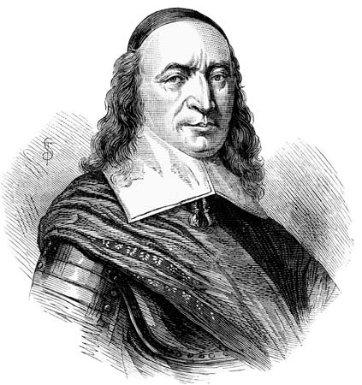
Creating New York
Eventually, New Netherlands’ success brings about British interest in the Dutch colony
Dutch governor Peter Stuyvesant gives up control to the British
The colony is renamed New York and continues its success under British rule
The sea port and trade brought in very diverse groups of people

Slide 4
Discussion
Who are “the Dutch?”
How might the Patroon system impact the types of people who settle in the Middle colonies?
How can having diversity change the way a society works?

Slide 5
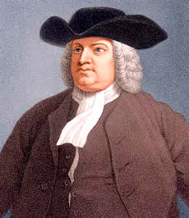
Pennsylvania
Founded by William Penn as a safe haven for many different religious groups
Penn led Quakers to settle Pennsylvania to gain religious freedom

Slide 6
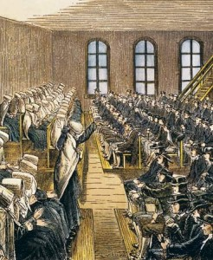
Quaker Beliefs
Believed in equality for ALL
Native Americans: treated with respect, bought land instead of stealing it
They also believed in an “inner light” which made them all ministers
Women: viewed as equals, allowed to preach in church
Philadelphia: major trade city

Slide 7
Reflection
How might one region being accepting of diversity and others impact that region’s relations with others?

Slide 8
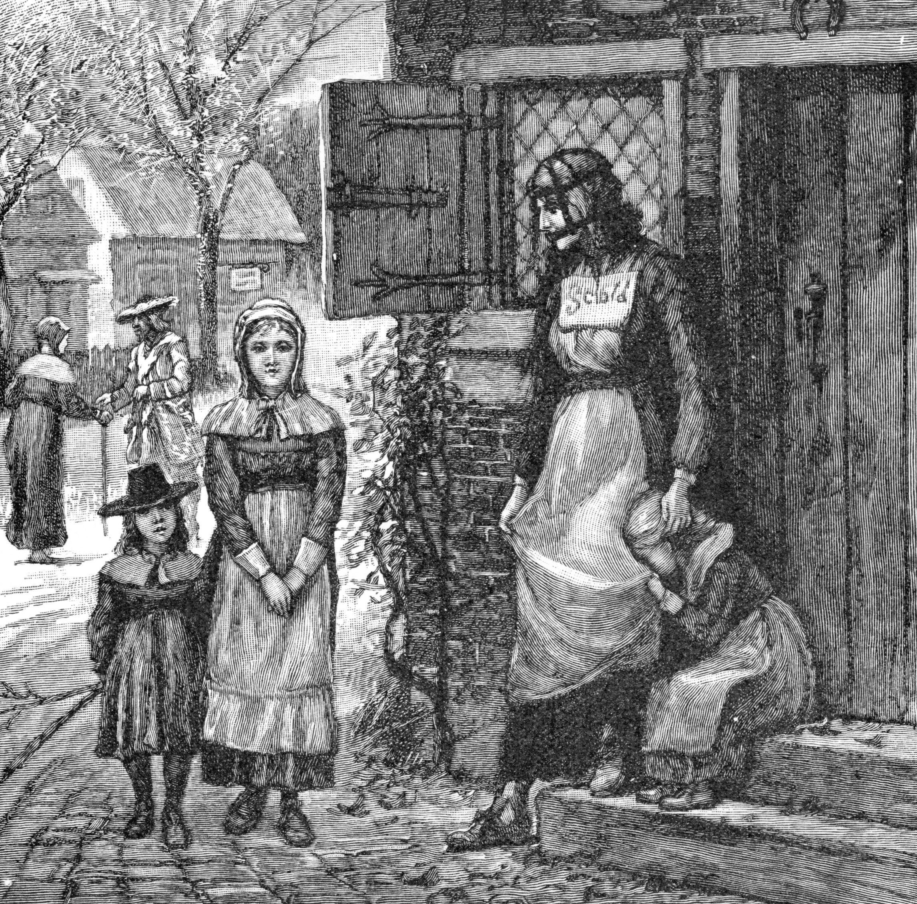

Slide 9
