Slide 1
Manifest Destiny

Slide 2
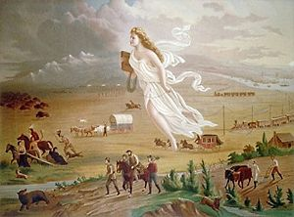
Manifest Destiny
Idea that America was destined to control all land between Atlantic and Pacific Oceans
God wanted the US to control all the land
Supported idea that America was special

Slide 3
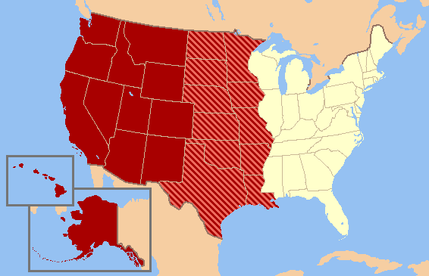
Motivations for Manifest Destiny
Cheap land
So much land, it is not very expensive
Valuable Natural Resources
Start new life
Escape prior issues in life (debt, crime)

Slide 4
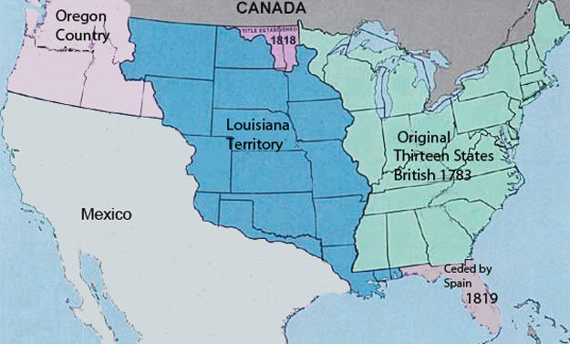
Oregon
America had gotten Oregon territory from Spain
United States and Britain had agreed to share control of Oregon
Tensions over control were bound to happen

Slide 5
Discussion
What is Manifest Destiny?
What would make Americans believe in Manifest Destiny?
How would the belief in Manifest Destiny impact our relations with countries? (how would other countries view us because we think this way?)

Slide 6
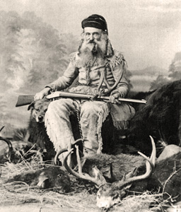
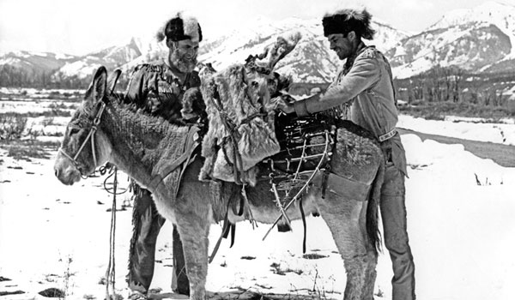
Life in Oregon
Oregon was the furthest point away from civilization
Not many people lived there and those who did needed to use survival skills
Mountain men: people who explored the west and lived off the land and fur trading in Oregon.

Slide 7
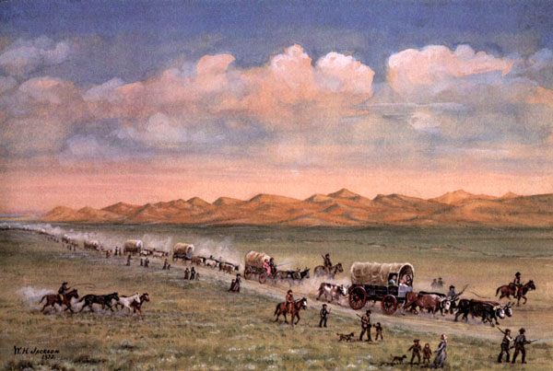
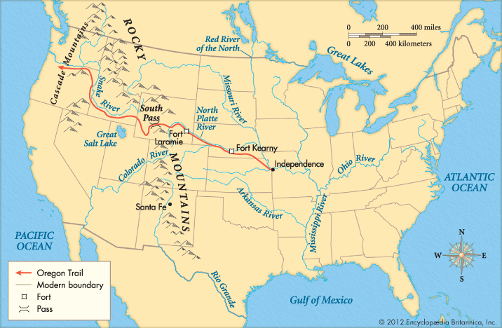
Oregon Trail
More and more people began traveling west to find better opportunities
Oregon Trail: trail to Oregon territory that took travelers through the mountainous west
Journey was rough and many struggled to survive.

Slide 8
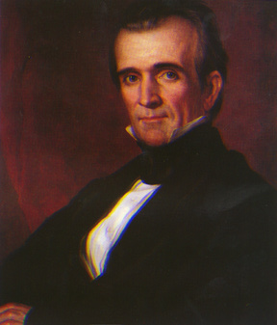
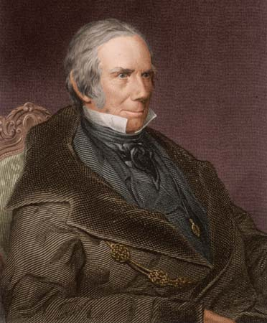
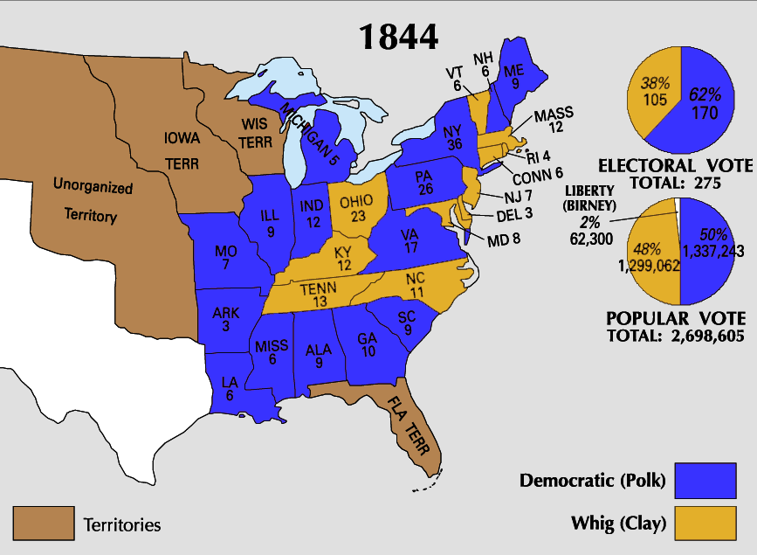
Election of 1844
Democrat James K. Polk (Jackson copy) vs. Whig Henry Clay (again…) Polk was a “dark horse” (an unknown)
Big Issue: Westward Expansion (Polk supports)
Polk’s Promises:
“54⁰ 40⁰ or Fight!”
Settle Oregon border conflict with Britain
Annex Texas (make it part of country)
Take over California and southwest
Polk wins the election

Slide 9
Reflection
Is Manifest Destiny a good thing for America or do you predict there will be issues?

