Slide 1
Kansas-Nebraska Act
Goal: Examine issues surrounding the idea of popular sovereignty in addressing the slave issue in territories.

Slide 2
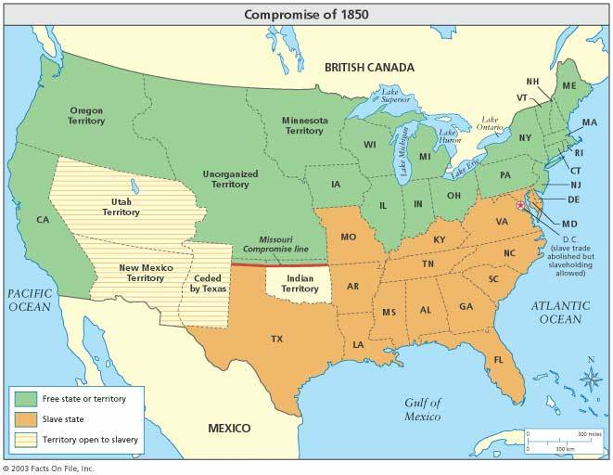
Issues after Compromise
After the Compromise, Kansas was getting close to statehood
Would they be slave or free?
Missouri Compromise had set them out as free states but now, Southerners were worried about losing more power

Slide 3
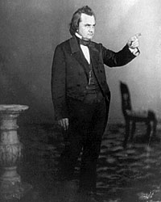
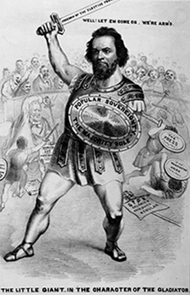
Douglas’ Plan
Northern Senator Stephen A. Douglas came up with a solution
New states would use popular sovereignty
People in territory or state get to vote to decide if they want slavery
Douglas believed this solved the problem
People should have final say over political balance of power

Slide 4
Discuss
What is popular sovereignty?
How is popular sovereignty related to the issue of slavery?
What issues might arise by using popular sovereignty to decide if a state is free?

Slide 5
Kansas-Nebraska Act
Uses popular sovereignty
Repealed Missouri Compromise, made Kansas and Nebraska able to decide if they want slavery
Northerners disliked that it could make what were free territories have slaves
Southerners supported bill as they believed slave owners would settle Kansas
Political Impact:
Destroys Whig Party (Cannot agree)
Creates the Republican Party (Party in North against expansion of Slavery)

Slide 6
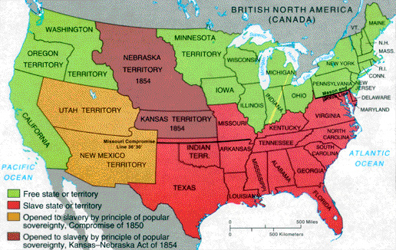
Following the Act

Slide 7
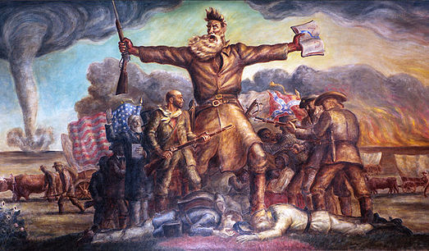
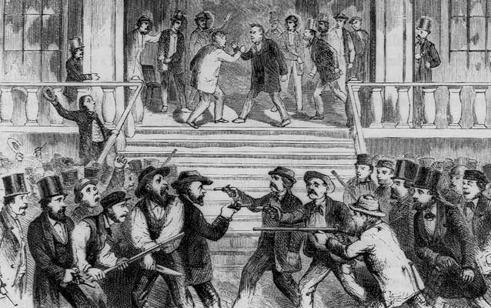
“Bleeding Kansas”
Kansas-Nebraska act created a mad dash for both pro and anti-slavery supporters to move to Kansas
The side with more people would decide if Kansas was free or slave (popular sovereignty)
Pro Slavery forces won (kind of)
This caused an uprising between pro and anti-slavery forces in Kansas and Congress
John Brown attacks and kills 5 slave owners

Slide 9
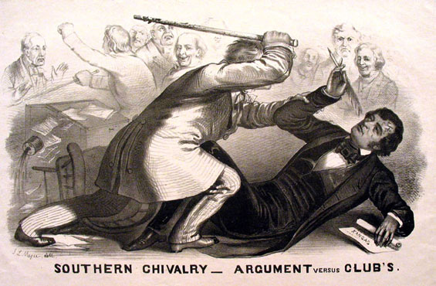
“Bleeding Sumner”
Tensions were high while debating the Kansas-Nebraska Act
Charles Sumner was beaten by Congressman Preston Brooks over comments made about Bleeding Kansas

Slide 10
Reflection
- How did using popular sovereignty to address the issue of slavery create problems?

