Slide 1
Jeffersonian Troubles
Notes:
thi

Slide 2
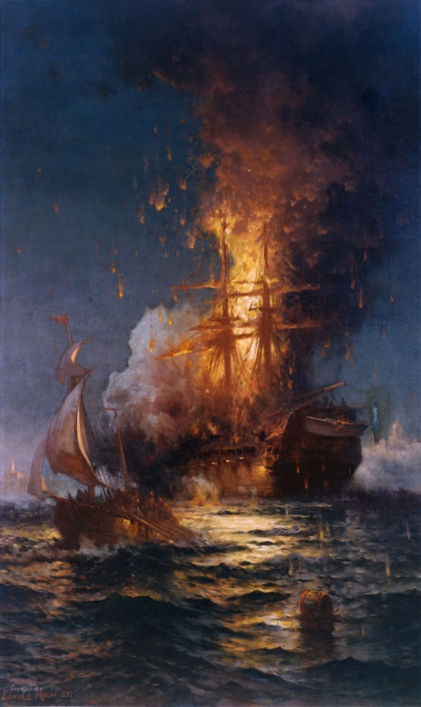
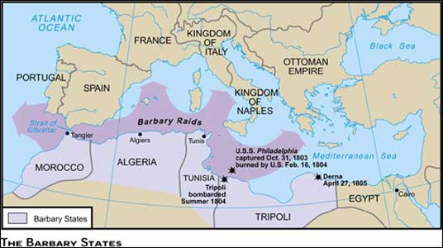
Barbary Wars
Pirates from the Barbary states (North Africa) demanded tribute (payment) to leave ships alone
Since US refused to pay, pirates would capture ships and imprison crews
To Jefferson this was unacceptable and he blockaded Tripoli, an African
city-state
Eventually both sides came to a peace agreement
Result: Jefferson had built up the US navy

Slide 3
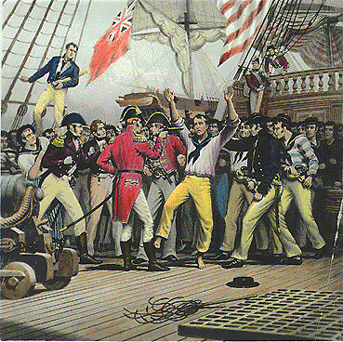
More European Conflict
While pirates were through attacking US ships, France and Britain were not.
France and Britain were again at war
Harassment continued with ships who traded with the countries
Britain and France seized ships bound for their enemy
Britain used impressment (kidnapping and forced labor) of US traders as France had done

Slide 4
Discussion
What were some of the impacts of the Barbary Wars on America?
How was Jefferson’s handling of the conflict with the pirates in conflict with his views?
What may be a solution Jefferson could use to solve America’s issues with Britain and France?

Slide 5
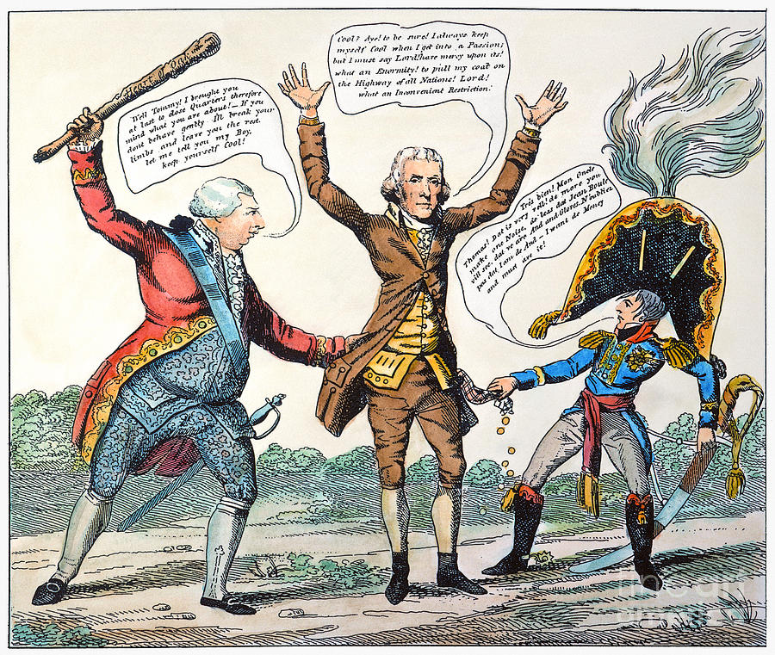
Dealing with Impressment
To stop issues with Europe, Congress and Jefferson decided to stop all trade with them
Jefferson enforced the Embargo Act of 1807
Prohibited trade with ALL countries; targeted Britain
Idea was that Britain would suffer from not trading with US, and would beg the US to trade
Reality: They barely noticed

Slide 6
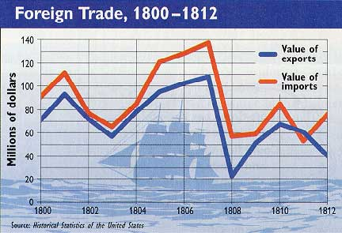
Impact of Embargo
While Britain was hardly effected by the Embargo, the US struggled
New England which relied on trading had massive unemployment
The South could no longer sell its cash crops to Europe
The West could not sell its wheat to Europe and production fell
The Embargo only hurt the US

Slide 7
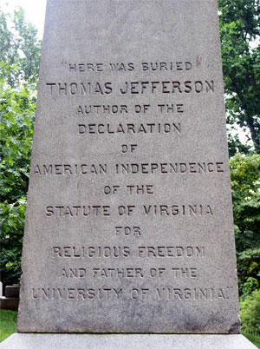
Really TJ? No mention of being President? You didn’t do THAT bad…

Slide 8
Reflection
Evaluate (was it good or bad) the presidency of Thomas Jefferson. Defend your position.

