Slide 1
Jeffersonian Democracy

Slide 2
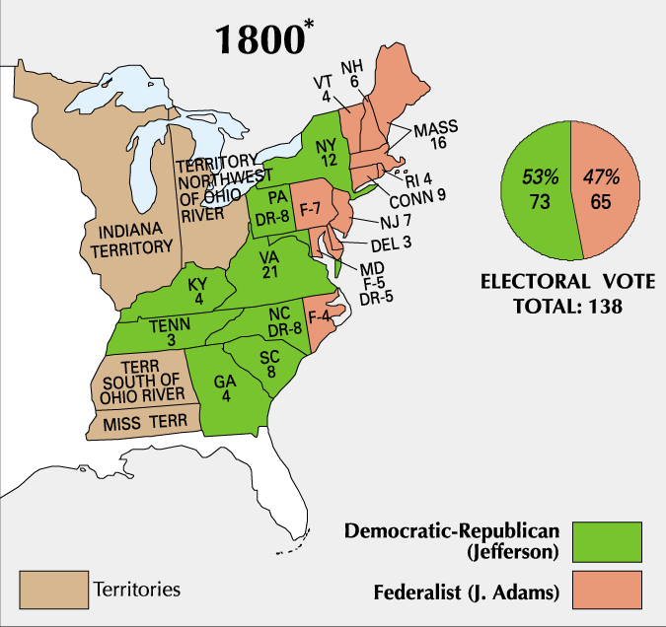
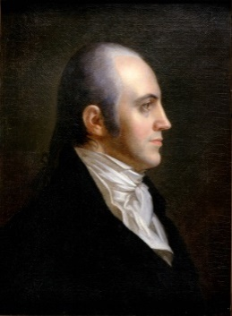
Election of 1800
Jefferson v. Adams
Very bitter campaign (personal attacks)
Jefferson ties Aaron Burr who was his Vice President candidate
Result:
Election goes to House of Representatives and they decide Jefferson wins
Peaceful transition of power between political parties
12th Amendment: Ratified to elect President and Vice President separately

Slide 3
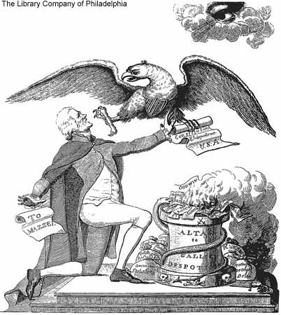
“Revolution of 1800”
Jefferson saw his victory as another American Revolution
This time, rejecting the Federalists rule
Believed the “Principles of ‘98” (Kentucky and Virginia
Resolutions) was now what people wanted
Jefferson believed he had a mandate (authority from
the voters) to undo what Hamilton had done.
Hamilton’s Financial Plan
Alien and Sedition Acts
Foreign Policy

Slide 4
Discussion
1. What was significant about the Election of 1800?
2. How is Jefferson’s vision of government different than how the government was at the time?
3. How might Jefferson’s “revolution” cause issues?

Slide 5
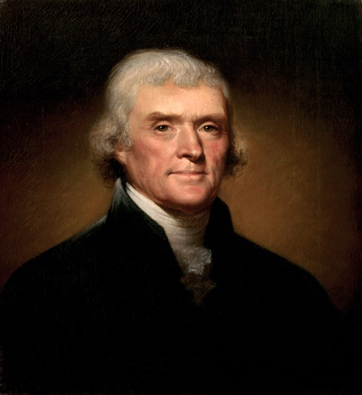
Jeffersonian Democracy
Jefferson took the oath of office in his everyday clothes at a very subdued ceremony
He outlined his goals for his presidency
Smaller and weaker Government
Power to the “Common man”
Focus on farming economy (away from industry)
“Let us, then, fellow-citizens, unite with one heart and one mind… Every difference of opinion is not a difference of principle… We are all Republicans, we are all Federalists.”

Slide 6
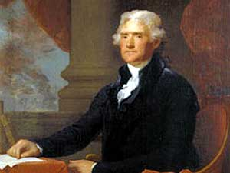
Jeffersonian Change
Jefferson brought his strict interpretation to the presidency and made many changes to the Federalist government
Shrunk size of government (military and workers)
Ended:
Alien and Sedition Acts
Whiskey Tax (and all other taxes except tariff)

Slide 7
Reflection
What is Jeffersonian Democracy? How did it impact the country?

