Slide 1
Jacksonian Democracy

Slide 2
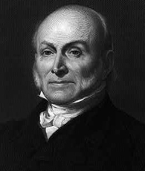
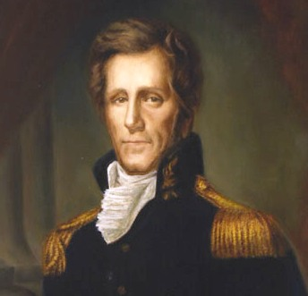
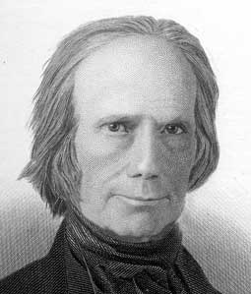
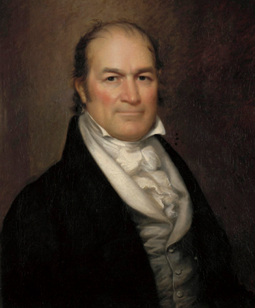
Election of 1824
Election dominated by Sectionalism
Following Era of Good Feelings, 4 people run for president
John Quincy Adams (North)
Andrew Jackson (South and West)
Henry Clay (West)
William Crawford (South)
Jackson gets the most votes, but not a majority
Since we have no winner, the top two go to the House of Representatives
Jackson and Adams
Clay, Speaker of the House of Representatives , convinces his supporters to vote Adams
Clay later became the Secretary of State for Adams (corrupt bargain)

Slide 3
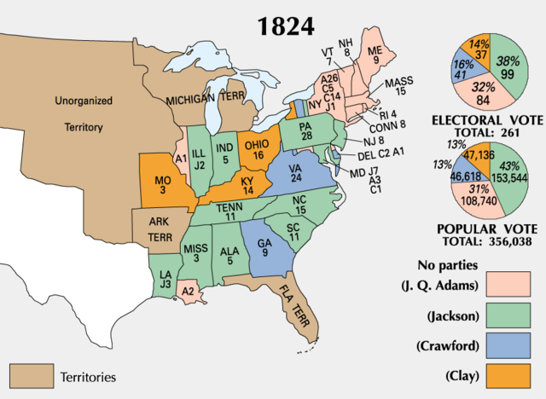

Slide 4
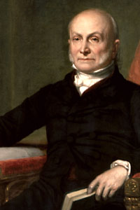
John Quincy Adams Presidency
Adams and Clay denied any corrupt bargain
Adams had big plans to expand government’s role in transportation
Opponents (Andrew Jackson supporters) refused to allow Adams to do anything he wanted.
Congress allowed for some improvements to transportation but not nearly what Adams wanted

Slide 5
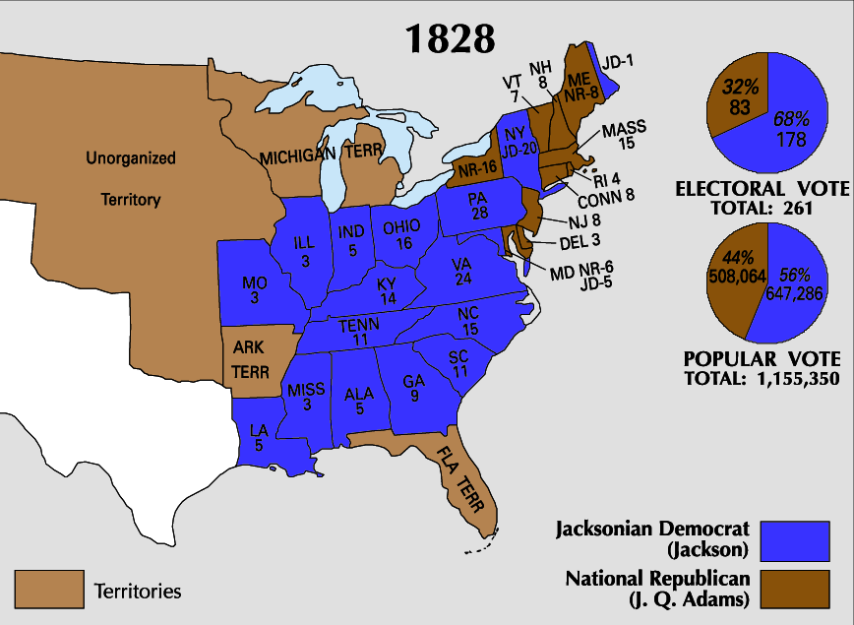
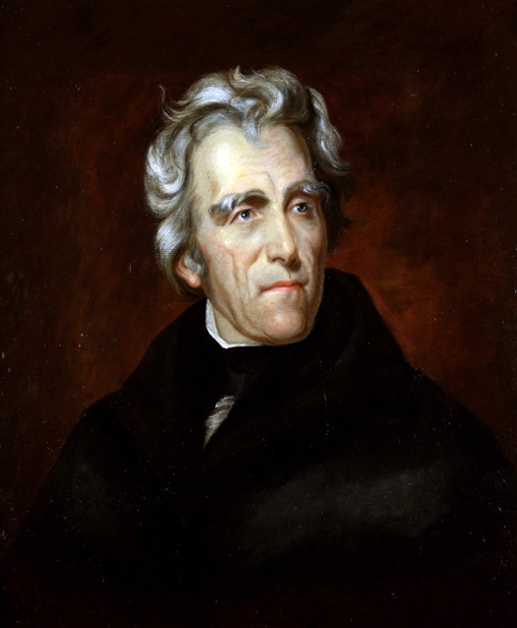
Election of 1828
Corrupt bargain upsets many Jackson supporters
They hated Adams and made sure everyone knew it
Andrew Jackson runs for president against Adams again and wins big in 1828 (very nasty campaign)
Cause: Universal Male Suffrage
All white men can vote (no property needed)

Slide 6
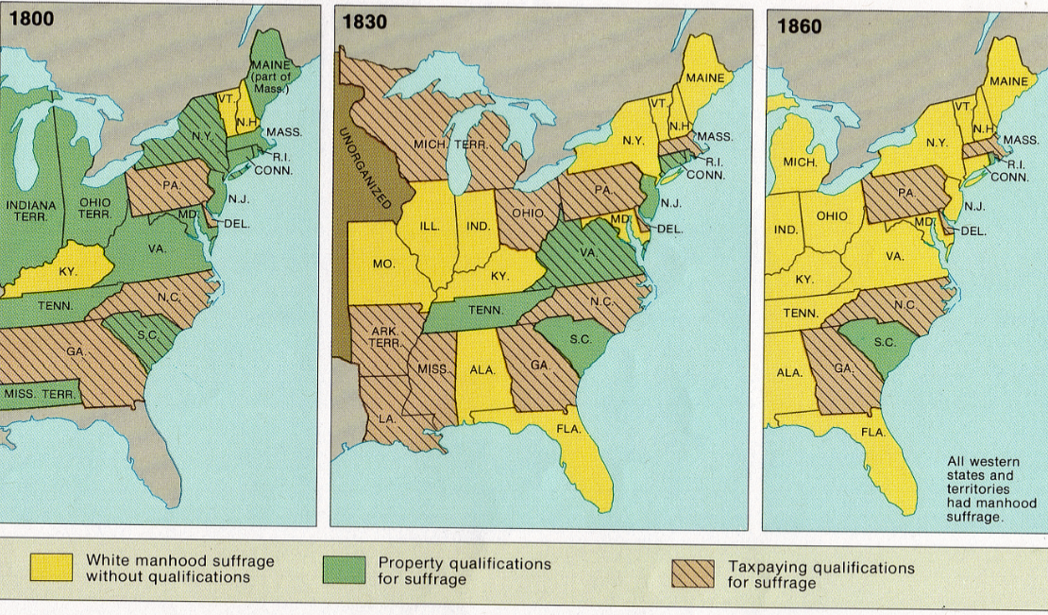

Slide 7
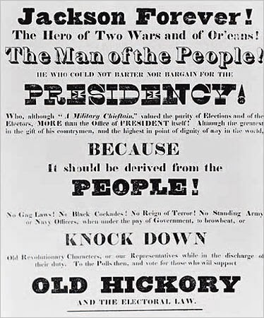
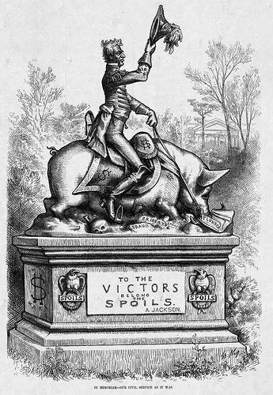
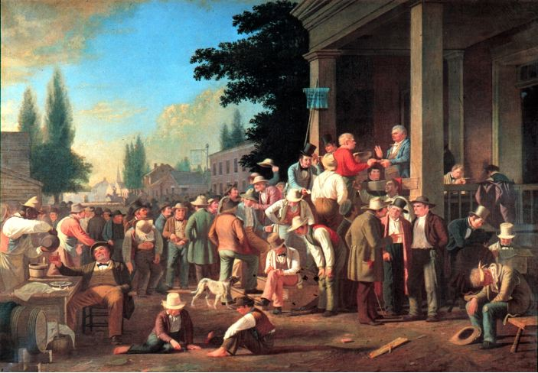
Jacksonian Democracy
The push to give more of a say to the common man
Like Jeffersonian Democracy BUT actually followed through
Jackson promises “equal protection and equal benefits” for all Americans (all white men)
Spoils system: giving out government jobs to supporters of the President

Slide 8
Discussion
What is Jacksonian Democracy? (Describe it in your words)
How does Jacksonian Democracy relate to universal male suffrage?
Predict how things will change because of more power being given to the common man and their “champion” in Jackson.

Slide 9
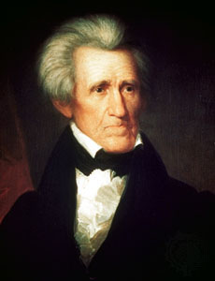
Jackson’s beliefs
Jackson believed he was the champion of the common man
Nicknamed “Old Hickory” by his soldiers because of how tough and hard he was, but was very popular
He helped create the Democratic Party
Political Party which operated on the following ideas
Common man (or their representative in government) should have power
Less government power (unless it helped the common man)
Supports States’ rights

Slide 10
reflection
Compare and Contrast Jeffersonian and Jacksonian Democracy.

