Slide 1
Industry in the North

Slide 2
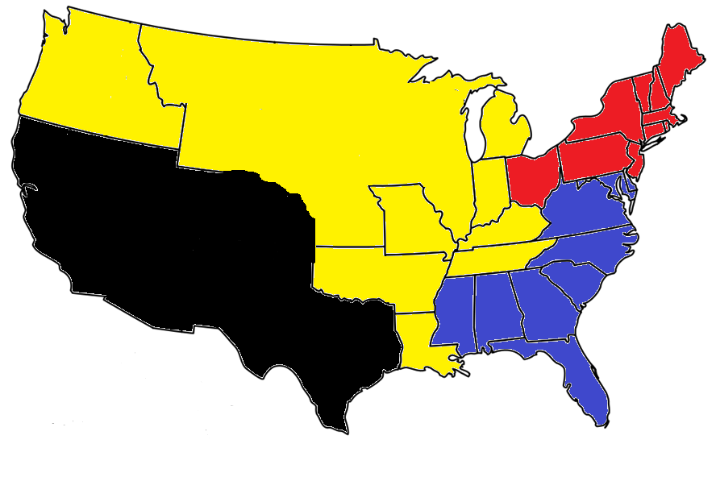
What is the North?

Slide 3
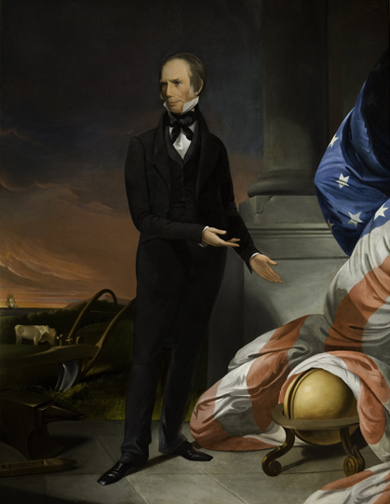
The “American System”
Former war hawk Henry Clay, a Nationalist came up with a plan for the nation’s economy
Goal: promote interdependence among the three sections
of the country
Three parts of the American System
National Bank
Protective Tariff
Improve Transportation (build roads, canals, etc.)

Slide 4
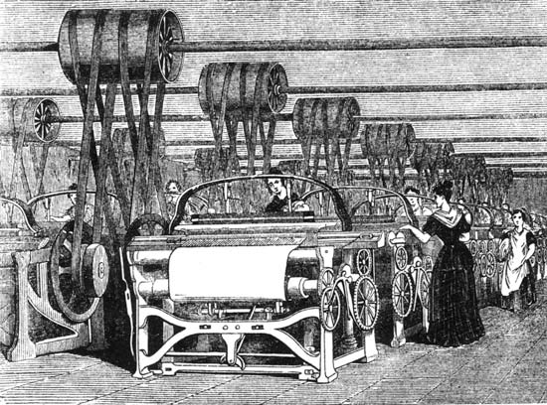
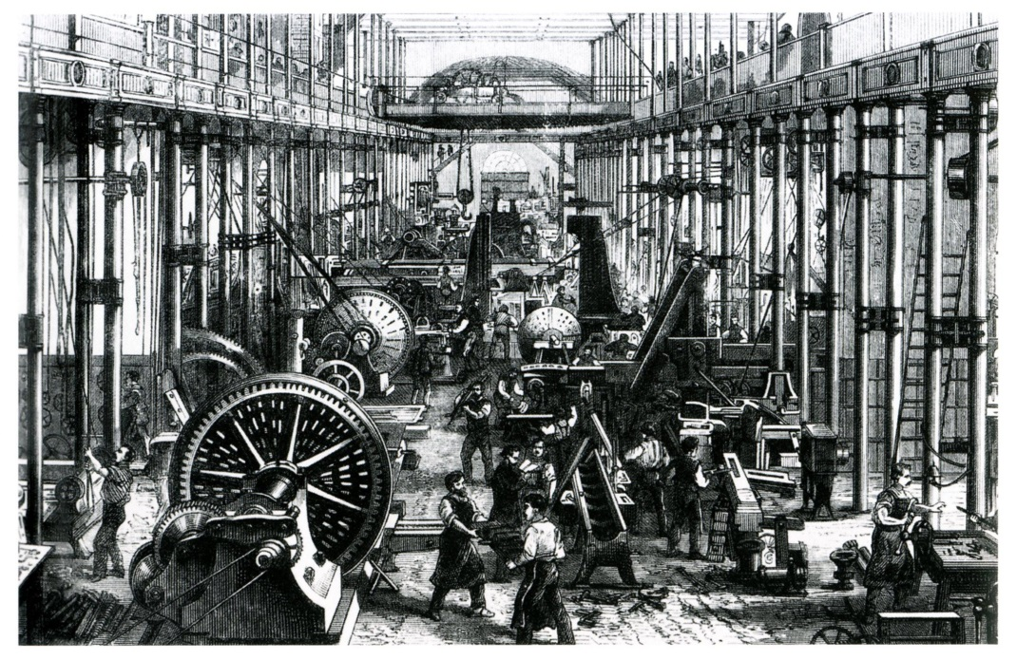
Economy of the North
Had focused on only trading which hurt during Embargo and War of 1812
Focus turned to Industry
Need to make their own stuff
Industrial Revolution (major changes in making things)

Slide 5
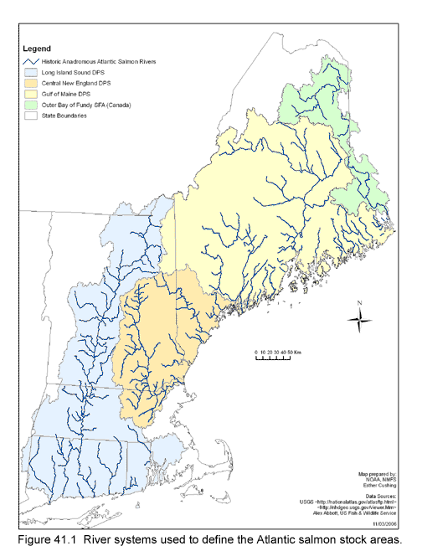
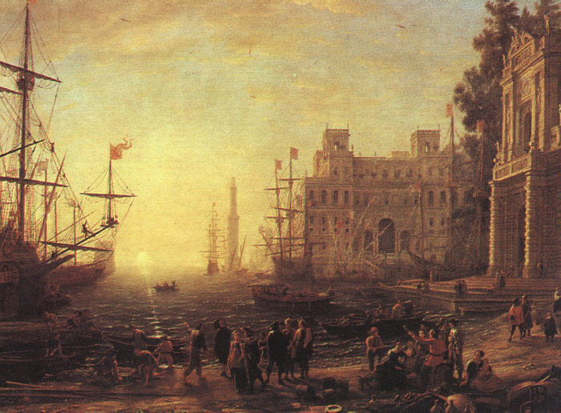
Factors helping Industry
Poor soil (not good for growing crops)
Rapid rivers of New England powered mills
Port cities (NYC, Boston, Philadelphia) allowed for easy access to trade goods

Slide 6
Discussion
How would an industrial revolution change a country?
Why would the North (and not the South) begin focusing on industry?
What problems may arise with so many jobs popping up in the North?

Slide 7
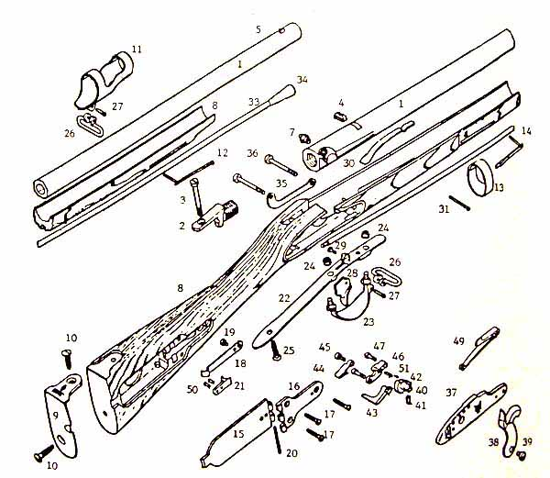
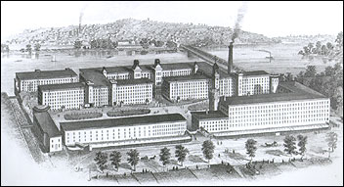
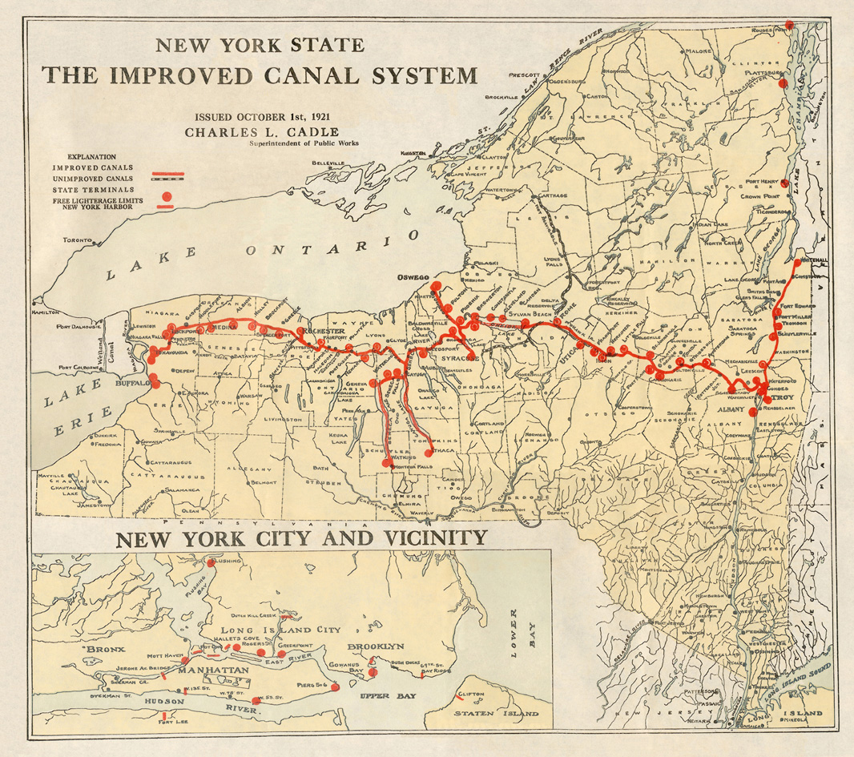
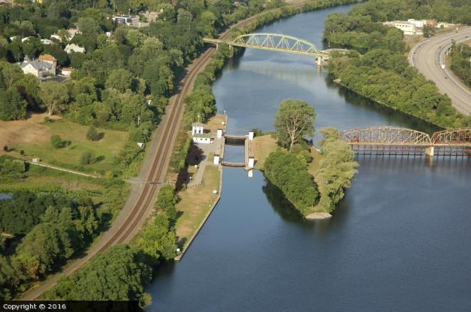
New Innovations
New improvements allowed people to make things faster and easier
Interchangeable Parts
Factory System
Erie Canal: Man made water way from Hudson river to Great Lakes
Benefits:
Made New York City a major trading port
Quicker to travel from East to West
Reduced the cost of moving goods and raw materials

Slide 8
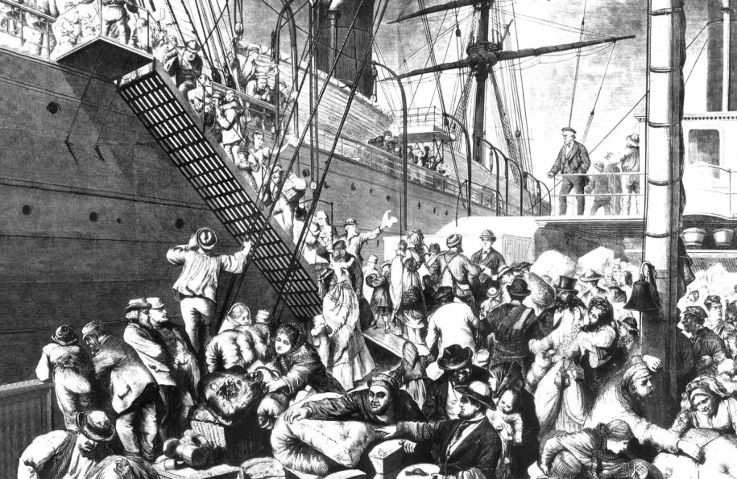
Immigration
Push/Pull factors: What pushes a person out of their home country and what pulls them to their new country
German Immigrants:
Push: Lack of Freedom
Pull: Midwest farms
Irish Immigrants:
Push: Crop famine (potato)
Pull: Northern cities for factory jobs
Nativism: Opposition to immigrants
Increases dramatically

Slide 9
Life in the North
Write a diary entry as if you are someone who was traveling through the North and experiencing the things discussed today in class. Your diary entry should include answers to the following:
How has the industrial revolution changed life?
What is a new innovation that you have seen? How do you believe it will impact America?
What have you noticed about the immigrants within the city? What type of conditions do they and other poor workers live in?

Slide 10
Reflection
Now that the North has gone through the industrial revolution, what problems do you predict will come up?

