Slide 1
Individualism in America

Slide 2
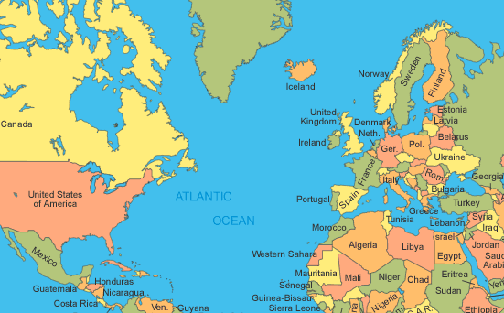
Growth of Individualism
The French and Indian War resulted in Britain controlling all land east of the Mississippi River
Colonists enjoyed salutary neglect (beneficial neglect)
Britain used a “hands off” approach to colonies
Why?
Britain was so far away
Britain could not control actions of colonists

Slide 3
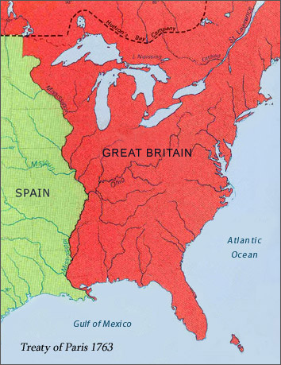
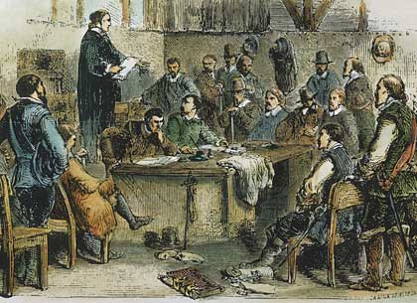
Effect of Salutary Neglect
Individualism on the rise
Colonies become self-reliant (on-their-own attitude)
Develop their own (representative) governments
Expanding westward

Slide 4
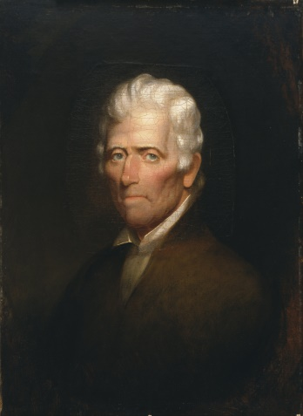
Moving west
Many wish to expand to the new lands west of the Appalachian Mountains
Daniel Boone (an explorer) helps construct the Wilderness Road
a route through the Cumberland gap and the mountains to the west
Many colonists utilize the road to get to Tennessee and Kentucky
William Bean, Thomas Sharpe Spencer and Dr. Thomas Walker were the first settlers in Tennessee

Slide 5
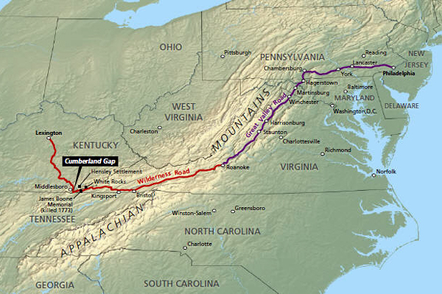
Wilderness Road

Slide 6
Discussion
What would be the advantage of salutary neglect for both Britain and the colonists?
How does this lead to a rise of individualism in the colonies?
Predict what problems may come up from salutary neglect.

Slide 7
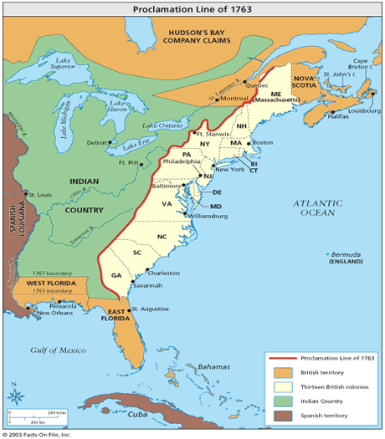
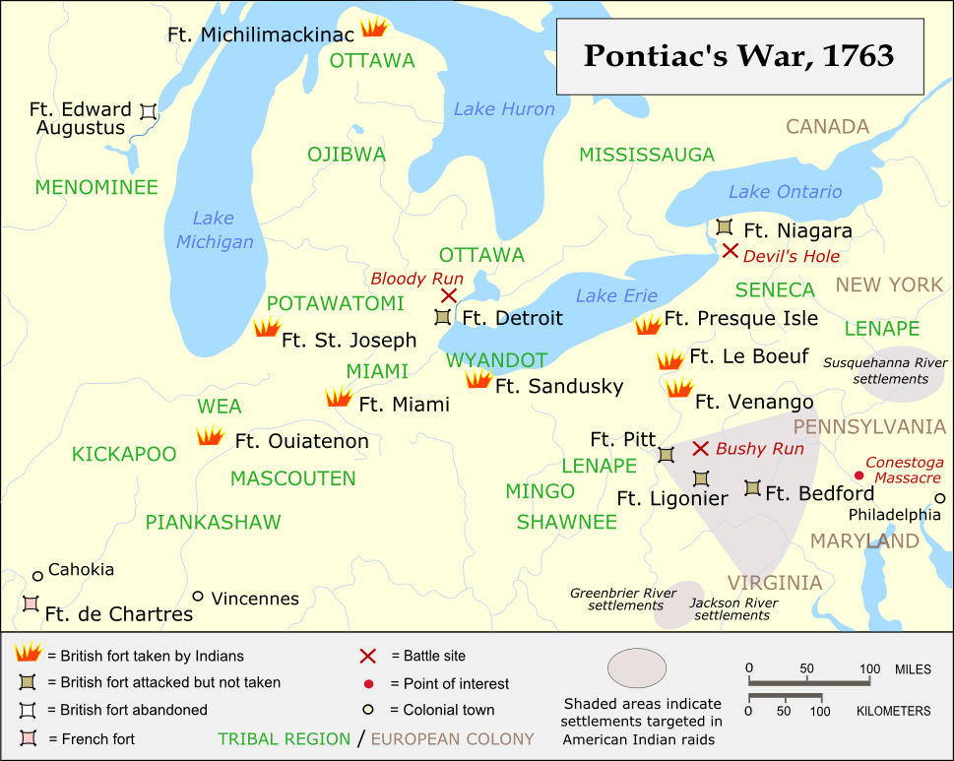
Britain Makes some rules
Pontiac’s Rebellion: Native American rebellion against colonists in Great Lakes
Britain saw the need to limit where colonists can go
Proclamation of 1763: outlawed colonists from settling west of Appalachian Mountains (Indian Land)
Upsets colonists
Britain cannot enforce it (too far away)

Slide 8
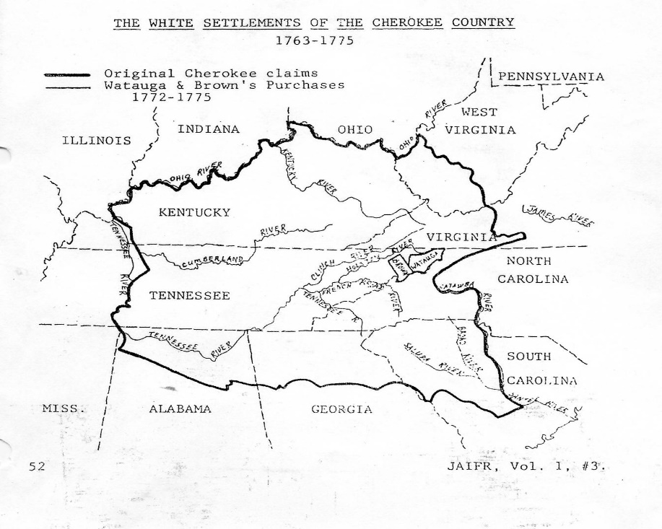
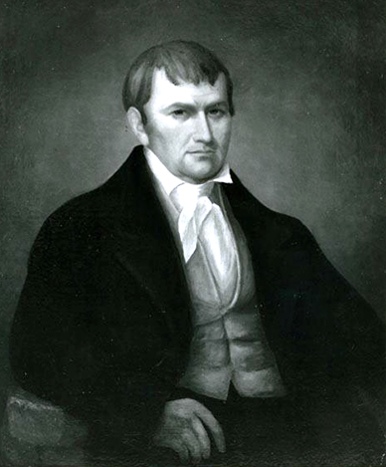
Tennessee Settlement
Colonists ignore British and continue to settle in west
Watauga Settlement: first settlement in Tennessee
Land bought from Cherokee Indians- still conflict with Cherokee
Sets up a majority-rule government
James Robertson: leaves Watauga and settles at Fort Nashborough
“Father of Middle Tennessee”

Slide 9
Reflection
How did the colonists’ individualism conflict with Britain’s newfound need for control?

