Slide 1
Indian Removal

Slide 2
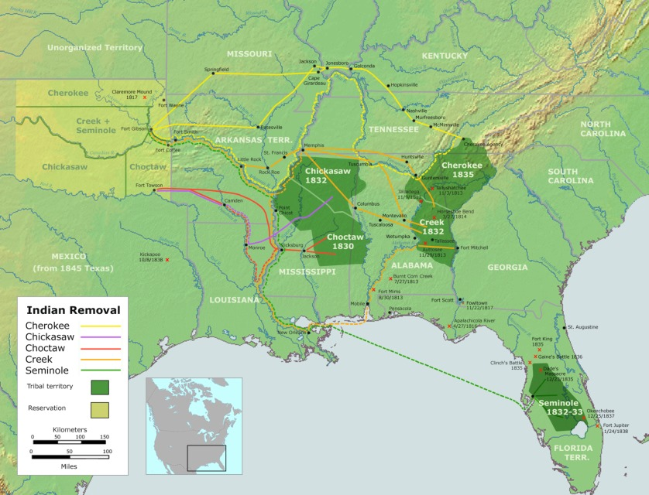
Location of Native Americans
Native Americans are located everywhere
Concentration in the South

Slide 3
What Americans wanted
Americans wanted the land that Native Americans lived on.
Many believed this was necessary for America to grow
Jackson disliked Native Americans and had fought them many times
He was committed to relocate them to the west

Slide 4
Indian Removal Act
Indian Removal Act: law passed that required Native Americans to relocate west of the Mississippi river.
Jackson believed moving Indians west was best for everyone
Natives would be able to practice their own culture without interference
Americans would be able to use the land Natives were on to make money (Cotton and Slaves)

Slide 5
Cherokee Indians
Cherokees were much more advanced than many tribes who still did not have a written language
Cherokee Indian Sequoyah had invented an alphabet and writing system for Cherokees
Allowed Cherokees to communicate among each other and become better educated
With this, Cherokees challenged the Indian Removal Act through the government system

Slide 6
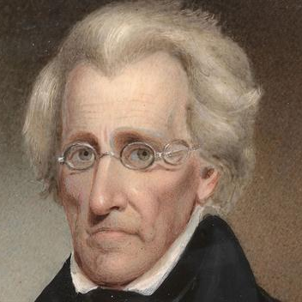
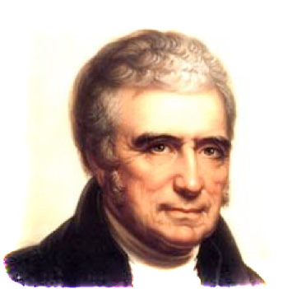
Native American Challenge
Cherokee Indians refused to sell their land and move west
They challenged law in the Supreme Court
Worcester v. Georgia: Case where Cherokees challenged Georgia’s ability to enforce the Indian Removal Act
John Marshall stated Georgia could NOT make Cherokee leave their land
Jackson ignored Marshall and forced the Cherokee to move west
“Marshall made his decision, now let him enforce it.”
“Government cannot force Indians to move”
JACKSON
MARSHALL

Slide 7
Discussion
Why did Americans want Native American land?
How did the Cherokee Indians try to prevent the Indian Removal act?
Do you believe Jackson acted unconstitutionally by ignoring the Supreme Court?

Slide 8
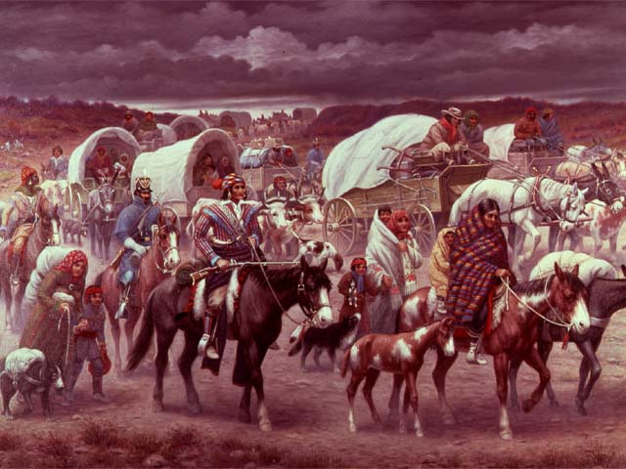
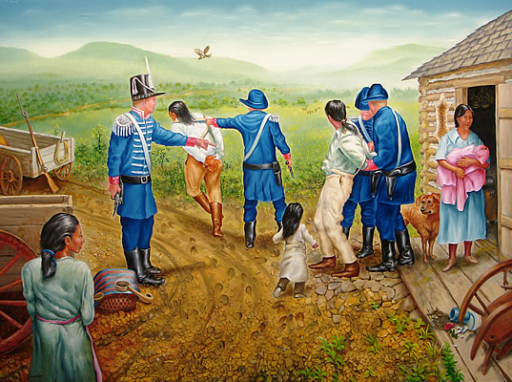
Trail of Tears
Harsh journey of Native Americans to their new home in the “Indian Territory”
Armed soldiers took Native Americans from their homes with nothing more than the clothes on their backs
They were forced to travel through the fall and winter in terrible conditions
¼ of Native Americans died during this journey

Slide 9
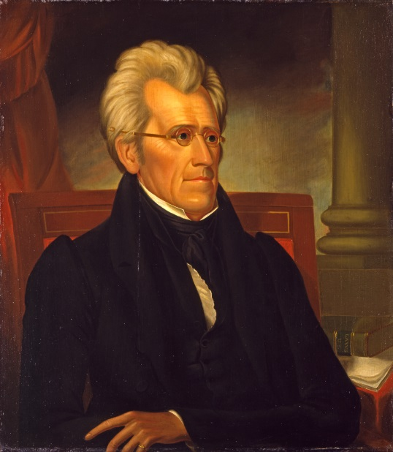
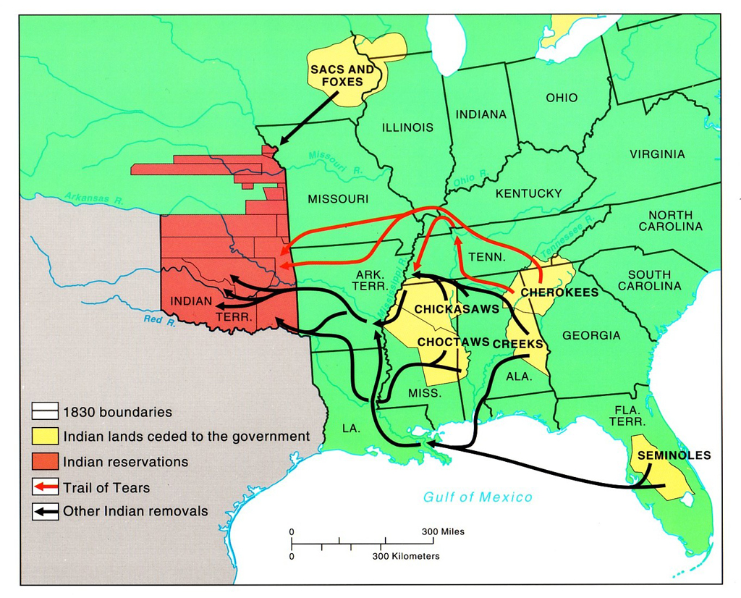

Slide 10
Primary Source
Trail of Tears
“Murder is murder, and somebody must answer. Somebody must explain the streams of blood that flowed in the Indian country in the summer of 1838. Somebody must explain the 4000 silent graves that mark the trail of the Cherokees to their exile. I wish I could forget it all, but the picture of 645 wagons lumbering over the frozen ground with their cargo of suffering humanity still lingers in my memory.”
Who would have most likely said this?

Slide 11
Reflection
Should Jackson be impeached? Why or why not?

