Slide 1
Ending a Revolution

Slide 2
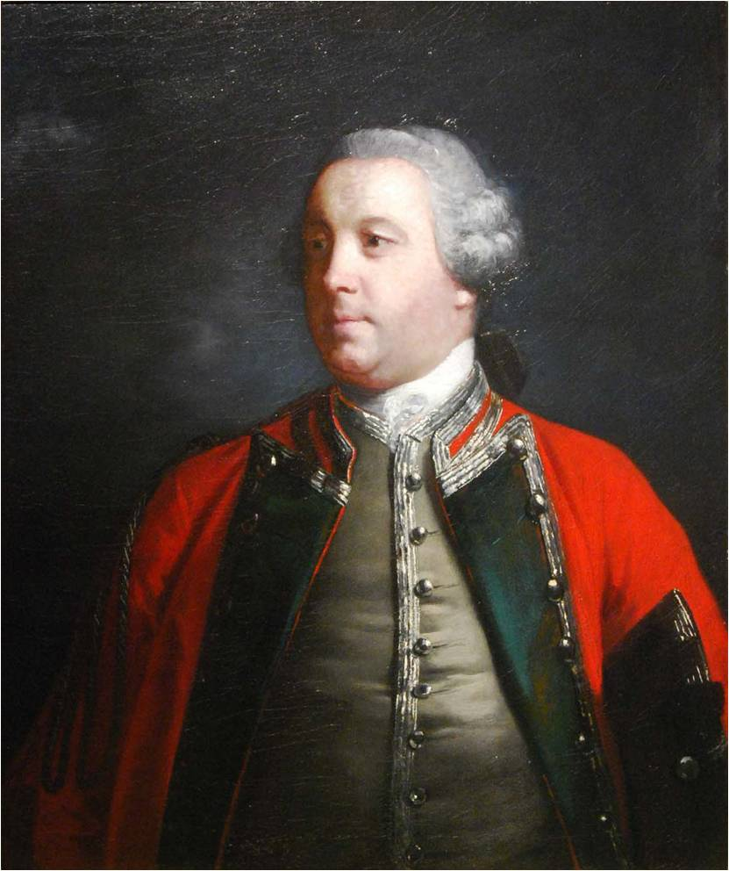
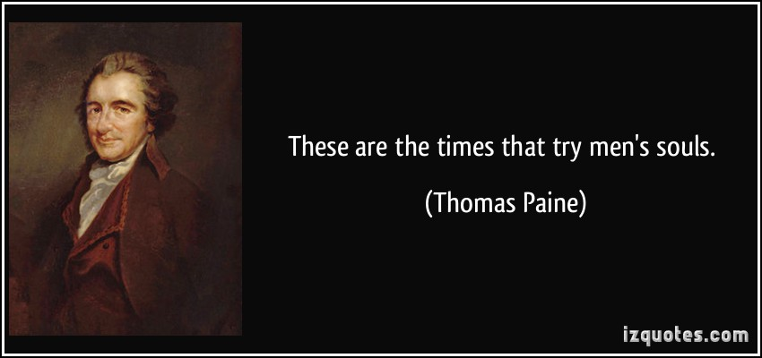
America on the Verge
Many Americans were wondering whether or not to continue supporting war
Thomas Paine writes another pamphlet The Crisis
Convinced many soldiers to continue fighting in the war
British strategy changes to focusing on Southern Colonies
Utilize loyalist support to make South give up
British place new man in charge, Lord Cornwallis

Slide 3
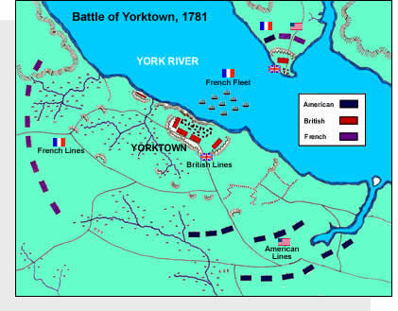
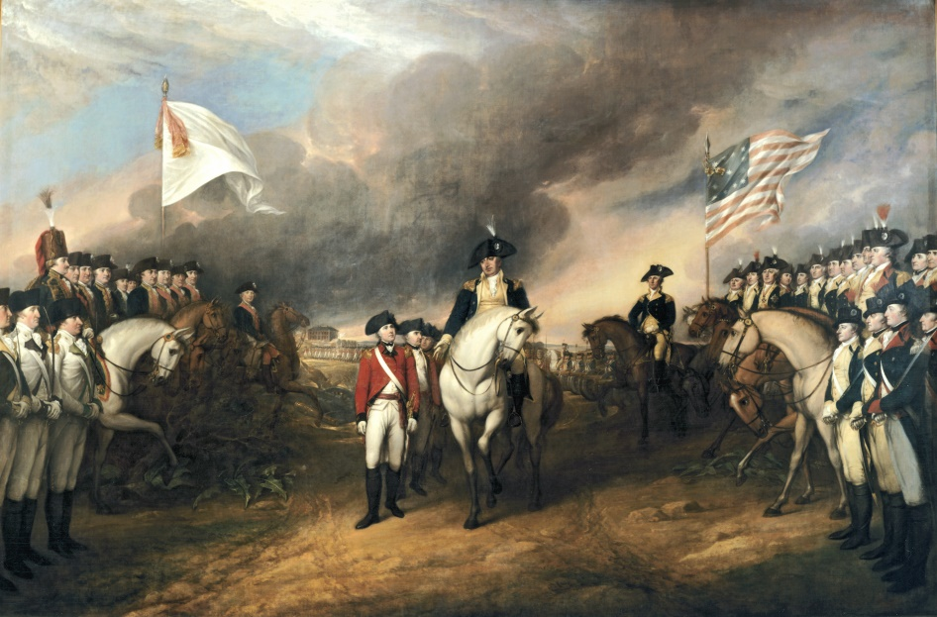
Yorktown
Cornwallis underestimates the colonists and makes poor decision to take his men to Yorktown (a peninsula)
Continental army surrounds British on land, French navy shows up to trap them by sea
Cornwallis forced to surrender to Washington

Slide 4
Discussion
How did Thomas Paine again save the American Revolution?
Why did the British believe changing strategy to focusing on the South would work better?
Predict what the outcomes of the war will be.

Slide 5
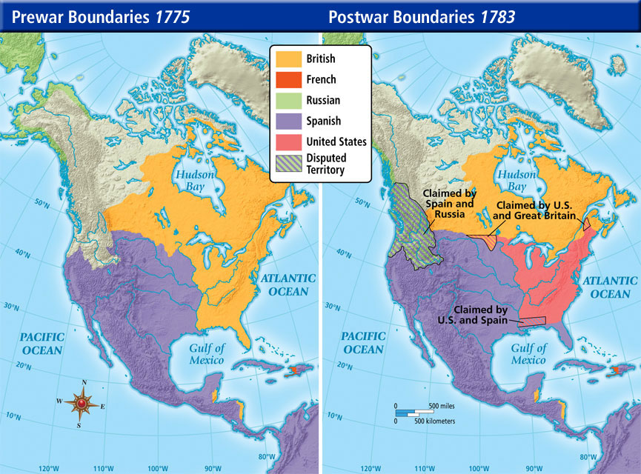
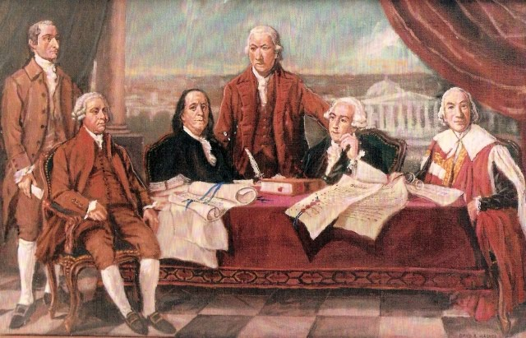
Effects of the War
Treaty of Paris signed; ends the war (more a result of the British becoming tired of the war)
Britain recognizes American independence
Britain agree to give up all claims of territory of 13 colonies including Ohio River Valley
Problems for America- what to do now?
No economy
No continental government
British still in Canada

Slide 6
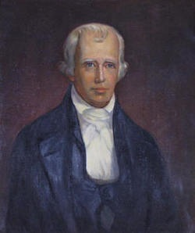
Impact on Tennessee
Cherokee Indians in Tennessee (Watauga) side with Britain
Although there was a tough past, Britain did not want expansion west into Tennessee, Americans (Wataugans) did
John Donelson and James Robertson travel to middle Tennessee create Nashville to escape pressure from Britain and Cherokee
Conflict with Cherokee Indians increased
Battle of the Bluffs: Cherokee led by Dragging Canoe attack Nashville and fail to take it

Slide 7
Reflection
What was the most important effect of the Revolution?

