Slide 1
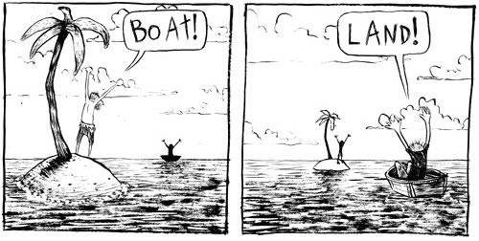
Point of View
How can the same event be viewed so differently?

Slide 2
Election of 1860
Goals:
Evaluate the 4 candidates of the election of 1860 and how the campaign reflected sectionalism of the country.
Examine the impact of Lincoln’s inaugural address

Slide 3
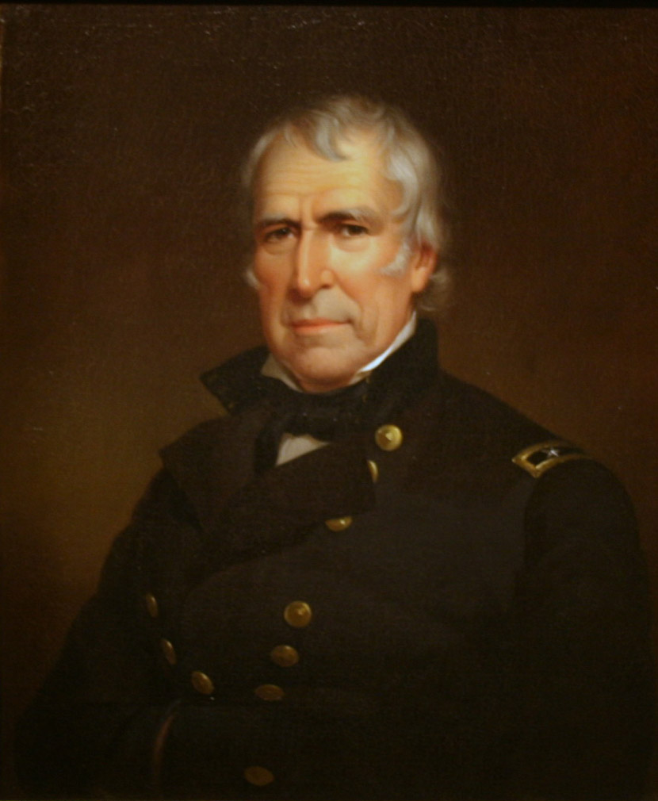
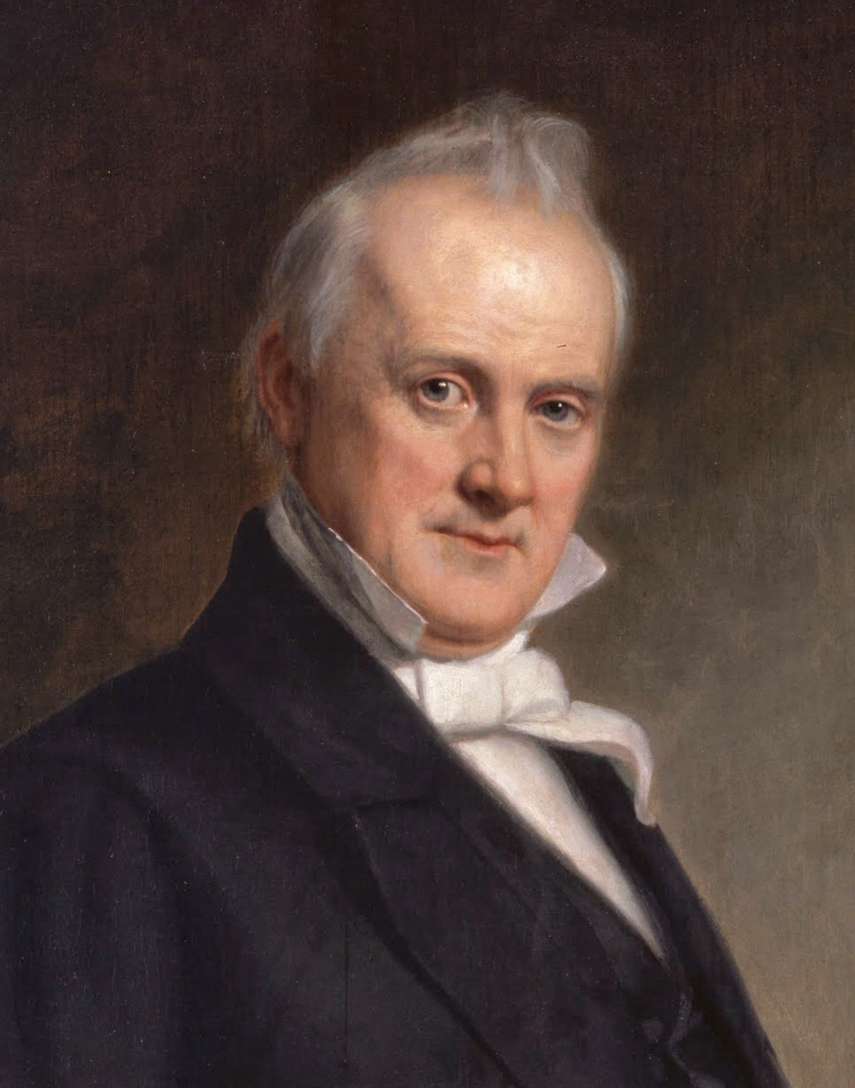
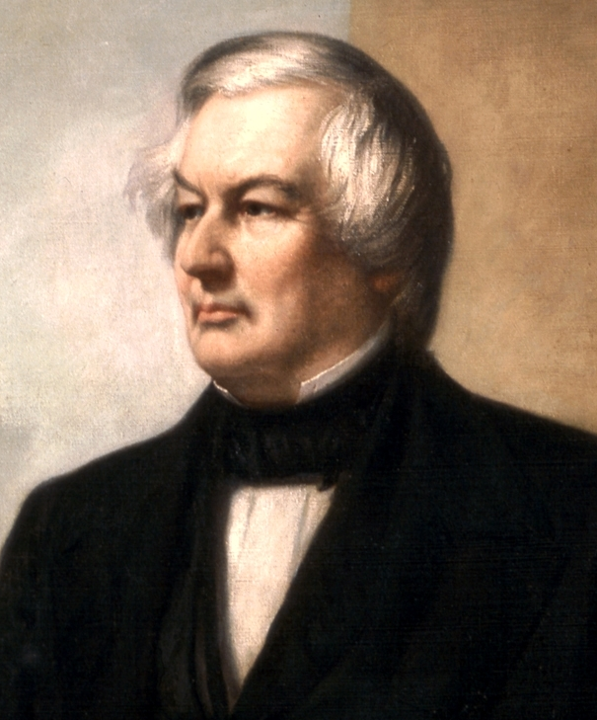
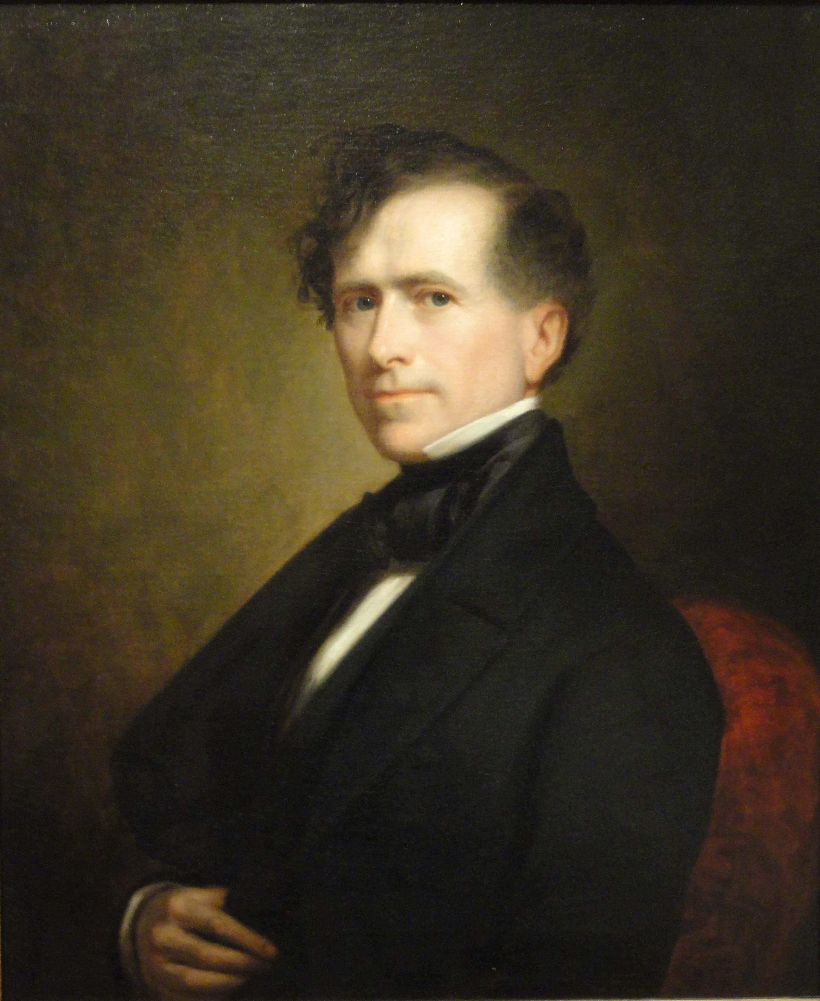
“Forgotten Presidents”
1849-1850 Zachary Taylor (Whig)
1850-1853 Millard Fillmore (Whig)
1853-1857 Franklin Pierce (Democrat)
1857-1861 James Buchanan (Democrat)
All four were ineffective at preventing the Civil War because they did not deal with the issue of slavery

Slide 4
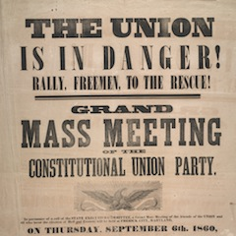
Election of 1860 issues
The Democratic Party splits between North and South over slavery
Northern Democrats want popular sovereignty on the slavery issue (ignore it)
Southern Democrats want government to fully protect slavery
Republican Party wants to stop the expansion of slavery
New third party: Constitutional Union Party wants everyone to just get along (save the Union)

Slide 5
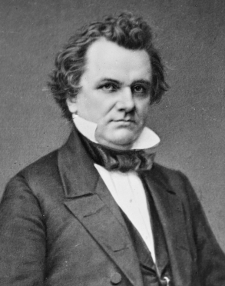
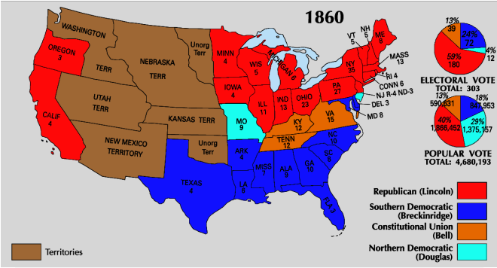
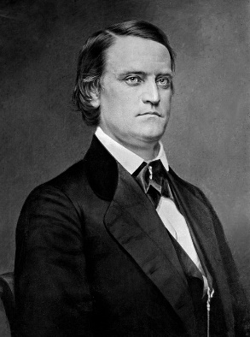
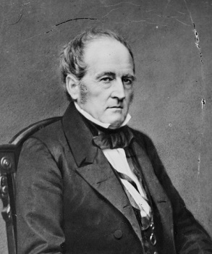
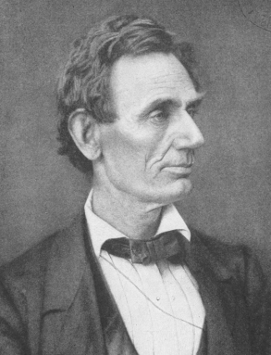
Election of 1860 Results
Candidates:
Northern Democrats: Stephen Douglas
Southern Democrats: John C. Breckenridge
Constitutional Union: John Bell (Tennessee)
Republicans: Abraham Lincoln
With Democrats split, the Republican Lincoln is able
to win the election

Slide 6
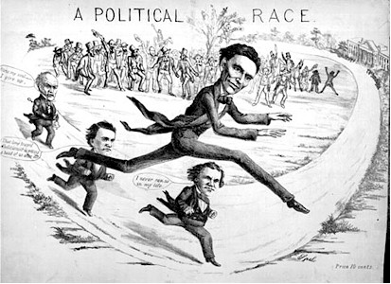

Slide 7
Discussion
Who were the 4 candidates in the election of 1860? Who won the election?
How would Northerners feel about the results of this election?
How would Southerners feel about the results of the election?

Slide 8
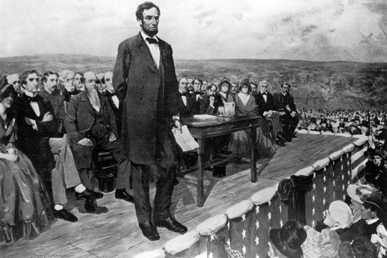
Lincoln’s Promise
Lincoln and Republicans promised they were not going to get rid of slavery in the South
Only stop it from expanding
Southerners don’t buy it
Southern states had said they would secede if Lincoln was elected and now had a choice to make

Slide 9
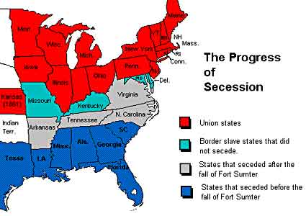
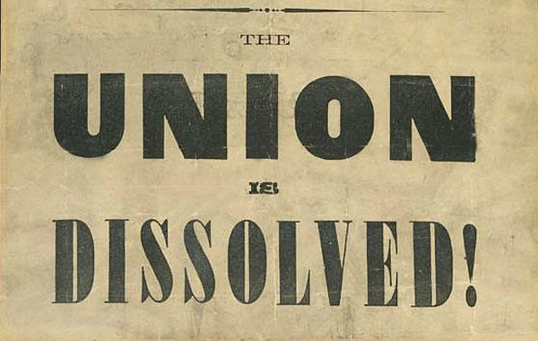
Lincoln addresses Secession
Lincoln tells Southern states he cannot allow secession
Vows to hold federal property in the South
Pleaded with South to avoid civil war
South Carolina seceded from the Union and many other Southern states followed

Slide 10
Reflection
How can the Election of 1860 be seen so differently by North and South?

Slide 11
Southern Secession

Slide 12
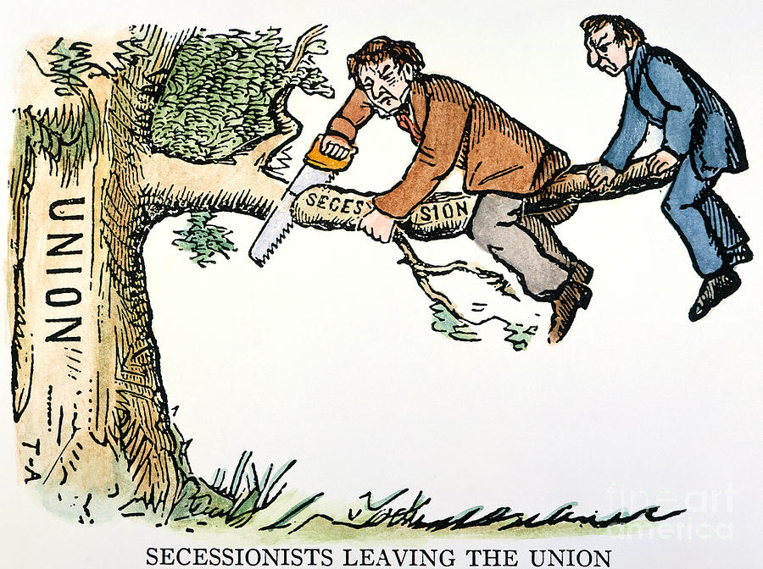
Southern Secession
Southern states believed they had the right to secede (states’ rights)
Many Southerners supported secession (breaking away from the Union) and believed they were justified in doing so
Crittenden Compromise: Senator John Crittenden’s last ditch effort to save the Union
Included protection of slavery in the South
Rejected by North and South

Slide 13
Secession
South Carolina begins secession, 6 other states follow (Alabama, Mississippi, Georgia, Florida, Texas, and Louisiana)-Virginia, Arkansas, North Carolina, Tennessee join after the Siege of Fort Sumter.
These states come together to for the Confederate States of America (think Articles of Confederation type government)

Slide 14
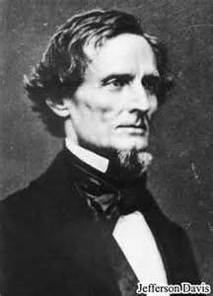
Fort Sumter
Fort Sumter: Union fort in Charleston, South Carolina
Confederacy demanded the forts surrender
The fort was low on supplies and needed help from Lincoln, which he sends
Jefferson Davis (Confederate President) orders troops to attack and take the fort
They succeed and force Lincoln to issue a call for troops from the Union to go to war

Slide 15
Reflection
How did the Election of 1860 reflect sectionalism in America?

