Slide 1
Economic Boom

Slide 2
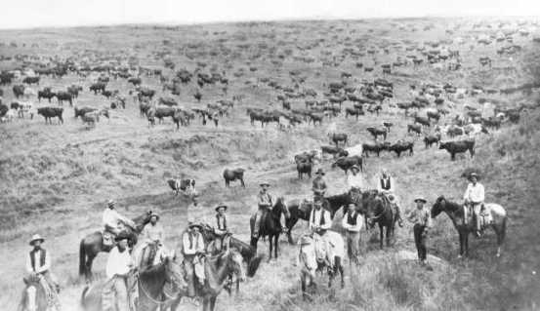
Agriculture
South: Southern planters could no longer rely solely on Cotton
Began branching out to other crops
West: Settlers moving west battled the harsh climate
Great Plains- Growing crops like Wheat and Corn “Bread Basket”
Cattle- Texas and other states in west become “open ranges” where cattle grazed unlimited.
North: Fairly limited and really only corn and wheat

Slide 3
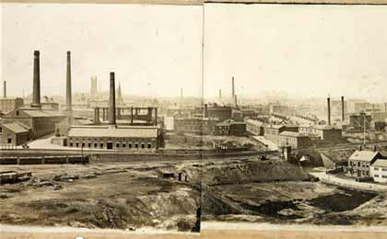
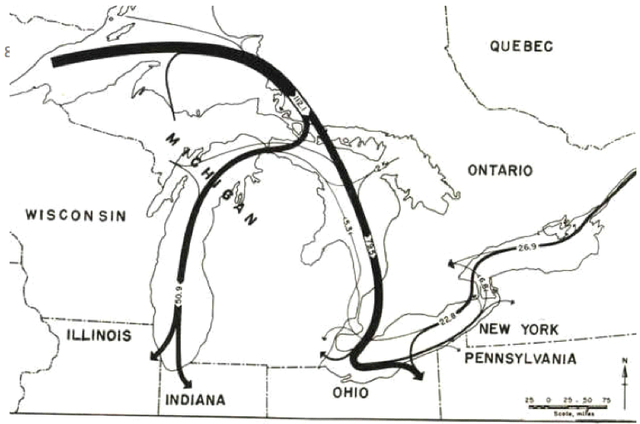
Industry
South: Majorly lacking
South devastated by Civil War but still lacked industry then
West: Nearly no industry early on due to lack of resources and people
North: dominated American manufacturing
Textile mills
Steel industry gets big with iron ore deposits from Great Lakes

Slide 4
Discussion
How can over focusing too much on one thing (agriculture or industry) hurt an economy?
Which region did the West seem to model itself after North or South?
Predict what might happen to add a huge boost to the economy of the west?

Slide 5
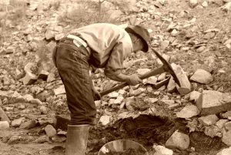
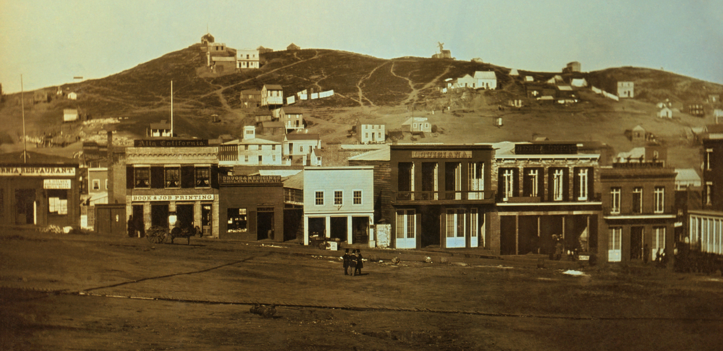
New Economy in the West
The west brought with it new opportunities and new resources.
Mining becomes a major draw of the West
Gold and Silver huge early on
Copper, Lead, and Zinc come after
Creates “Boomtowns”
Towns that spring up to support mining operations (usually become Ghost towns after)

Slide 7
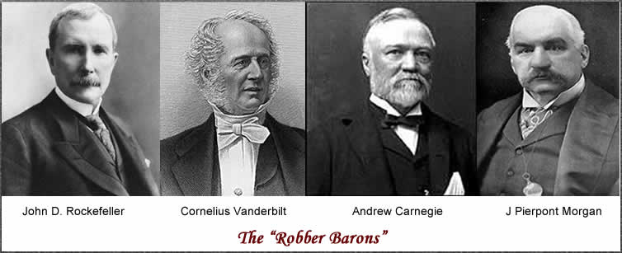
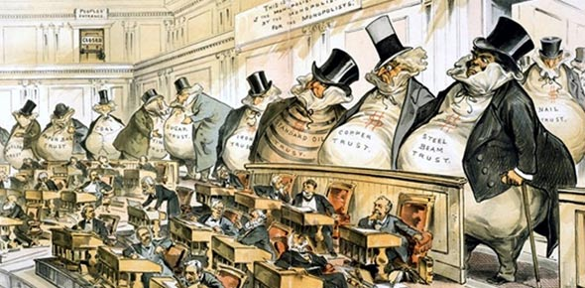
“Gilded Age”
With the slavery and states’ rights issues solved, American turned its focus to making money
A new class of ultra rich replaced former slave owners- wealthy industrialists
As industries rose, so did money made by them
Rich got SUPER rich
Poor got SUPER poor (immigrants)
Everyone else did ok

Slide 8
