Slide 1
Daily Quiz
Who was the commander of Union forces in the West?
Robert E. Lee
Ulysses S. Grant
“Stonewall” Jackson
Jefferson Davis
Which of the following battles took place in Tennessee?
Shiloh
First Bull Run
Fort Sumter
Manassas

Slide 2
Daily Quiz
3. What does this political cartoon represent?
Anaconda Plan – the Confederacy’s plan to defeat the Union
Anaconda Plan – the Union’s plan to defeat the Confederacy
Anaconda Plan – Europe’s plan to get cotton
Anaconda Plan – The route the confederate armies planned to march on

Slide 3
Daily Quiz
4. Who was responsible for commanding the Union’s navy and having a victory at New Orleans?
a. Ulysses S. Grant
b. David Farragut
c. General McClellan
d. Robert E. Lee

Slide 4
Eastern Theatre

Slide 5
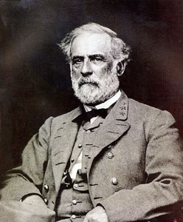
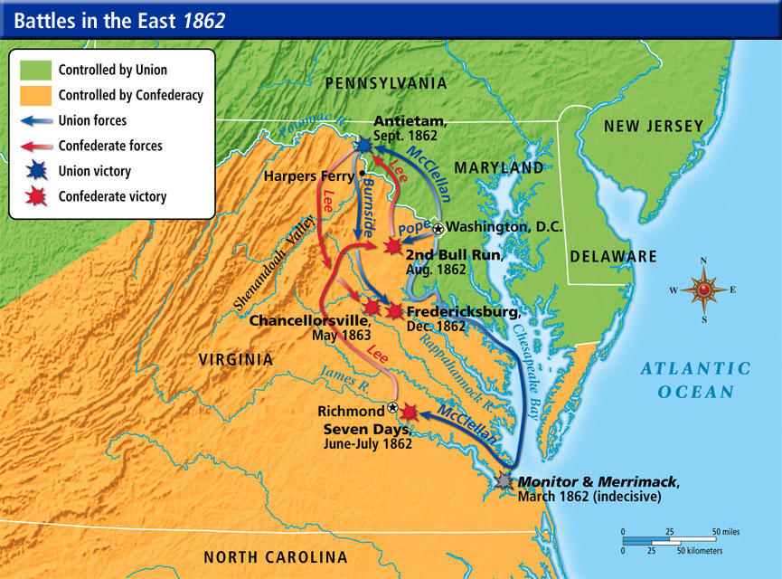
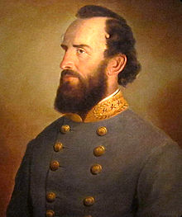
Different than the West
Confederacy enjoyed early victories in the East
General Robert E. Lee: very effective military leader for Confederacy
Lee is able to score victories over larger Union armies with help from Stonewall Jackson
Fredericksburg and Chancellorsville

Slide 6
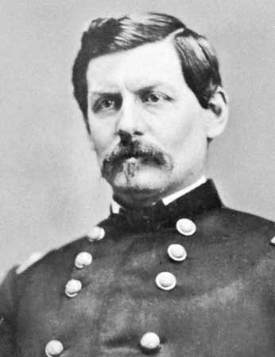
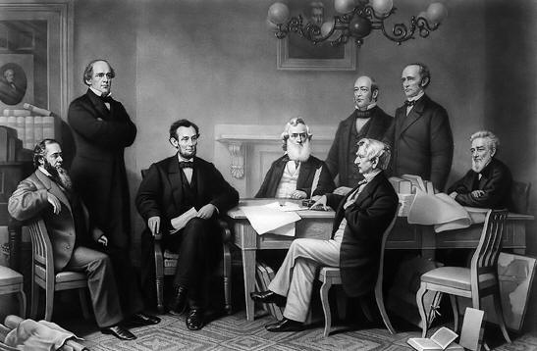
Union’s Issues
Union General in the East George McClellan received much of the blame
Many believed he was too cautious
Lincoln worried that these losses would turn the attitude of the North against the war
Many in the Union began questioning if they could win the war

Slide 7
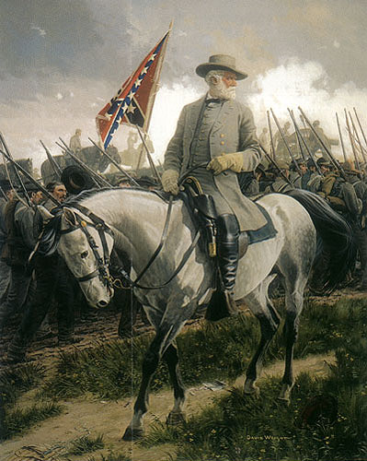
Confederate’s Strategy
After these victories, the Confederacy believed the Union was near its breaking point
Jefferson Davis (President of the Confederacy)urged Lee to invade the North
Hoped to bring the war to the people of the North and break their spirit
Lee invaded Maryland to put pressure on the North
Also, needed supplies

Slide 8
Discussion
Why were the Confederates able to get so many early victories in the East?
How would McClellan’s way of war cause issues for the Union considering their strategy?
Why would the Confederates change their strategy when it had been working so well?

Slide 9
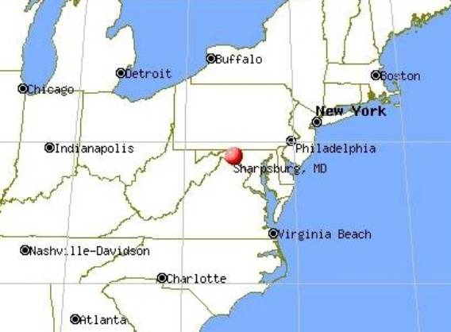
Battle of Antietam
McClellan is informed of Lee’s battle plan by spies
However, does not act on immediately
Lee finds out he knows and changes plans
The two sides meet in the single bloodiest day in American history.
Nearly 23,000 casualties in one day
The Union wins the battle and stops Lee’s advance to the North
Lee retreats back to the South

Slide 10
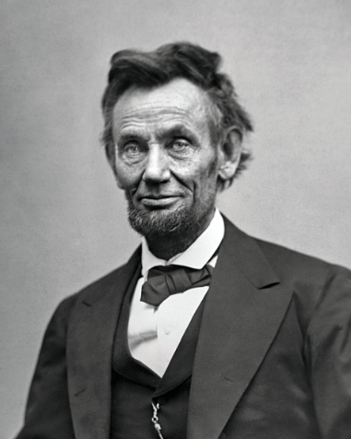
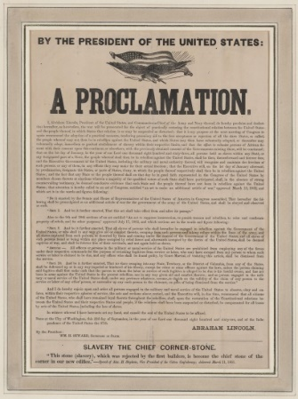
Emancipation Proclamation
Following Antietam, Lincoln decides it is best for the war to end slavery in the South after Antietam
Constitution does not let him do this BUT it does let him take property in wartime
Lincoln issues the Emancipation Proclamation
Freed all slaves in Confederate states (not in border states he feared they would join Confederacy)
Issued as a military action to hurt the South’s economy
Makes the new Union goal in the war to end slavery

Slide 11
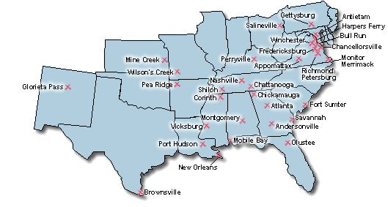
Civil War Battles

Slide 12
Reflection
What did the Emancipation Proclamation actually do? How may this impact the war?

