Slide 1
Early Years of the Revolution

Slide 2
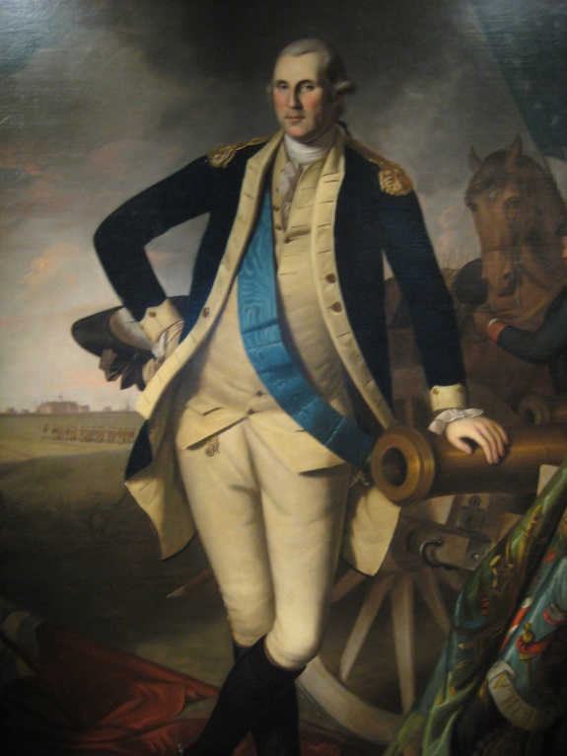
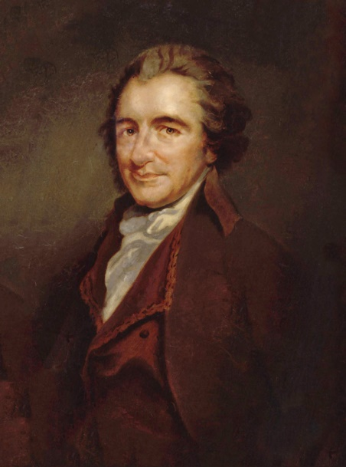
Selling the War to the Colonies
Following the Declaration of Independence, General George Washington is placed in command of the Continental Army
The official army of the colonies
Minutemen were citizens who joined militias to fight
Many colonists were still unsure of the decision to declare independence (those who were neutral)
Thomas Paine wrote a pamphlet called Common Sense
Argued in favor of American Independence
America did not belong to Britain but all of Europe
Convinced many colonists to support the Patriot cause

Slide 3
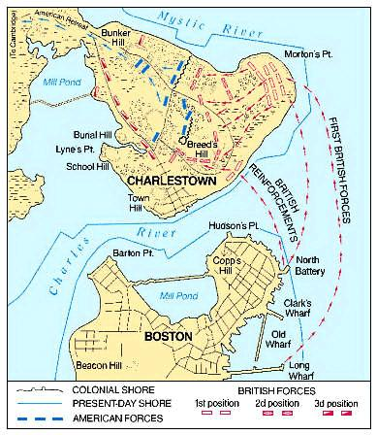
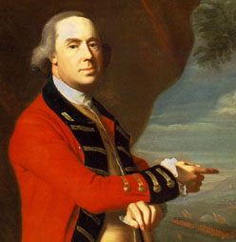
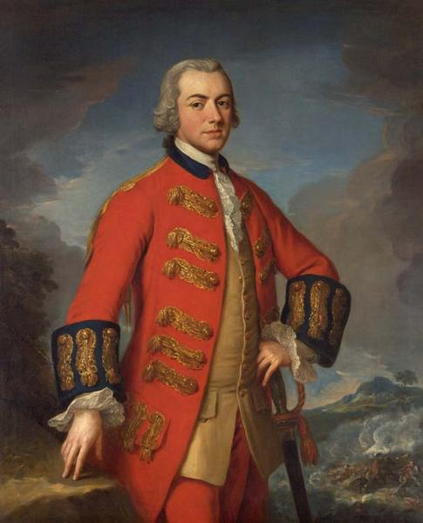
The War in New England
Following the retreat of British soldiers from Lexington and Concord, the British found themselves surrounded in Boston
Battle of Bunker Hill took place outside Boston
British victory (kept Americans from taking the hill)
British losses were staggering (really not much of a win)
British General Thomas Gage, the man in charge was removed from command and the more skilled General William Howe replaced him

Slide 4
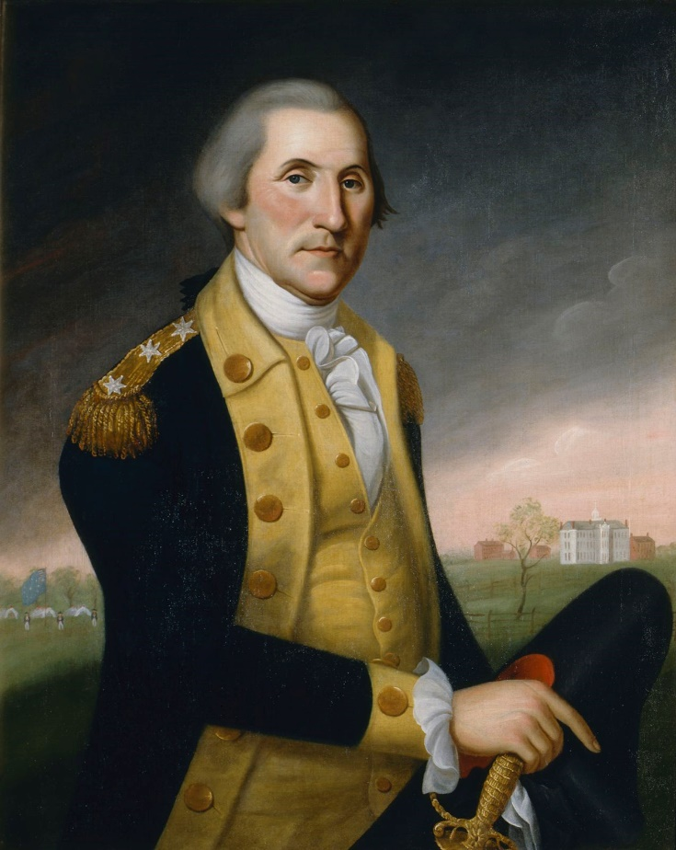
Moving to New York
General Howe was able to move his men out of Boston
British regrouped and invaded Long Island and New York City
General Washington attempted to stop the invasion but was soundly beaten
Washington moved his men to Pennsylvania before the British stopped their advance
This defeat was hard on the Continental Army and support began to waiver.

Slide 5
Discussion
How did Thomas Paine’s Common Sense convince colonists to support the independence effort?
What problems can arise if a general does not have the support of his soldiers? How could that general get the support back?

Slide 6
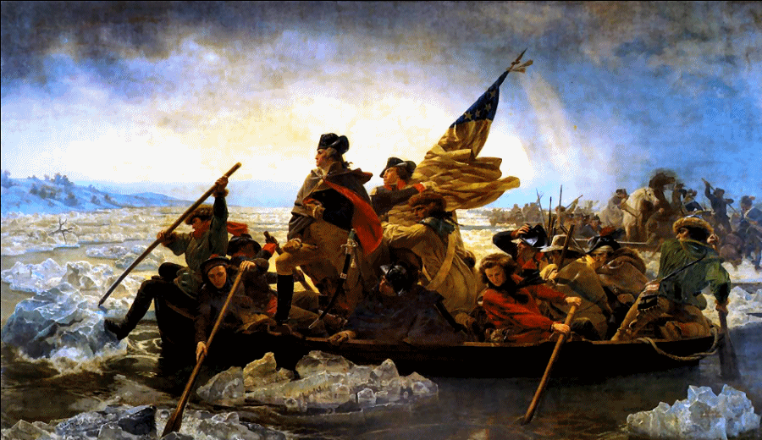
Washington’s Surprise
After a major defeat, Washington needed a string of victories
Soldiers were beginning to question leaving the army
Washington needed a morale boost
Battle of Trenton and Princeton
Washington plans a surprise attack on the British and Hessian (German mercenaries fighting for the British)
Washington’s sneak attack gave the Americans two major victories
Convinced soldiers to reenlist for another year

Slide 7
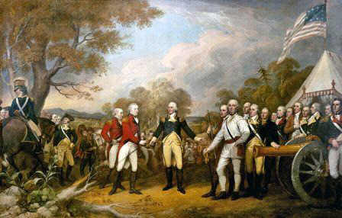
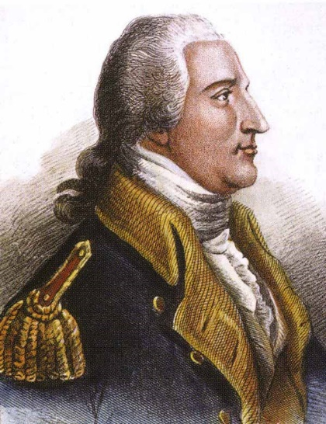
Turning Point
Britain changed its strategy
They believed New England was center of the rebellion
Strategy: Cut New England off from rest of colonies
Not everyone agreed, General Howe instead captured Philadelphia
Hoped capturing a major city would force colonists to give up
Battle of Saratoga
British fail to combine their armies and American forces score a major victory in New York
General Benedict Arnold helps lead the American victory
TURNING POINT OF THE WAR

Slide 8
Reflection
Why was the Battle of Saratoga important?

