Slide 1
Declaring Independence

Slide 2
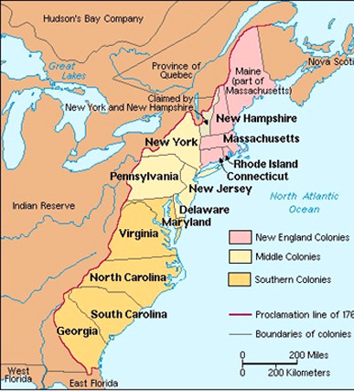
The Intolerable Time
Colonists from all over see the Intolerable Acts as a direct attack on colonial freedom
Still many were hesitant to take up arms against the most power empire in the world (Britain)
Boston was more than willing to fight as they were directly involved
Other colonies (especially New York and the Southern Colonies) were cautious

Slide 3
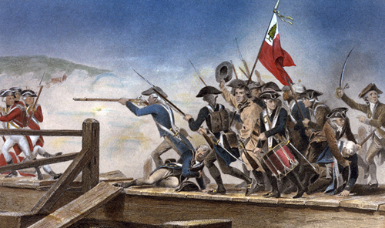
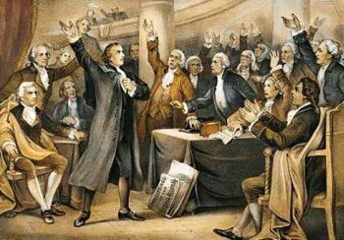
Lexington and Concord
When the British arrive, Sam Adams and John Hancock had escaped and most of the weapons removed
A battle ensued between British soldiers and Boston militia
“The Shot Heard Round the World”
Britain was out matched and forced to return to Boston
Other colonies began rushing to Boston’s defense
Patrick Henry, a member of the House of Burgesses in Virginia, gave an exciting speech in support of declaring independence. (Give me Liberty, or give me Death!)

Slide 4
Discussion
“Gentlemen may cry, Peace, Peace! but there is no peace. The war is actually begun! The next gale that sweeps from the north will bring to our ears the clash of resounding arms! Our brethren are already in the field! Why stand we here idle? What is it that gentlemen wish? What would they have? Is life so dear, or peace so sweet, as to be purchased at the price of chains and slavery? Forbid it, Almighty God! I know not what course others may take; but as for me, give me liberty or give me death!
-- Patrick Henry, Speech to the Virginia Convention, 1775
Why was it important for Patrick Henry (who was from Virginia) to give this speech?
What is Patrick Henry asking for?

Slide 5
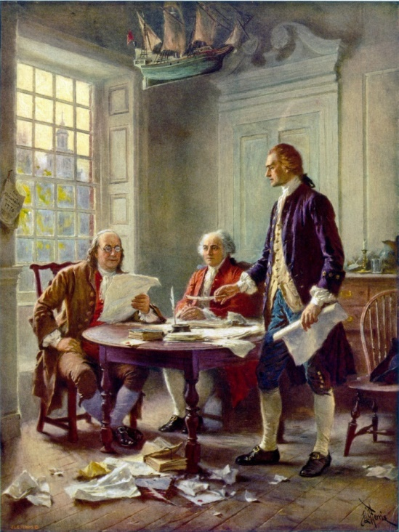
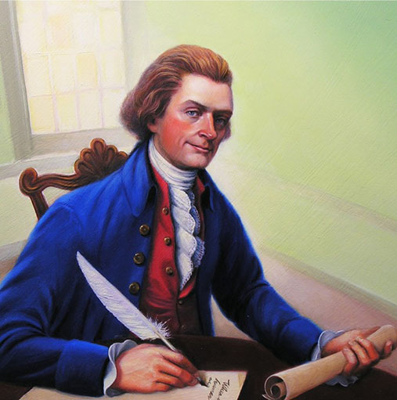
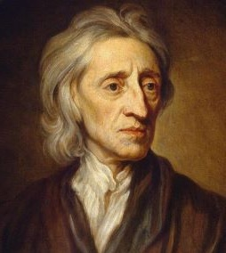
Second Continental Congress
Colonial leaders met at the Second Continental Congress in 1775
They needed a plan following Lexington and Concord
They chose a committee to write a Declaration of Independence
Thomas Jefferson picked as the primary author
Ben Franklin and John Adams served as editors
Jefferson used the ideas of philosopher John Locke (natural rights)

Slide 6
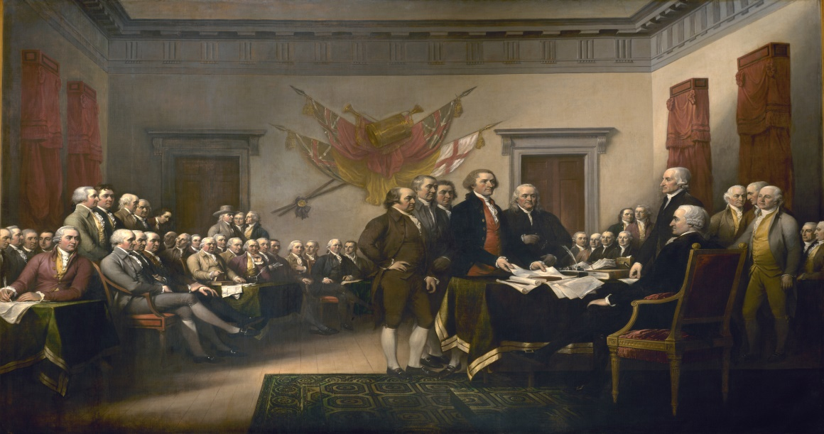
The Declaration of Independence
Major Points:
1. All men are created equal
2. Men have inalienable rights of life, liberty, pursuit of happiness (“natural rights” from John Locke)
3. Governments are instituted to secure natural rights
4. If Government does not protect rights then people have a duty to alter or abolish it
Attempted to prove independence was right by listing all their problems with the king (27 things)

Slide 7
Reflection
Do you believe declaring independence was the right move for the colonists? (consider what comes next) Why or Why not?

