Slide 1
Creating America

Slide 2
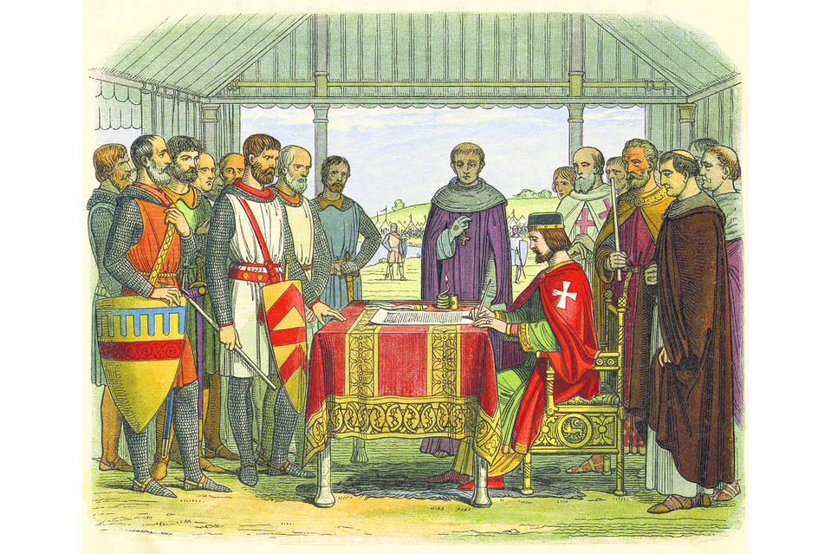
Historical Influence
Since many Americans had British heritage, they relied on British government ideas
Magna Carta: Signed in 1215 and forced the King to follow the laws/ limited his power
English Bill of Rights: Laid out the rights of ALL people in Britain
Mayflower Compact: Majority Rule (Democracy)

Slide 3
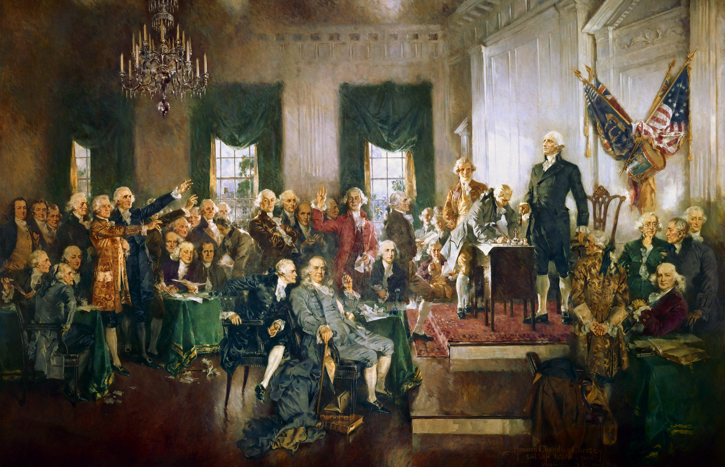
Constitutional Convention
Leaders met to plan/create a new government
Issues they faced:
Small states v. big states (Representation in the government)
Slavery issue (do they count?)

Slide 4
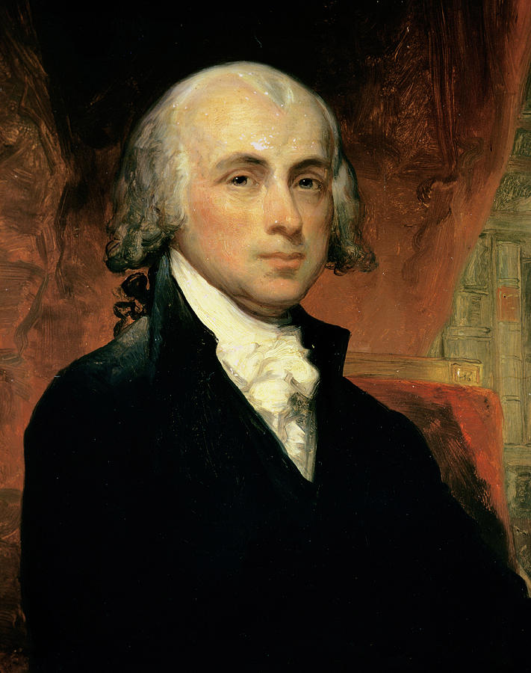
The Plans
Virginia Plan
New Jersey Plan
Strong National Government
Representation in government: based on your population (how many people you have)
Created by James Madison
Favored by larger (more populated) states
Government where states still have a lot of power
Representation in government: equal for all states (every states gets the same number of votes)
Favored by smaller (less populated) states

Slide 5
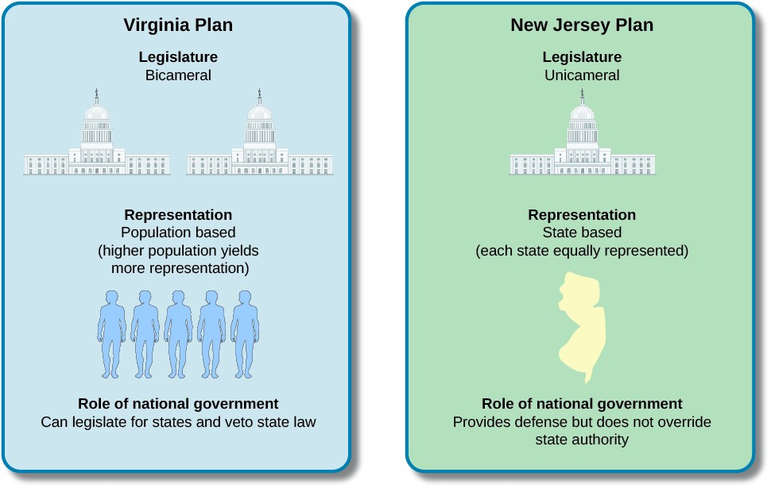

Slide 6
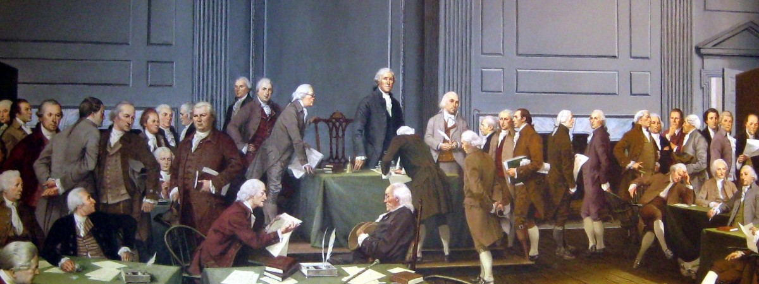
The Great Compromise
Solution for new government; combined the Virginia and New Jersey Plan
The Compromise
Two chambers of Congress
House of Representatives: Representation based on population (Virginia Plan)
Senate: Representation equal for all states (New Jersey Plan)
Power would be split between states and national government

Slide 7
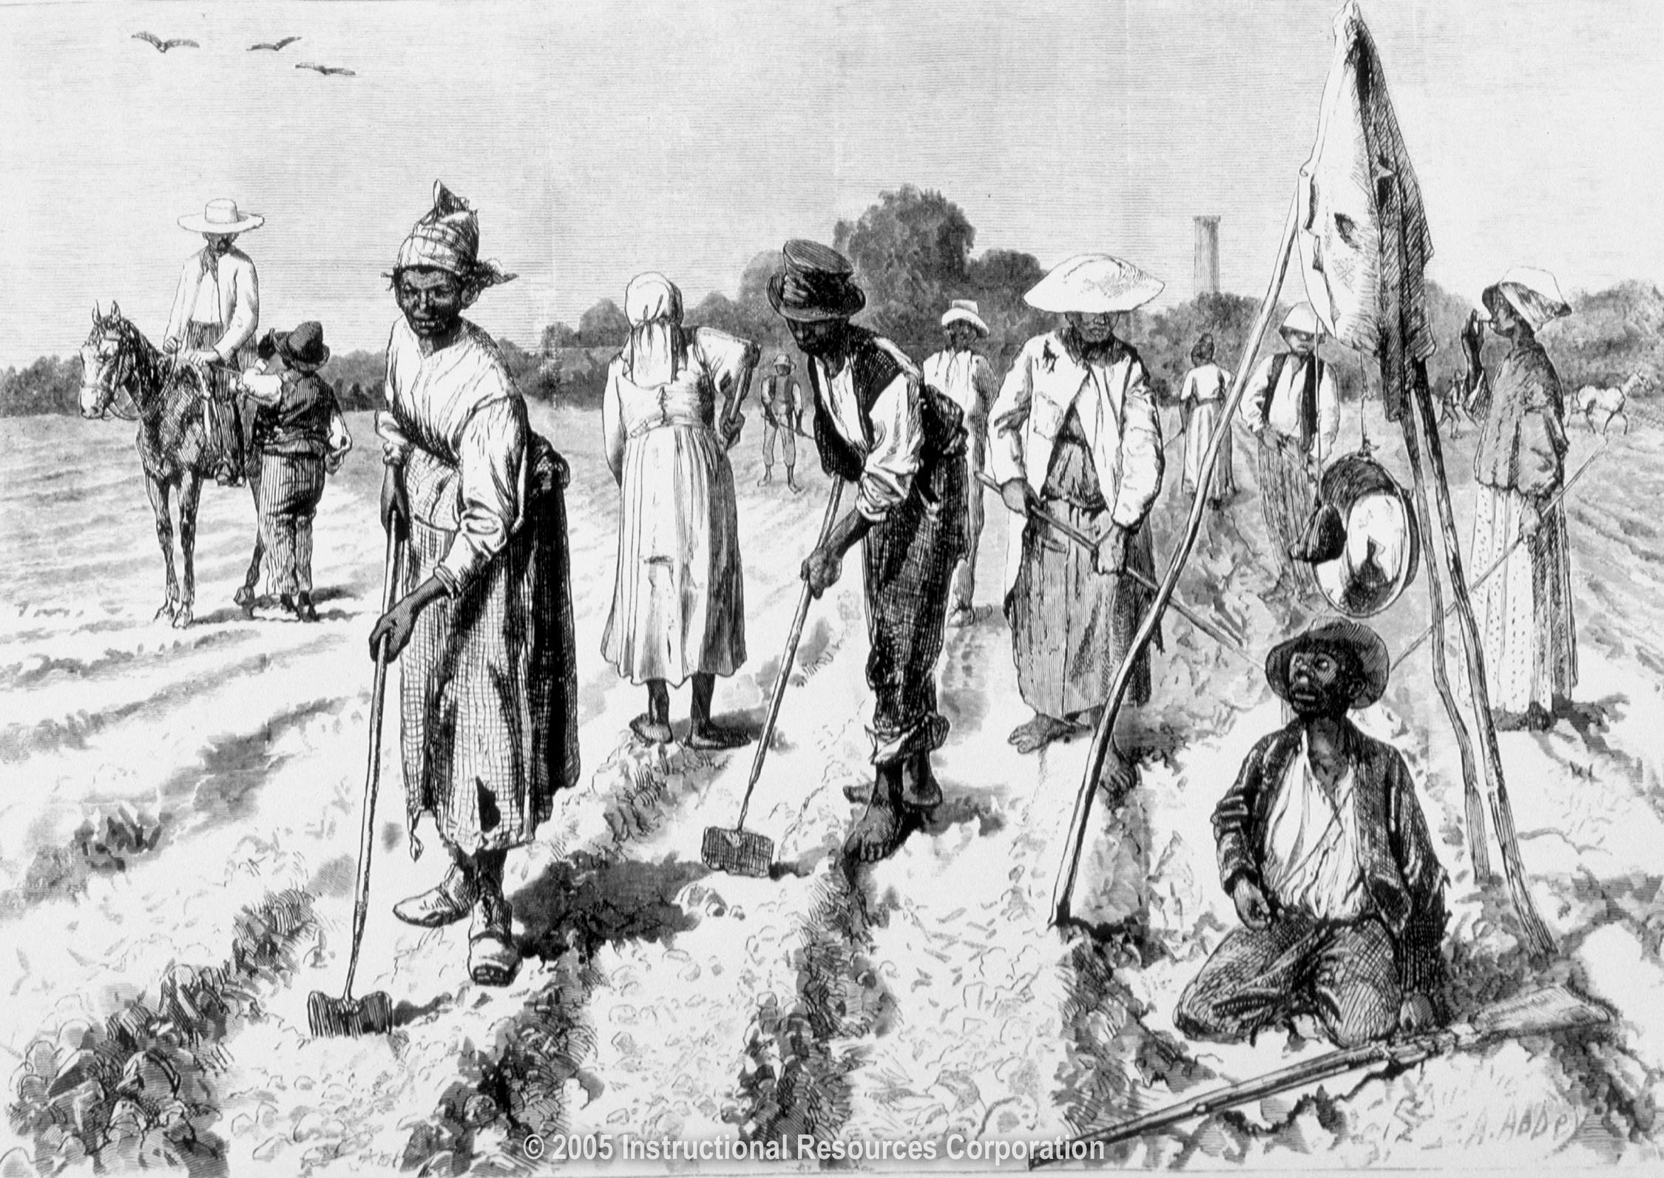
Slavery Issue
Since we are using population in representation, do slaves count?
Northern states: (less slaves) Slaves should not count
Southern states: (more slaves) Slaves should count
3/5 (Three-fifths) Compromise
A state can count 3/5 of their slave population
What they are really saying: A Slave is worth 3/5 a human being

