Slide 1
Contrasting Patriots and Loyalists

Slide 2
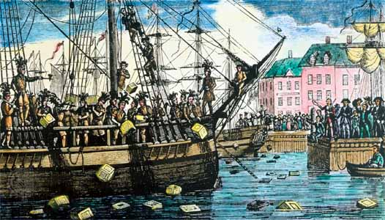
Which Side to Pick?
Colonists did not always agree on situation with Britain.
They split into distinct groups: Patriots and Loyalists.

Slide 3
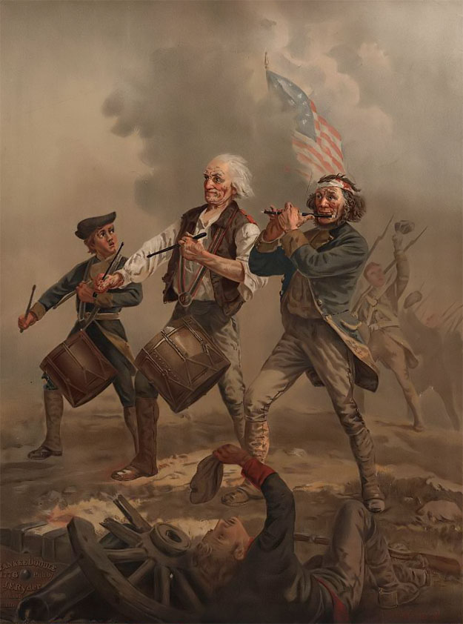
Patriots
Definition: Supported rebellion in colonies
Percent: 40% of colonists
Demographics:
Age: Younger
Social Class: Middle/lower class
Religion: Protestant (various)
Jobs: Farmers, traders, craftspeople
Time in Colonies: Families in colonies for long time (Disconnected from Britain)
Stance on Conflict: Believed the British were illegally taxing colonies (no representation)
Location in Colonies: Concentrated in New England

Slide 4
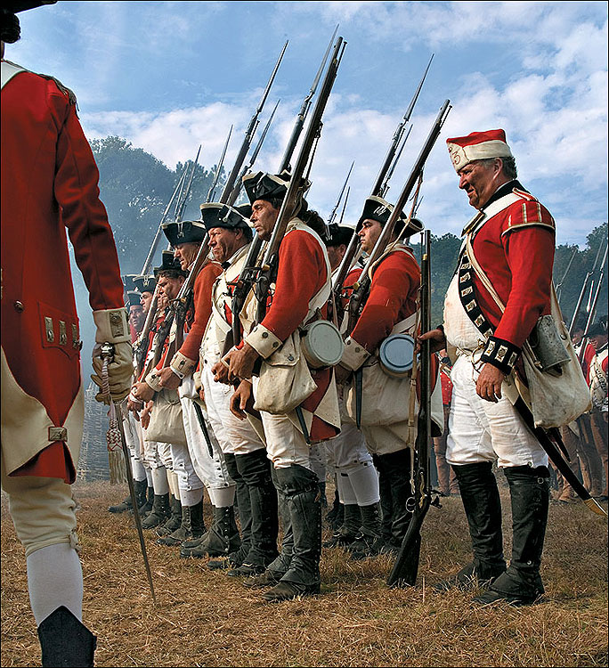
Loyalists
Definition: Supported Britain in war
Percent: 20% of colonists
Demographics:
Age: Older
Social Class: Upper class
Religion: Church of England
Jobs: Held jobs as officials for Britain or land owners and merchants
Time in Colonies: Newer to colonies (many were first generation)
Stance on Conflict: Believed the rebels were unreasonable, Britain has right to tax
Location in Colonies: Concentrated in New York and the South

Slide 5
Discussion
Based on the facts above, where would you fit? Would you have been a Patriot or Loyalist? Or would you have been neutral? Why?

Slide 6
Military differences

Slide 7
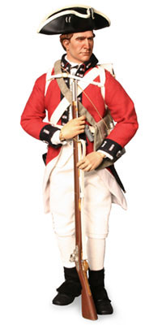
Great Britain
Strengths:
Population (more people)
Wealth (access to $)
Naval Forces
Professional Army
Better Generals
Mercenaries (hired soldier)
Loyalists

Slide 8
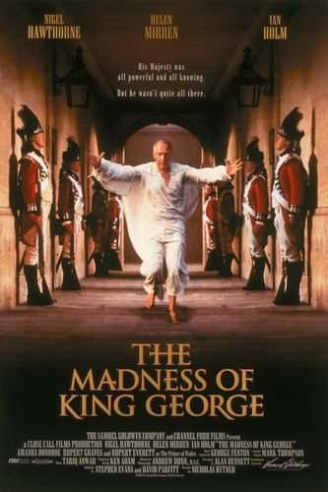
Great Britain
Weaknesses:
British government not smart
Lack of desire to win war
“What really happens if we win?”
Military difficulties
Brutal treatment of soldiers
Undernourished (old, rancid food)
The need for a clear victory
Soldiers were 3,000 miles from home
Vast colonial territory to conquer (and no capital)

Slide 9
American Colonies
Strengths:
Outstanding leadership
Military: George Washington
Foreign Relations: Ben Franklin
Defensive war (defending their home)
Agricultural base in country
Moral advantage – had “just cause”
and believed in what they were fighting for

Slide 10
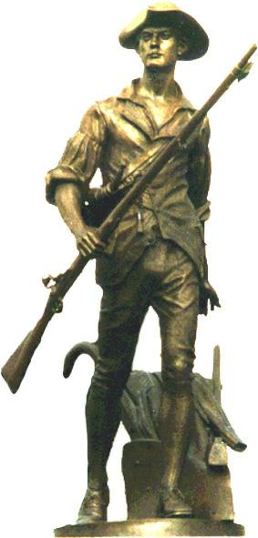
American Colonies
Weaknesses:
Poorly prepared for war
No formal government- who makes the
decisions?
Economic difficulties
No actual money to use
Colonists resent any taxes
Limited military supplies
Firearms, clothing
Soldiers unreliable (left at any time) and
Not trained

Slide 11
After examining the strengths and weaknesses of each military, what do you believe is the greatest strength and greatest weakness for EACH side. Answer: Which side do you believe has the upper hand?

Slide 12
Reflection:
How could you convince the neutral colonists to join one side or the other?

