Slide 1
Colonial Government

Slide 2
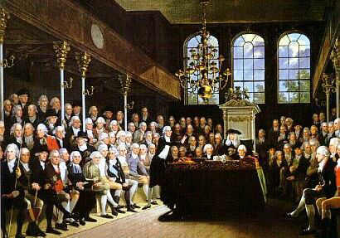
British Influence
Since most colonists in the colonies were from England, they used English government principles
English Principles:
Protected Rights
Representative government

Slide 3
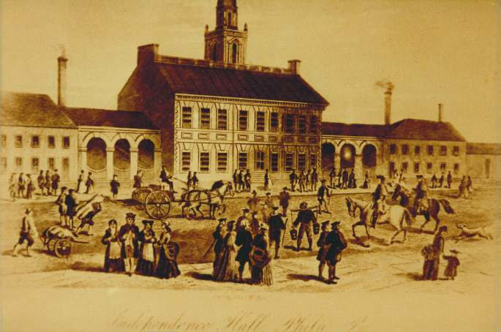
Government in Colonies
Only white, landowning men could vote
Status in society depended on property ownership
Only part of society represented in government
Examples:
Direct Democracy :(Pure Democracy)People directly involved in government
Representative Democracy (government):Virginia House of Burgesses: elected representatives to make laws (first in colonies)

Slide 4
Discussion
How are direct democracy and the House of Burgesses different?
What problems may arise from allowing only white, landowning men to vote?
How do these colonies make sure that their governments do not change constantly?

Slide 5
Examples of Government in Colonies
Virginia Charter (1606): Representative Government; allows colonists to possess same rights as those in England
Mayflower Compact (1620): Majority rule (democracy)
Charter of Massachusetts Bay Colony (1629): Established a form of representative government and equal protection under the law

Slide 6
“…every Persons which shall dwell... Within every and any of the said colonies… shall HAVE and enjoy all Liberties…as if they had been abiding and born, within this our Realm of England…”
from The First Charter of Virginia, 1606
“…And the magistrates shall make laws and ordinances for the good and welfare of the said Company, and for… ordering of the said lands and plantation…
Excerpt from The Charter of the Massachusetts Bay, 1629

Slide 7
Examples of Government in Colonies
Fundamental Orders of Connecticut (1639): First Constitution in colonies, set up a representative government
“there shall be yearly two General Assemblies or Courts…the first shall be called the Court of Election, wherein shall be yearly chosen from time to time, so many Magistrates and other public Officers as shall be found requisite: Whereof one to be chosen Governor for the year ensuing and until another be chosen…”
from The Fundamental Orders of Connecticut, 1639

Slide 8
Reflection
How might these colonial governments impact the eventual American government?

