Slide 1
Colonial Economy

Slide 2
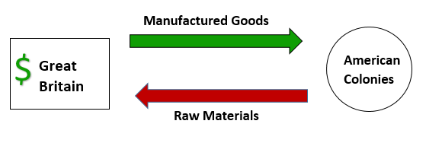
Economy
Economy: what goods and services are provided by the nation/region
Most of the colonies rely on agriculture (farming)
Climate determines much of what colonists do
Colonists adjust their activity to their climate and geography
Colonial Economy originally to supply British with materials and money
Mercantilism: economy where a country takes resources from colonies to benefit themselves

Slide 3
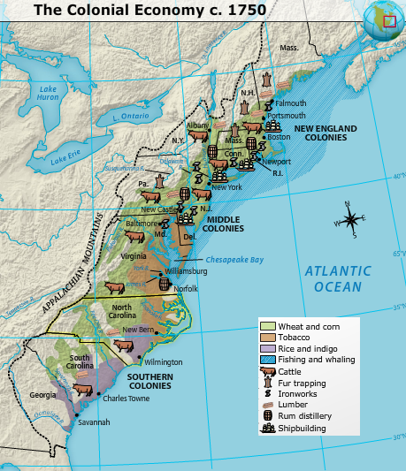

Slide 4
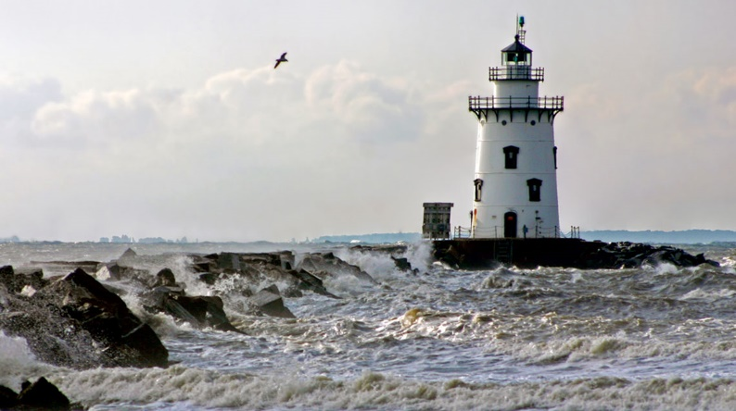
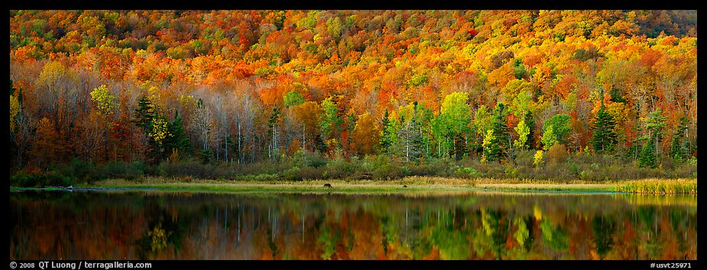
New England
Climate: Long winters, rocky soil
Large scale farming impossible (cash crops)
Farming enough to meet family needs
Economic Activities
Fur trapping
Timber rich forests leads to shipbuilding
Fishing and Whaling
Trading (Harbors and ports)

Slide 5
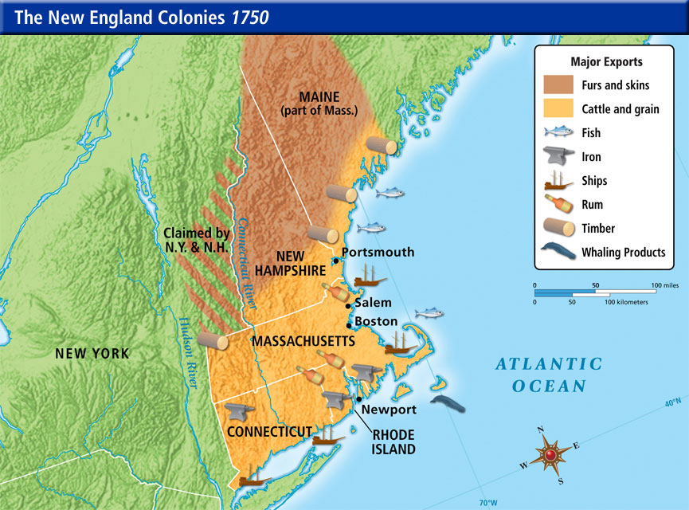
New England

Slide 6
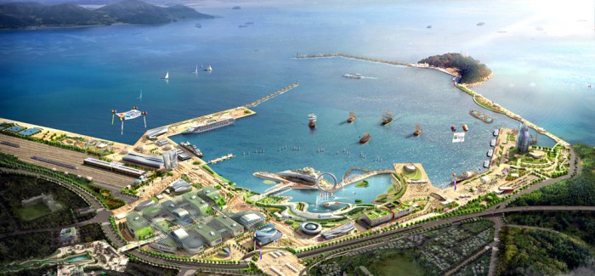
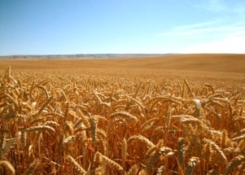
Middle Colonies
Climate: mild with fertile soil
Economic Activities
Farming “Bread Basket” (grain)
Trading (Ports like New York City and Philadelphia allow money to be made by trading)

Slide 7
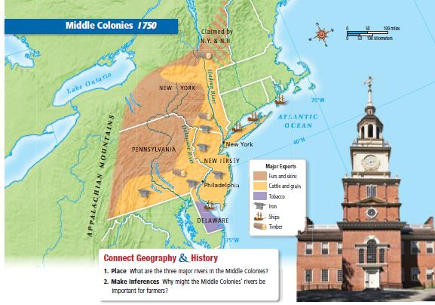
Middle Colonies

Slide 8
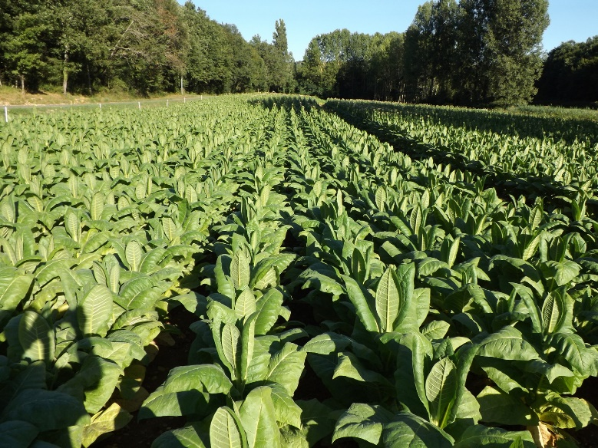
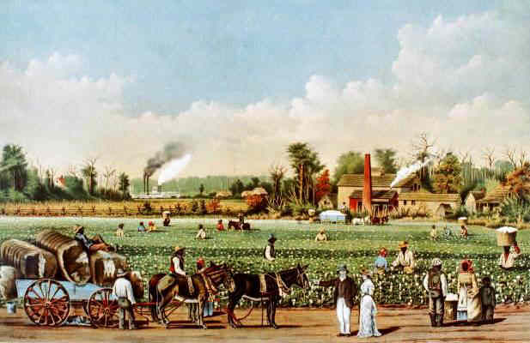
Southern Colonies
Climate: warm with rich soil
Makes great conditions for large scale farming
Economic Activities
Cash Crops (Tobacco, Indigo, Rice)
Plantations (very large farms) are common
Leads to expansion of Slavery
Very little trade or industry developed here

Slide 9
Southern Colonies

Slide 10
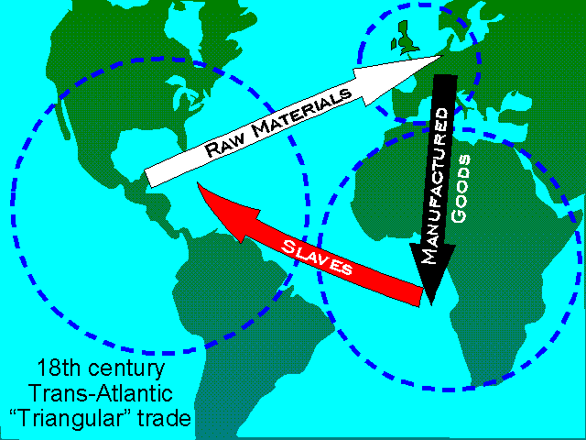
Trade
Triangular trade: trade routes between three destinations West Africa, Europe and the Americas

Slide 11
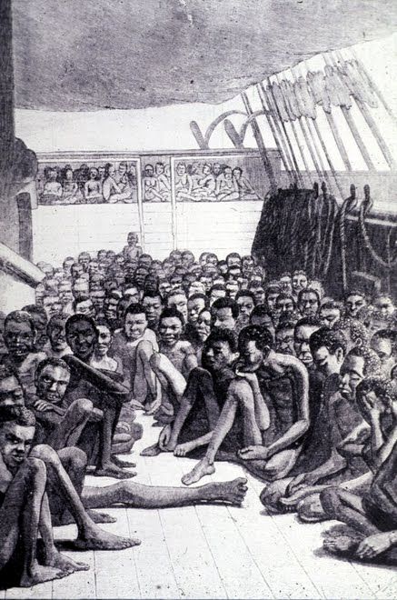
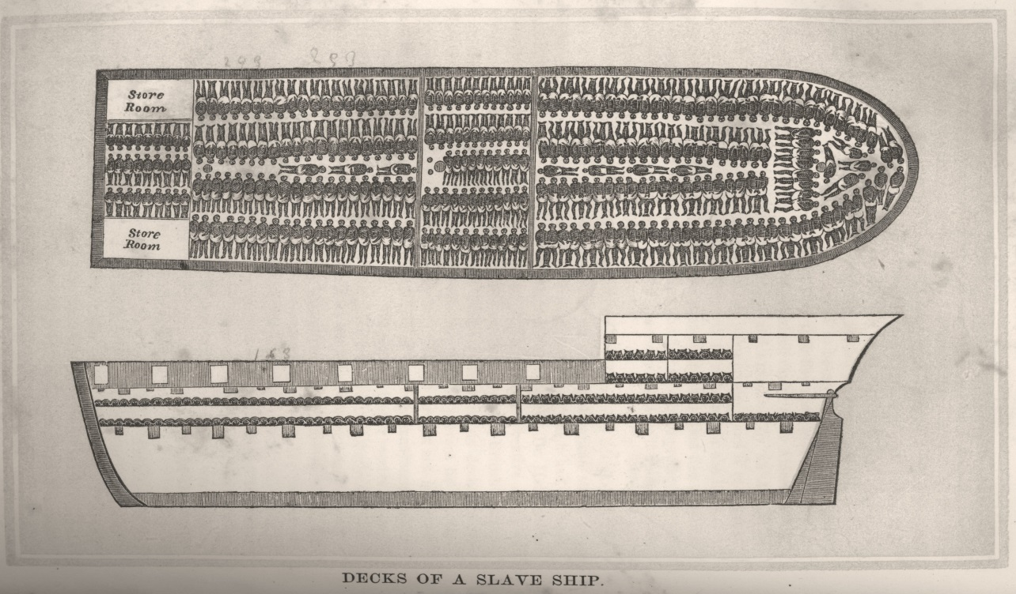
Middle Passage
Passage of slaves from Africa to the Americas
Very terrible conditions-lasted over a month
Chained together
Little food or water
Unsanitary

Slide 12
Reflection
How might the differences in regional economies impact their growth in relation to each other?

