Slide 1
Daily Quiz- 9/12
French and Indian War ends
?
Stamp Act
1. Which event completes the sequence?
A Colonists refuse to move beyond Appalachian Mountains.
B British grant monopoly on tea to British East India Company.
C Colonists and British soldiers clash on Boston Common.
D British impose taxes on colonies to cover costs of the war.
2. What policy is illustrated in the diagram?
A. monopoly
B. Indentured
C. mercantilism
D. Salutary neglect
Mother Country
provides security and manufactured goods
Colonies
provide raw materials and a consumer market

Slide 2
Breaking Point

Slide 3
Review
Proclamation of 1763: Upset colonists, told they could not move west
Sugar Act: tax on imported sugar products
Stamp Act: direct tax on colonists on all printed paper items
Sons of Liberty rise up; protest taxes and boycott goods that are taxed
“No taxation without Representation”
Quartering Act: forced colonists to house British soldiers
Causes Britain to repeal Sugar and Stamp Acts but…
Declaratory Act: Britain declares that they can do whatever they want to colonies

Slide 4
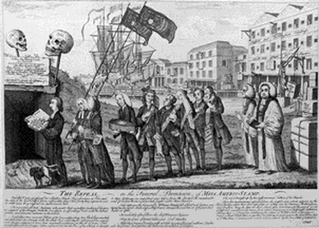
Britain Declares a new tax
Townshend Acts: tax on major imported goods (glass, paint, tea, lead)
Sons of Liberty set up boycotts on these items (and others smuggle items into colonies)
Protests continue and some get pretty violent
Britain sends more soldiers to keep the peace in colonies

Slide 5
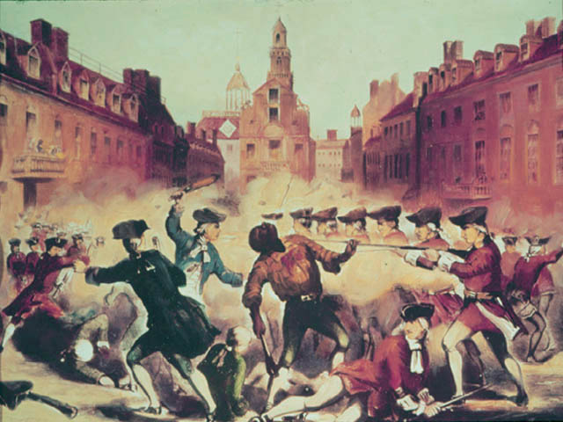
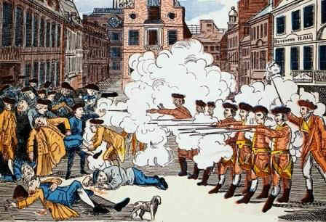
Boston Massacre
Colonists in Boston were particularly upset with taxes (Townshend acts hurt traders most of all, many traders in Boston)
Colonists gathered to protest and were met by British soldiers
Tensions rise and the British soldiers fire upon the unarmed protestors
Soldiers are brought to trial and John Adams helps defend them
Found that soldiers acted in self defense

Slide 6
Discussion
Why would Britain repeal and then add another tax to the colonies?
How could the Boston Massacre cause the colonists to feel about the British?
What choices do the colonists have at this point? How can they solve their issues with the British?

Slide 7
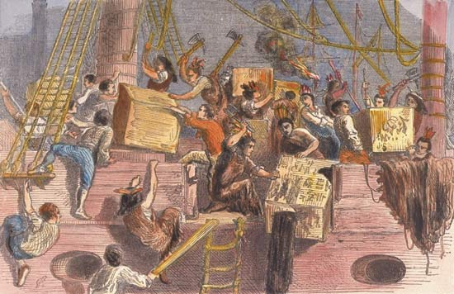
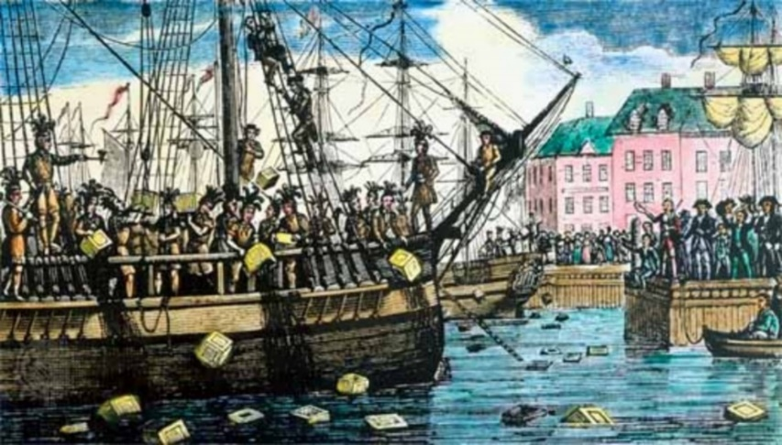
Boston Tea Party
Townshend Acts are repealed due to protests and boycotts EXCEPT the tax on tea
Sons of Liberty founder Samuel Adams uses committees of correspondence (secret communications used to set up protests)
They organize the Boston Tea Party protest
Upset by monopoly on tea by British East India Company
Sons of Liberty board ships in the Boston Harbor and dump over 300 crates of tea into the water
Britain believes at this point they must respond in a harsh way

Slide 8
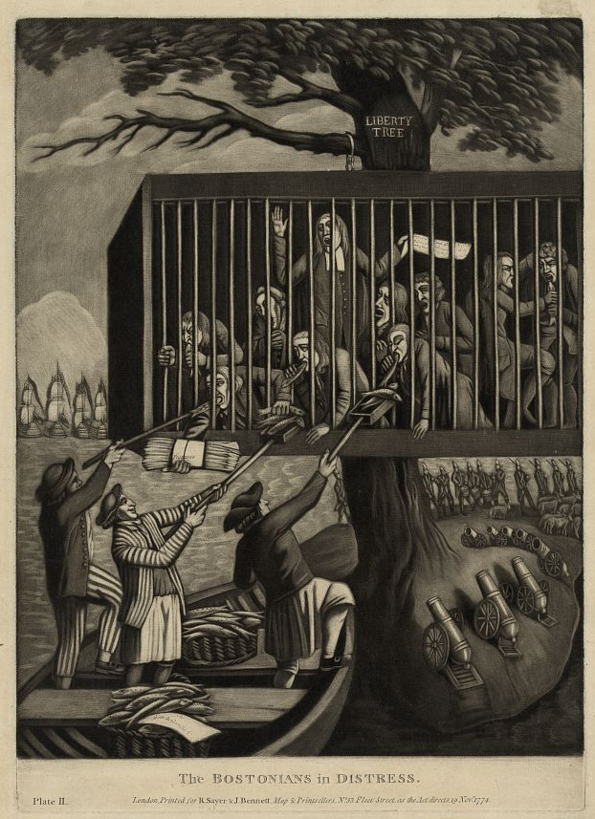
Intolerable Acts
In response, Britain imposes new rules, especially for Boston
Intolerable Acts: Punishment for Colonists due to Boston Tea Party
Closed the port of Boston (no trading at all)
Outlawed their local government
Instituted martial law (British Soldiers everywhere in Boston)
Colonists viewed this as intolerable-attacked their rights and freedom

Slide 9
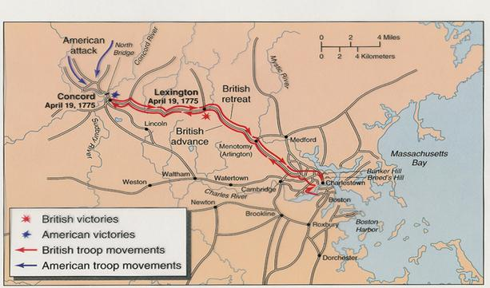
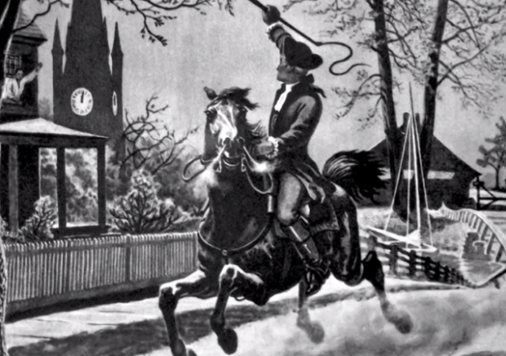
Lexington and Concord
Lexington and Concord were two small towns outside Boston
They were bases for Sons of Liberty activity and storage of weapons
When the British discover this, they head to capture the leaders of the Sons of Liberty and the weapons
Paul Revere makes his midnight ride to warn the Sons of Liberty members there

Slide 10
Reflection
Do you believe the Sons of Liberty’s actions were justified? Why or why not?

