Slide 1
Battle for America

Slide 2
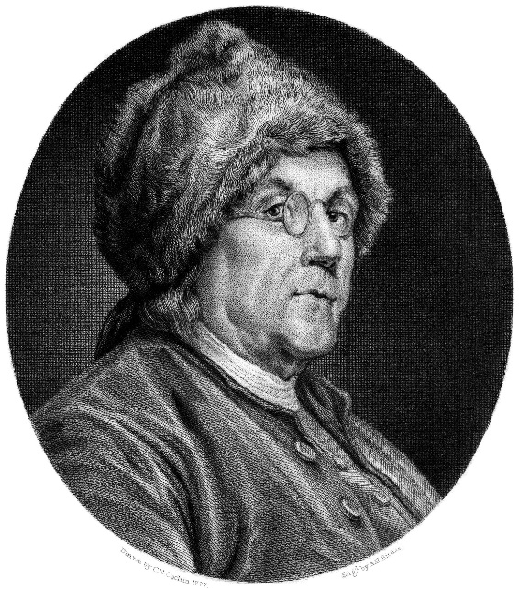
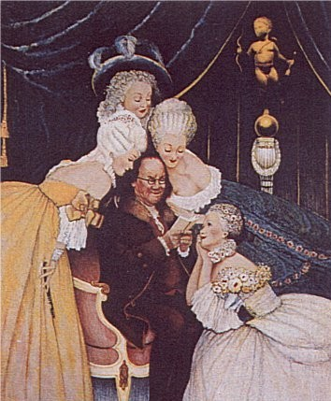
Need for Allies
America stood little chance of defeating Britain outright
Focus was on outlasting Britain
Ben Franklin was busy in Europe recruiting support
Saratoga caused the French to join into an alliance with America
Thought maybe the Americans could win

Slide 3
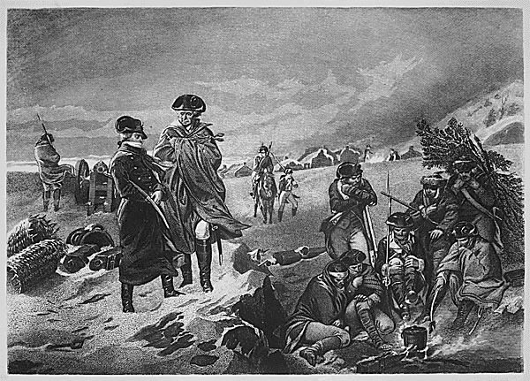
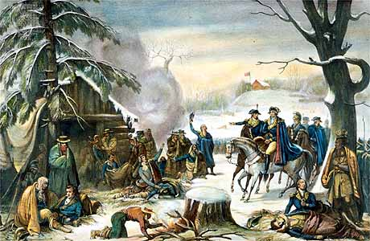
Valley Forge
Washington and his men were camped for the winter at Valley Forge, Pennsylvania
Conditions for soldiers were very poor
Cold winter- little winter clothing
Little food and supplies
Many die or suffer
Many soldiers began to wonder was it all worth it

Slide 4
Account from Valley Forge
I am Sick - discontented - and out of humour. Poor food - hard lodging - Cold Weather - fatigue - Nasty Cloaths - nasty Cookery - Vomit half my time - smoak'd out my senses - the Devil's in't - I can't Endure it - Why are we sent here to starve and Freeze - What sweet Felicities have I left at home; A charming Wife - pretty Children - Good Beds - good food - good Cookery - all agreeable - all harmonious. Here all Confusion - smoke and Cold - hunger and filthiness - A pox on my bad luck. There comes a bowl of beef soup - full of burnt leaves and dirt, sickish enough to make a hog spue - away with it Boys
How would conditions like these impact morale of soldiers?
Why would soldiers endure such conditions?
What benefit may come from having the army in one place for so long?

Slide 5
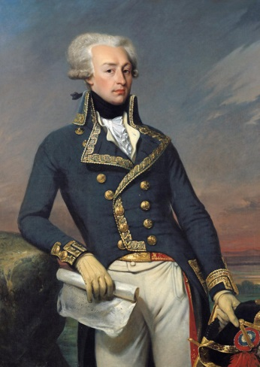
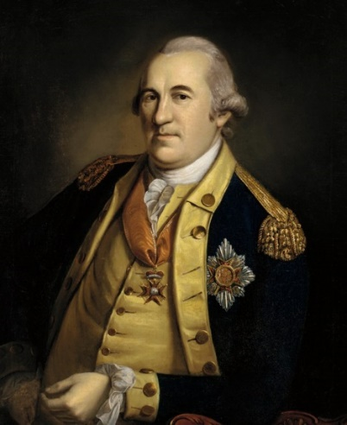
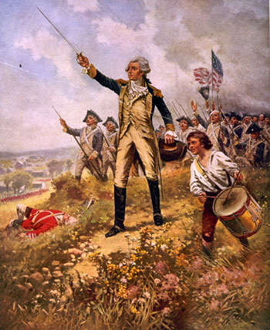
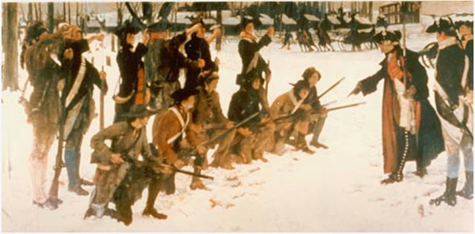
Assistance from Abroad
Europeans came to help Washington at Valley Forge
Marquis de Lafayette- Frenchman who believed in the American cause, aided Washington
Friedrich von Steuben- German soldier who helped train Washington’s soldiers

Slide 6
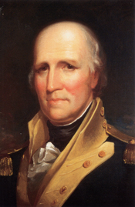
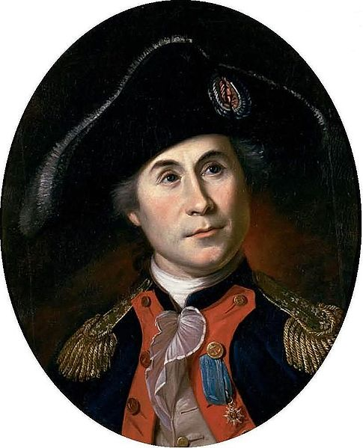
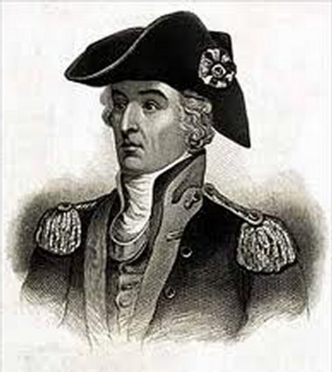
Fighting the War
Washington was not the only leader fighting the British
West of the Appalachian Mountains
George Rogers Clark- led an expedition west against Britain and weakened British control in the west
At sea
John Paul Jones took the fight to Britain by breaking the British blockade and attacking ships off the coast of Britain.
Guerilla Warfare
Francis Marion (the Swamp Fox) ambushed British patrols in the South and then disappeared into the swamps

Slide 7
Reflection
What role did Valley Forge play in the American Revolution? Discuss both the bad and the good.

