Slide 1
The Bank War

Slide 2
History of the Bank
Hamilton started the bank in 1791
Rule: Must be reapproved every 20 years
Next time it came up for approval in 1811-President Madison (strict interpretation) allowed the Bank to expire
However, after the War of 1812, Madison realized a Bank was needed in case of war
Madison approved the Second Bank of the US in 1816

Slide 3
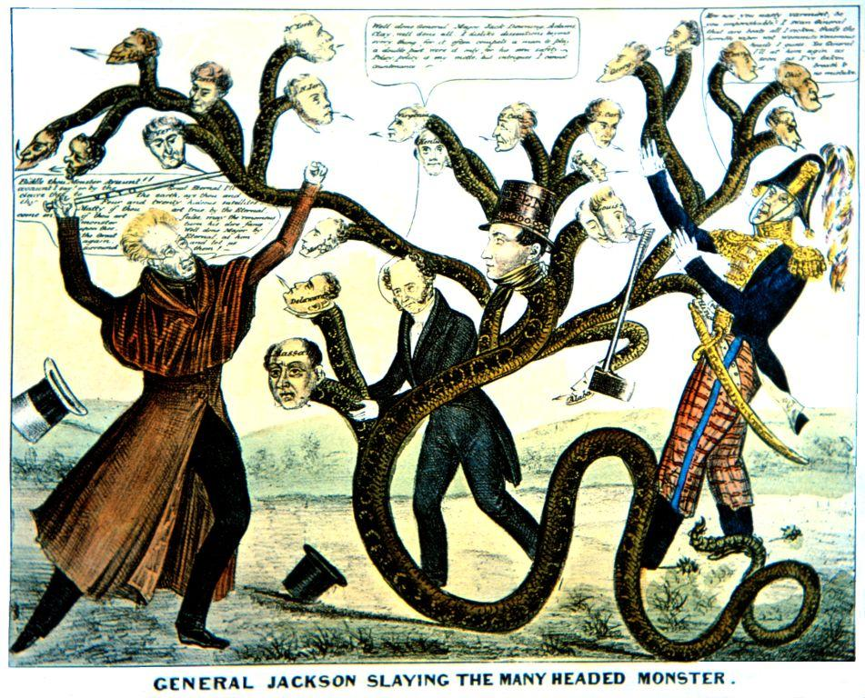
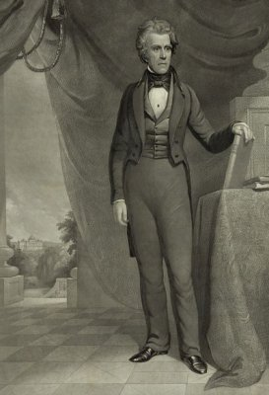
Jackson and The Bank
Jackson distrusted the National Bank
Believed it benefited the rich, not the common man
Bank is brought up for renewal and Jackson has decision to make
Jackson vetoes the Bank renewal

Slide 4
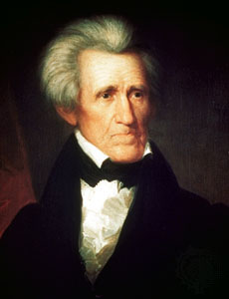
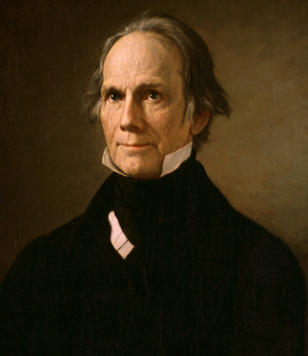
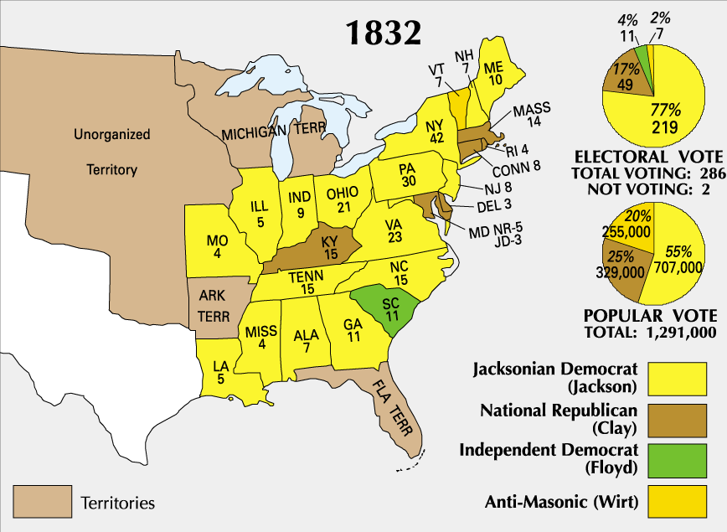
Election of 1832
Jackson runs for reelection against Henry Clay
Clay thinks Jackson’s veto will cost him election
Jackson wins in landslide
Result: Jackson thinks he has permission to do what he wants
People support him and his beliefs
Jackson removes all money from the National Bank
Gives it to small state banks

Slide 5
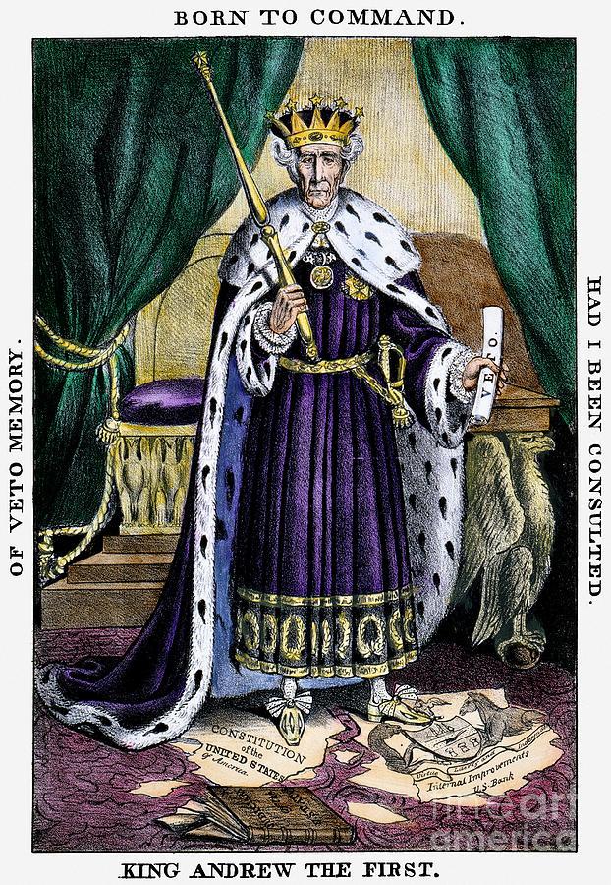
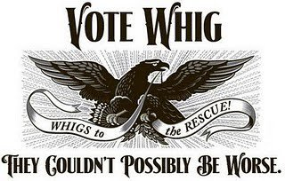
Whigs
Opponents of “King Andrew” organized into their own political party
Whig Party: political party formed to oppose “King” Andrew Jackson and his policies
Lead by Henry Clay and Daniel Webster
Beliefs:
Power should be in Congress, not with President
American System

Slide 6
Discussion
Why did Jackson not like the Bank?
How did Henry Clay’s plan backfire?
What problems may arise from Jackson’s veto of the Bank and removing its money?

Slide 7
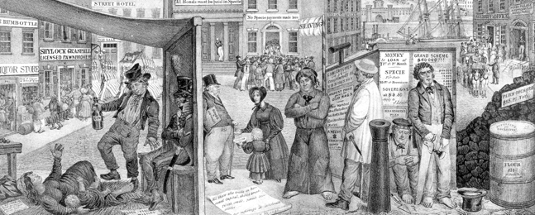
Panic of 1837
Jackson ending the Bank had some negative impacts
Small state banks gave money to anyone who wanted it
Most could not pay back
Result: Economic Depression and high unemployment for poor

Slide 8
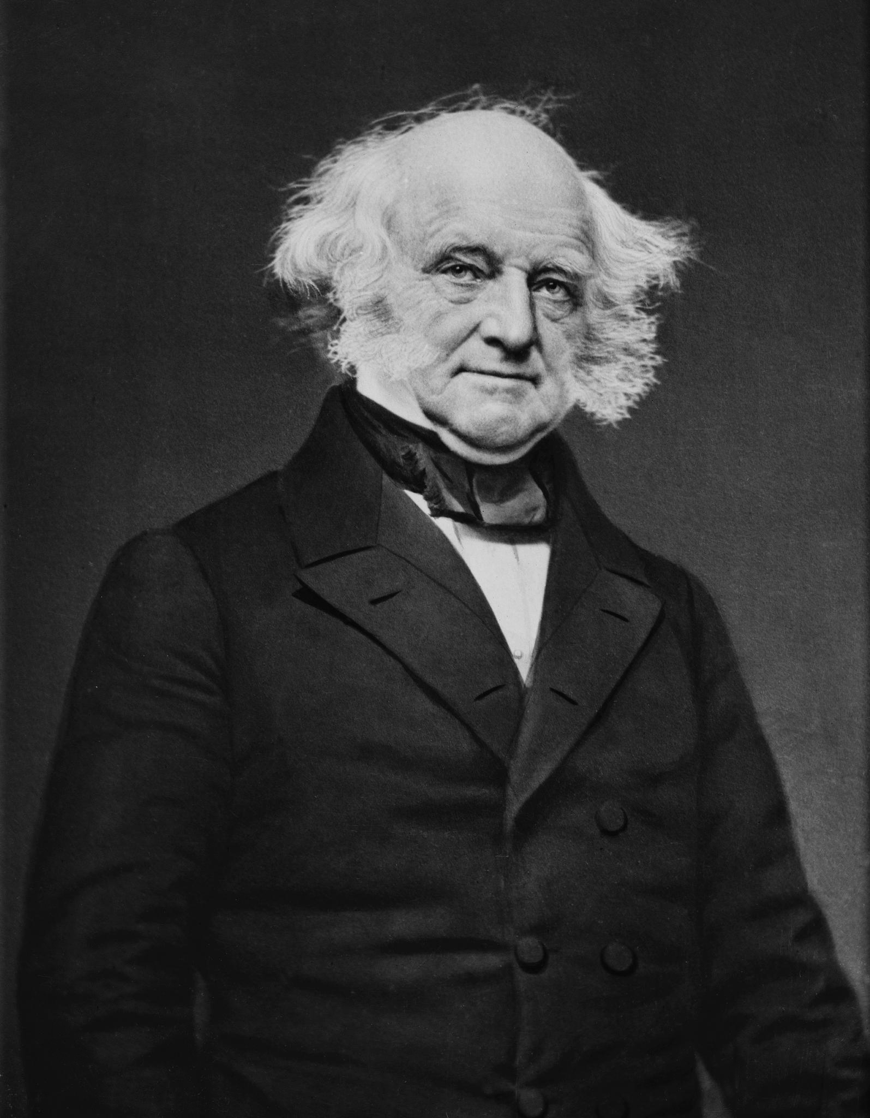
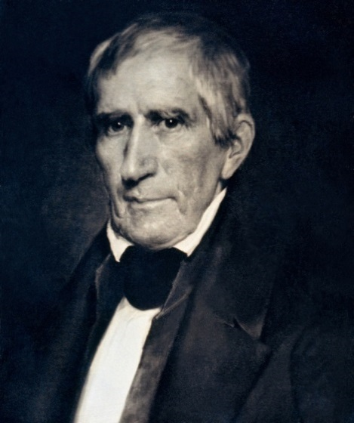
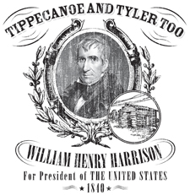
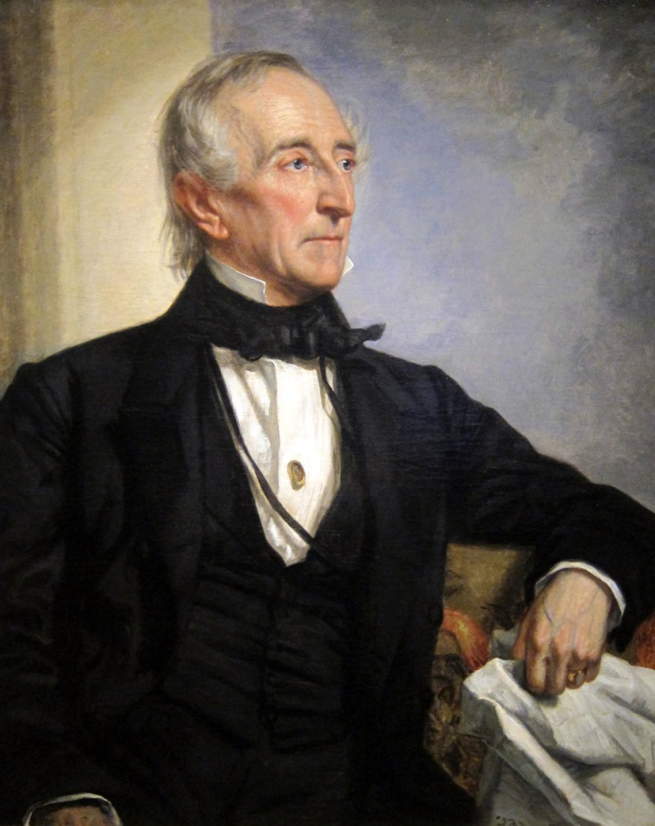
After Jackson
Martin Van Buren: Jackson’s hand picked successor
Got blamed for Panic of 1837
Allows Whigs to take over
William Henry Harrison: War Hero and Whig (Tippecanoe and Tyler too!)
Dies one month in office
John Tyler: Harrison’s Vice President
Not a Whig or Democrat and hated by all
Vetoed many Whig polices and damaged the Whig party

Slide 9
Reflection
Should Jackson be considered a good President? Why?

