Slide 1
Abolition Movement

Slide 2
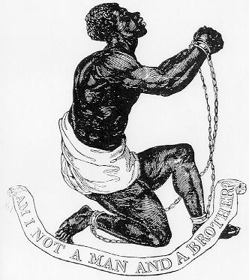
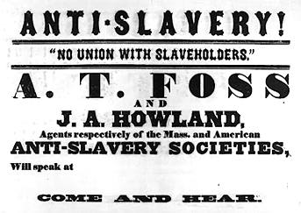
Abolitionists
The Abolition Movement sought to end the practice of slavery
Many Americans believed that slavery would gradually end on its own
As it continued to grow, the abolition movement began
Believed it was morally wrong

Slide 3
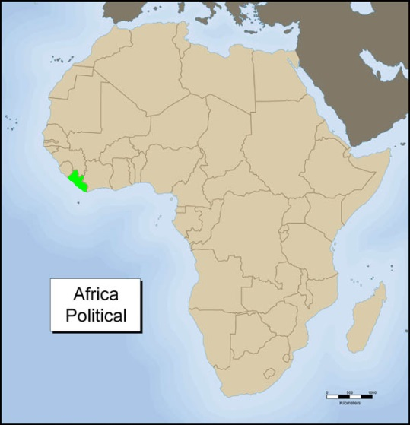
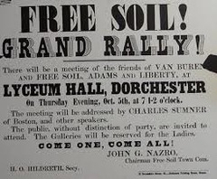
Abolition Actions
Not all abolitionists believed African Americans were equal to whites
Colonization Plan
Many Northerners feared what may happen by freeing millions of uneducated slaves. Plan: send them to a colony in Africa.
Send African Americans back to Africa to the American colony of Liberia (only 10,000 go)
Politically, abolitionists tried to get change
Free Soil Party: political party whose entire purpose
was to end slavery; only existed in North

Slide 4
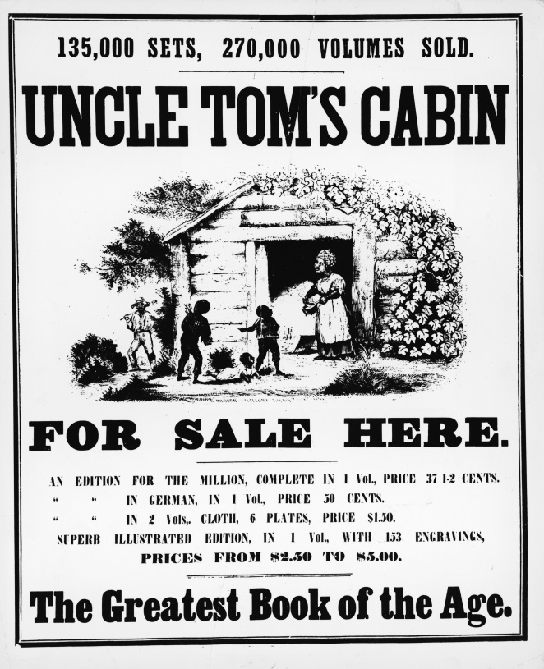
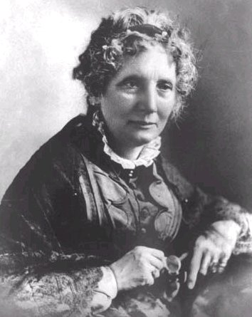
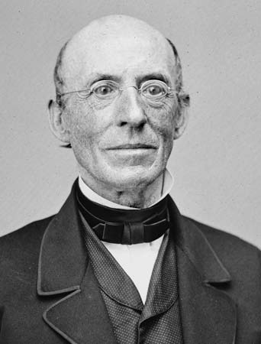
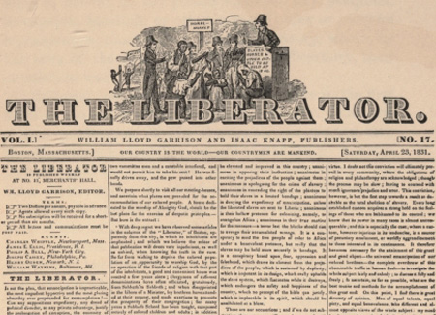
Abolition Actions
William Lloyd Garrison created an anti-slavery newspaper called The Liberator
One of the first white abolitionists to call for an immediate end of slavery
Harriet Beecher Stowe published the novel Uncle Tom’s Cabin
Best seller in the North
Portrayed slavery as cruel and brutal
Many Northerners first experience with Slavery
Impact: tensions between North and South

Slide 5
Discuss
Why is it important to have a “movement” behind a belief?
How can writers like Garrison and Stowe have a major impact on changing society?
How might former slaves speaking out against slavery be more effective than non-slaves?

Slide 6
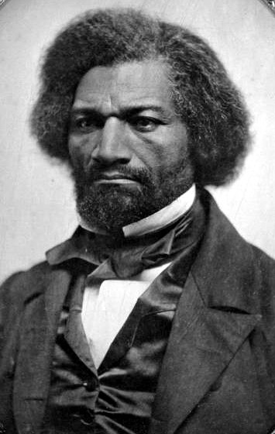
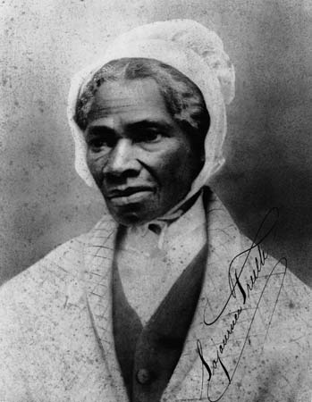
Freed Slaves Actions
Many freed slaves refused to give up the fight against slavery even after they escaped it
Fredrick Douglass was a runaway slave who was a very powerful speaker against slavery
Being a former slave, he spoke from experience and pushed for equality
Sojourner Truth was another freed slave who spoke of its evils
Also leader on women’s rights

Slide 7
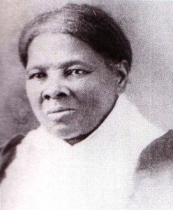
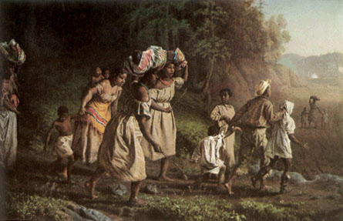
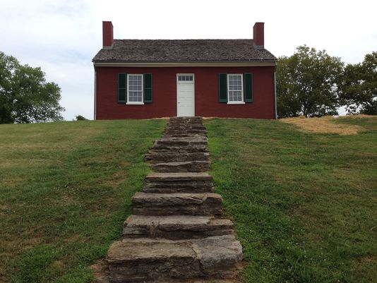
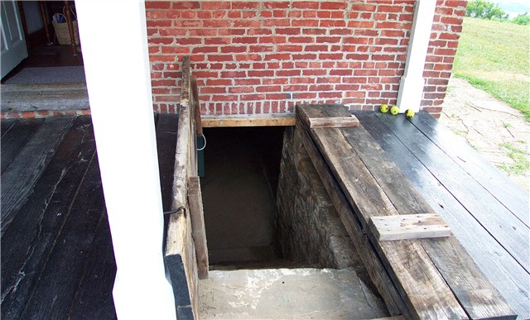
Underground Railroad
Not a railroad and not underground
A system of escape routes from the South to the North to help runaway slaves reach freedom (out of the country)
Slaves would travel with “conductors,” who were abolitionists, to freedom
Travel at night using the north star to guide them
During the day they would hide in barns or basements of sympathetic people along the way
Harriet Tubman, a freed slave, was most famous conductor

Slide 8
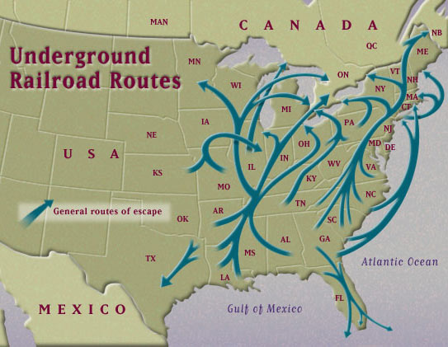
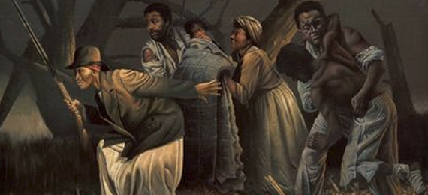

Slide 9
Reflection
Why did slaves feel the need to change their situation? What tactics did abolitionists use to get change?

